Slide 1
Academic Parent-Teacher Teams
^{(APTT)}
Parent-Teacher Collaboration To Drive Student Achievement
September 10, 2014 - Georgia Parent Mentor Conference

Slide 2
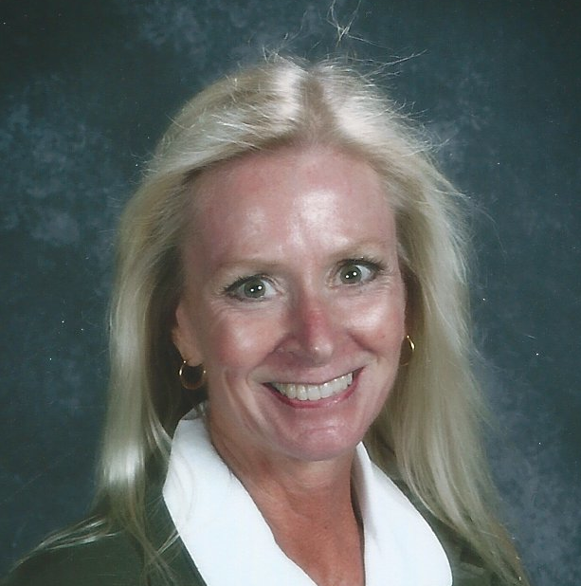
Introductions
Linda Bushor
lbushor@wested.org
480.236.5148
Maria Paredes
mparede@wested.org
480.823.9425

Slide 3
Review Agenda
Notes:
Have copies on teacher tables

Slide 4
Our Purpose and Objectives
Purpose:
Objectives:
Provide Parent Mentors with information and strategies to assist teachers and parents in building family capacity as it ties to academics.
Gain greater knowledge about family engagement
Walk away with a better understanding of the APTT Model
Understand the areas that parent mentors can assist
Notes:
nametags

Slide 5
Why improve our Family Engagement school practices?
Current research supports:
Intentional and strategic
Linked to learning
Systematic and sustained
Developmental
Relational and collaborative
Karen L. Mapp et al, (2013) Partners in Education A Dual Capacity-Building Framework for Family-School Partnerships
(A publication of SEDL in collaboration with the USDE)
Notes:
Allow teachers to discuss each bullet in teams and share with the whole group.

Slide 6
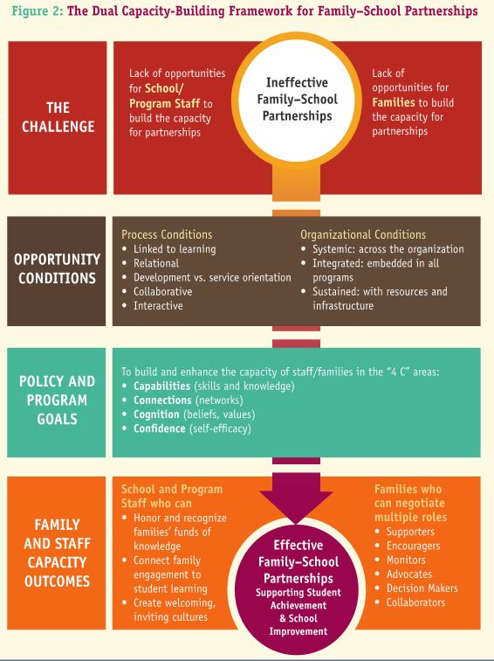

Slide 7
Family Engagement Matters for Students & Schools
Family Engagement Research & Background
% of schools substantially improving in reading
5 “essential supports” predicted dramatic school improvement
Combined, supports had greater impact
Weakness over time in any area undermined improvement
Bryk, A.Sebring, P., Allensworth, A., Luppescu, S., & Easton, J. (2010). Organizing Schools for Improvement: Lessons from Chicago. Chicago:
University of Chicago Press.
Notes:
9:45

Slide 8
It’s a Matter of Time
Based on 6 hours of instruction, 180 days per year, and 8 hours of sleep time.
(School = 1,080 Hours) (Sleep = 2,920 Hours) ( Away from school = 4,760 Hours) (Total Hours in a Year = 8,760)

Slide 9
Reactions?
With your elbow partner, discuss your reactions to the graph.
Notes:
Have audience discuss as partners then share out (Popcorn) whole group.

Slide 10
Activity
What do you do in your school to engage families?
How are you defining family engagement in your school?
Notes:
Have participants work in groups and using chart paper write what they do to engage families.
*Travis is sending charts and markers

Slide 11
Activity: Part 2
Go back to the list you created and put a a star next to everything you invite parents to participate in that has to do with learning.
star
Notes:
Have teams work on this for about 5 minutes. Share out reflections whole group.
Review the list again and circle everything you invite parents to that is focused on Foundational Grade Level Skills

Slide 12
Activity: Part 3
Review the list again and circle everything you invite parents to participate in that is focused on grade-level learning goals.
circle

Slide 13
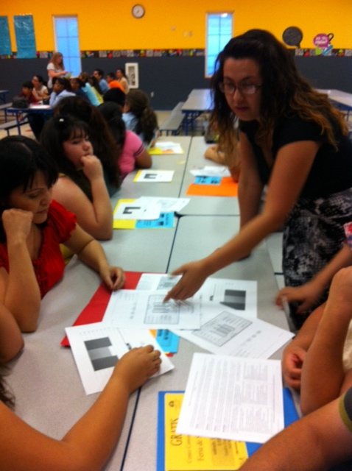
Definition
Family engagement is parent-teacher collaboration to drive student learning and achievement.

Slide 14
School-Based Family Engagement
Parent Involvement
Family Engagement
What a school does to bring parents onto a school campus.
Conferences
Festivals/celebrations
PTA/PTO/PTSA
Workshops
Volunteer opportunities
What parents do to apply what they learn in order to support student learning at home and in the community.

Slide 15
Our Perspective on Relative Impact of Family Engagement Strategies on Student Learning
Lower impact
Higher impact
Celebrations
Parent help on administrative tasks
Parent training events
Goal-setting talks
Weekly data-sharing folders
Parent resource rooms
Regular, personalized communication
Fundraisers
Back to school night
Home visits
Family support services
Parent-teacher conferences
Positive phone calls home
Modeling of learning support strategies
Potlucks
Performances and showcases
Generic school newsletters
Interactive homework
Classroom observations
Parent help on learning projects
Flamboyan Foundation defines family engagement as collaboration between families and educators that accelerates student learning.
Notes:
What do you notice about the activities on the higher impact side of the chart? What do they have in common?
(Prompt if they don’t say: 1) teacher-led; 2) learning-focused; 3) individualized; 4) they either build relationships or support academic partnering; 5) most of them don’t require the family to come to the school
The family engagement activities that schools often engage in are school-wide, not learning-focused, and require families to come to the school. “Numbers of participants” is what gets recognized – rather than the increase in a parent’s ability to play the five roles. If families are being asked repeatedly to come to school but are not getting anything that will help them with what they most care about – educating their individual child, then schools often see the undesired effect of families choosing NOT to attend school events because they feel like their time is wasted.
“High impact” family engagement activities may or may not bring families to your buildings, because many of the highest impact family engagement happens at home. When families do need to come to the school, proactively encourage their continued participation by only inviting them to high quality/high impact offerings.

Slide 16
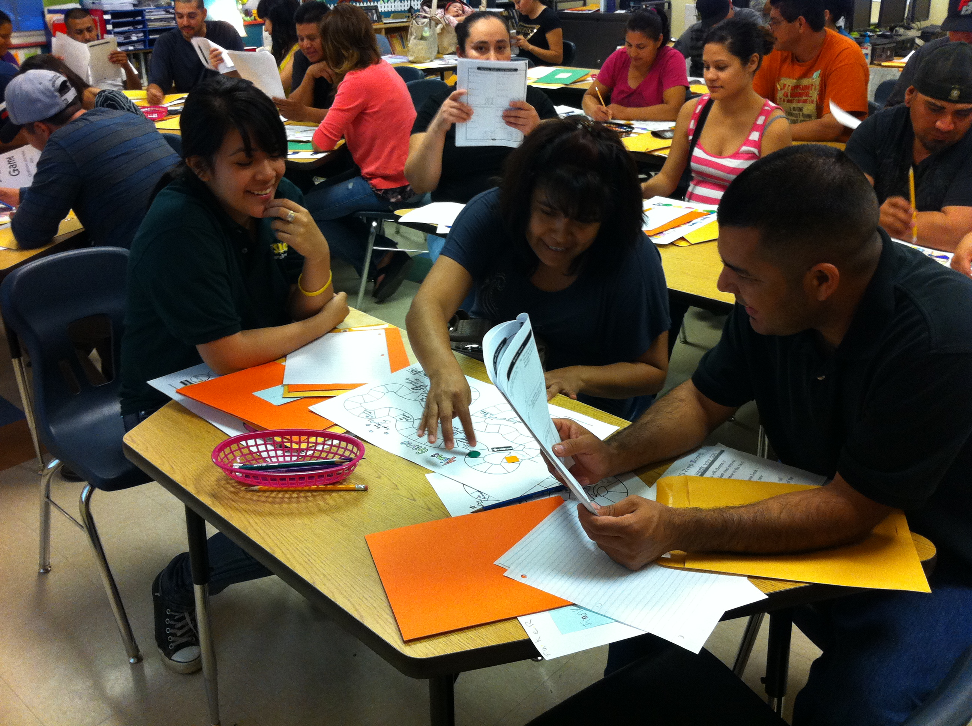
Making The Shift From Parent-Teacher Conferences to Academic Parent-Teacher Teams (APTT)
Notes:
Lets take a look at the most traditional practice
What are the pros and cons

Slide 17
How do we make the shift?
Prioritize family engagement efforts
Adopt The Academic Parent-Teacher Teams (APTT) Model
Utilize the expertise of Parent Mentors
Welcome expert assistance from WestEd
Provide supported planning time
Create a strong and effective family outreach plan
Do it together and build capacity over time

Slide 18
Academic Parent-Teacher Teams© (APTT)
What are APTT’s?
It is a classroom-based, teacher-led, data-driven family engagement model.
It repurposes traditional parent-teacher conferences.
Objectives:
Professionalize school-based family engagement.
Provide families with information, skills, and confidence to support student learning at home.
Build the capacity of educators and families to work collaboratively to drive student achievement.
Create a culture of mutual support and shared responsibility.

Slide 19
The APTT Model
Team Meeting
(75-min.)
Held In Early Fall
Individual Session
(30-min.)
Held In Oct-Nov.
Team Meeting
(75-min.)
Held In Winter
Team Meeting
(75-min.)
Held In Spring
Notes:
Page 8 of the manual

Slide 20
APTT Components and Essential Elements
Three Team Meetings
(75 min)
One Individual Sessions
(30 min)
Welcome and Icebreaker
Introduce Foundational Grade Level Skills (FGLS)
Sharing Data
Model practice activities
Facilitate family practice of activities and take home practice materials
Facilitate setting 60-day S.M.A.R.T. goals
Build strong collaborative relationships
Update family on student academic progress
Collaborate on student academic support
*All parents from the class come together
*The teacher, the student, and the students’ family

Slide 21
Review Foundational Grade Level Skills
Essential Element #2
What are Foundational Grade Level Skills?
Key grade level concepts that work as learning building blocks
Grade level concepts students must master in order to successfully move on to the next grade level
Notes:
Foundational Skills: Pg. 35 – 37
Have participants open class data graph. Walk participant through it and let them practice on their own.
3-5 foundational grade level skills per grade level for the school year.
*For team meeting #1, grade level teams select only one FGLS
*How do teams select grade level skills (P. 35-37)?
*What two activities are you going to use with families to reinforce the FGLS?
*What materials will be needed for the activities?
*What data does your school have in place to assess the FGLS?
Show audience the following websites:
www.ixl.com
www.parenttoolkit.com

Slide 22
Essential Element #3
Sharing Data
3rd Grade Reading Fluency Classroom Data
Notes:
TELL PARENTS WHY WE DO WHAT WE DO: It is really important to understand what your child knows and is able to do based on grade level achievement expectations. Data help us pace the amount of practice support the student needs, and it shows us how fast they are growing in that particular skill.
Also, tell parents that you will continue to support students on this skill in class and that parents need to continue their efforts at home. Remind parents that the top line is an end of the year goal and that those who have not reached it still have time and with continued support will make it.
What do you know from looking at this data?
What concerns you about the data?
What will you have to do to make the data clear to parents?

Slide 23
Model and Practice Activities
Modeling
Practice
Build capacity
Build confidence
Establish high expectations
Others reasons?
Deepens the understanding of the concept
Families are more comfortable and familiar with the materials
Learning activities they can do at home may be a first for many parents
Build classroom community
It’s fun!

Slide 24
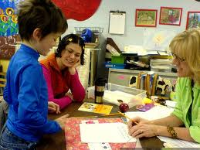
APTT Individual Meeting Process
Build strong collaborative relationships
Update family on student academic progress
Collaborate on student academic support

Slide 25
How Can Parent Mentors Support Teachers?
Family Outreach Plan
Making phone calls
Flyers
Home visits
Leave no stone unturned
Reproduce materials tailored to students needs
Take part in the APTT Meetings
Hold make-up sessions

Slide 26
How Can Parent Mentors Support Families?
Aggressive Outreach Plan
Build Family Capacity
Phone calls home
Home visits
Arrange transportation
Flyers
Think outside the box
Understand and value the APTT Model
Know how to help families during APTT Meetings
Check for understanding
APTT Meetings
Calls and Home Visits
Communicate with classroom teacher
Provide additional materials

Slide 27
Stanton APTT Video

Slide 28
How Does APTT Look In Each Setting
Regular Ed
Self-Contained
Meeting Format
Welcome and Icebreaker
FGLS
Sharing Data
Modeling Practice Activities
Facilitation of Family Practice
Setting S.M.R.T. Goals
Meeting Format
Same
Individualized
Sharing Data differently
Individualized Data Charts
Modeling Multiple Activities
Teacher, Parent Mentor, Aides
Teacher models “How To” set a S.M.A.R.T. Goal – Teacher, Parent Mentor help parents setting appropriate S.M.A.R.T Goal

Slide 29
Share your questions and comments with us.

