Slide 1
Welcome Class of 2014
Casting your Net
Aug. 20-21 2014

Slide 2
Together, We Can
In this session we will:
Peek at a few key sections of the Georgia Parent Mentor Partnership website
Discuss the ways parent mentors can introduce themselves in their districts
Review and submit the photo releases and Find A Mentor Page information

Slide 3
Job requirements
Parent Mentors are required to create a Plan of Work for the current school year which will be updated on a quarterly basis.
Parent Mentors are required to report Contact Tracking every quarter.
Parent Mentors are required to attend Regional Meetings and the Annual Kickoff conference.
Parent Mentors must file an Accountability Report at the end of the year and create a new Work Plan for the next year.

Slide 4
First Stop: Website
www.parentmentors.org
General information about the Parent Mentors and disability related information
Learning Curve -- Information just for parent mentors
User name: partnership
Password : mentor

Slide 5
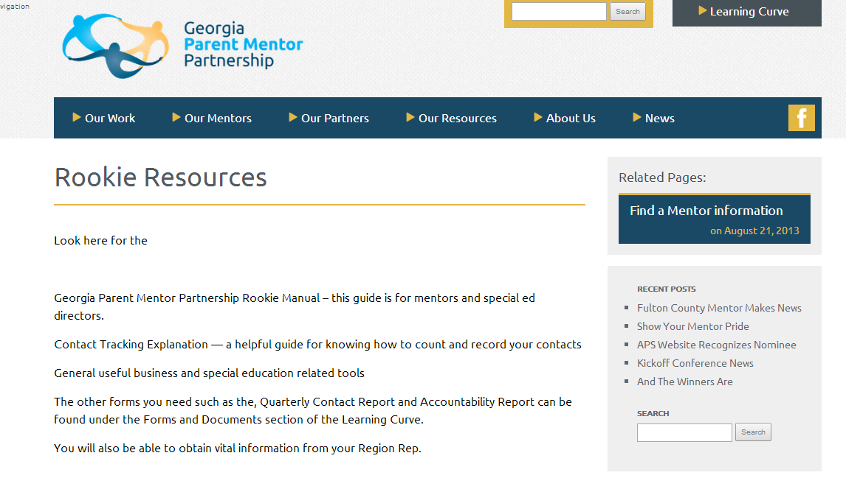
Resources just for You

Slide 6
Access to Answers
Join the GaPMP listserve, our primary means of communication between the mentors. Send an email aladd@doe.k12.ga.us and ask that you be added to our listserve, parentmentors_georgia@yahoogroups.com.
The listserve is a professional communication tool. Parent to Parent of Georgia (GaP2P) leadership are also on our listserve to share information. We collaborate with GaP2P, our state’s Parent Information Training Center (PTI), funded by the US Department of Education under IDEA.

Slide 7
Learning Curve: Accountability
This is where you will find the contact tracking form links, Annual Report document and other important information for filling out the Accountability/Plan

Slide 8
Avoiding the Oops
ALWAYS re-read texts, facebook posts, emails and other correspondence as though the family involved or your director are looking at it. Make sure you spell check and read for continuity and clarity. It’s hard to take it back once it goes out there. Don’t share confidential information!!!
Unlike volunteers, Parent Mentors are trained professionals working with families in your district . Confidentiality and trust are key.
You will also need to earn the trust of staff

Slide 9
Job One: Family Engagement
This is where you can find some helpful tools to use for trainings with teachers, parents and community .

Slide 10
In General: Calendar Page
This is where you can find information about important trainings and events that parent mentors are presenting or attending

Slide 11
In General: Resources to Share
Find resources for trainings and events for parents, school staff and for community engagement

Slide 12
Intros and Beginnings
Even if you already know a lot of people in your school district… this is a new role for you and, many people in your district may not be familiar with what a parent mentor does.
We can help you answer the question: “So… what does a parent mentor do?”

Slide 13
A Good Place to Start
Discuss professional protocols with your Special Education Director. For example, how are media contacts to be managed, who needs to approve letters, brochures, or other materials before they are distributed.

Slide 14
What Does It All Mean To YOU?
P M
A E
R N
E T
N O
T R

Slide 15
Practice Makes Perfect
My name is ___________________________
I am the parent mentor for
______________________________________
Parent Mentors ____________________________

Slide 16
Get on the GaPMP Page
Photo Release
General Info for the Find a Mentor page
Final Questions?

Slide 17
Other Helpful Resources
http://www.gadoe.org
The official site of the Georgia Department of Education with links on the Special Education Section to a Transition Manual to assist families and students to understand adult learning, working and living options. In addition, there is a link to the IDEA Implementation Manual created by 60 educators and 10 parents in a chapter format explaining the State Rules on Special Education in parent friendly terms.
Make sure you check on the Parent Section! In addition, go to Parent Involvement under Title I for the
Parent Friendly Schools model and many other resources.
GeorgiaStandards.Org
Provides information on the Georgia Performance Standards and the Common Core Standards that outline what students are expected to know and to do in each subject area at each grade level. There is a section specifically for parents as well as sections for educators providing lesson plans and other resources, along with links to other education sites.
http://www.p2pga.org
The site of the state’s Parent Training Information Center and a vast resource database on supports and services including information about Navigation Teams at the local level. There is an extensive database and trained parents answer the phone 40 hours a week.
www.partnershipsforsuccess.com
An initiative of the Georgia Council for Developmental Disabilities that provides students with disabilities opportunities to participate with their non-disabled peers in areas of recreation, social activities, sports, and community service. It also offers a self-determination curriculum and training on Student-Led IEPs.
www.georgiapta.org
Georgia PTA site that partners at the state level as well as in local communities with the
GaDOE and Parent Mentors in family engagement initiative

Slide 18
Thank YOU!
Jane Grillo
jgrillo@white.k12.ga.us
706-865-2315 ext 1312
706-201-0483 cell

