Slide 1


Cherokee County
Parent Mentors
Georgia Parent Mentor Partnership
Present:
Transition:
Preschool to
Kindergarten

Slide 2

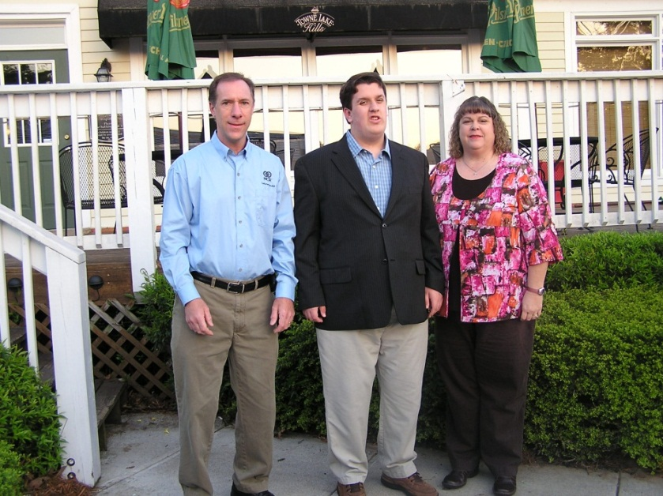
Parent Mentors are parents of a special needs child themselves whose children attend a Cherokee County School.

Slide 3

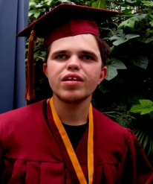
What do we do
The Cherokee County School District participates in the Georgia Department of Education’s Parent Mentor Program; a data-driven national model for family/school/community collaboration.
The Georgia Parent Mentor Partnership encourages families of students with disabilities and/or other academic risks to be critical players in the school improvement process. The Parent Mentor engages families of students with disabilities; including 504, SST, RTI & Title I in the education process and promotes/provides family training and engagement as an integral strategy in almost every state performance goal in Georgia.
The Parent Mentor Partnership is a springboard for change with the combined goals of increasing the graduation rate for students with disabilities and engaging families in the education of their own children.

Slide 4


We follow the National PTA Standards
as a basis to all of our work

Slide 5

We work on the GaDOE Strategic Plan and Federal Indicators for Students with Disabilities with our schools.
Goal 1 - Increase high school graduation rate, decrease dropout rate, and increase post-secondary enrollment rate.
Goal 2 - Strengthen teacher quality, recruitment, and retention.
Goal 3 - Improve workforce readiness skills.
Goal 4 - Develop strong education leaders, particularly at the building level.
Goal 5 - Improve the SAT, ACT, and the achievement scores of Georgia students.
Goal 6 - Make policies that ensure maximum academic and financial accountability.

Slide 6


Parent Mentors provide training and resources on a array of topics including Positive Behavior Support and Effective Communication among many others.
Mentors attend several trainings throughout the year to stay current on Special Education issues as it relates to both Federal and State areas; curriculum changes and graduation requirements. Many of these trainings are facilitated by the Georgia State Department of Education.

Slide 7

What is Parental Involvement?
The term parental involvement means
the participation of parents in regular,
two-way and meaningful
communication involving student
academic learning and other school
activities.

Slide 8

THE KEYS TO SUCCESSFUL
SCHOOL-FAMILY-COMMUNITY PARTNERSHIPS
EPSTEIN’S SIX TYPES OF INVOLVEMENT
PARENTING: Assist families with parenting and child-rearing skills, understanding
child and adolescent development, and setting home conditions that support children as students
at each age and grade level. Assist schools in understanding families.
Type 1
COMMUNICATING: Communicate with families about school programs and student
progress through effective school-to-home and home-to-school communications.
Type 2
VOLUNTEERING: Improve recruitment, training, work, and schedules to involve
families as volunteers and audiences at school or in other locations to support students and
school programs.
Type 3
Type 4
LEARNING AT HOME: Involve families with their children in learning activities at
home, including homework and other curriculum-related activities and decisions.
DECISION MAKING: Include families as participants in school decisions, governance,
and advocacy through PTA/PTO, school councils, committees, action
teams, and other parent organizations.
Type 5
Type 6
COLLABORATING WITH COMMUNITY: Coordinate resources and services
for students, families, and the school with businesses, agencies, and other groups, and provide
services to the community.
Reprinted with permission: Epstein, J. L., Sanders, M. G., Simon, B. S., Salinas, K. C., Jansorn, N. R., & Van Voorhis, F. L. (2002). School, Family, and Community Partnerships: Your Handbook for Action (Second Edition). Thousand Oaks, CA: Corwin Press.

Slide 9

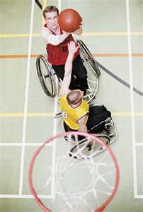

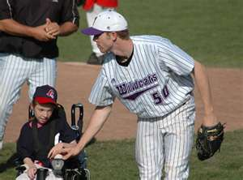
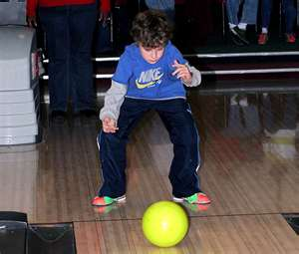
Community Activities
Cherokee Outdoor YMCA
770-591-5820
http://coy.ymcaatlanta.org/
YMCA -Canton
770-345-9622
http://cantonfamilyymca.org/
Cherokee Recreation & Parks Association
770-924-7768
www.crpa.net
Kim Watt
Cherokee County Navigator Team
http://cherokeenavigator.org
AMF Bowling Lanes-Woodstock
770-926-2200
http://www.amf.com/woodstocklanes/center
Next Step Ministries
770-592-1227
http://nextstepministries.net/
Cherokee County Special Olympics
770-356-3062
www.cherokeecountyspecialolympics.org

Slide 10





Helping your child transition
to Kindergarten
Read books about going to Kindergarten
Visit the school to get your child familiar with it
Talk about how exciting it’s going to be

Slide 11



Practice to keep their skills up over the summer
It’s important to work with your child over the summer so they
do not loose the skills they have already acquired.
Make summer learning fun!
Practice writing their names in sand, water colors, sidewalk chalk
Sing the alphabet song while traveling
See how many trees you can count; or clouds

Slide 12

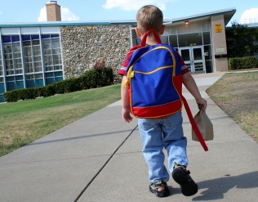


FIELD TRIP
If possible, visit the school over the summer and allow your child to look around and become familiar with the new setting.
Make sure to call the school to see if you can arrange this.
Visit important areas of the school; lunchroom, library, counselors office, nurses office, etc.

Slide 13



Resources
Sharon Jones
Sharon.jones@cherokee.k12.ga.us
770-721-8503
Jo Ellen Hancock
Joellen.hancock@cherokee.k12.ga.us
687-310-6198
770-721-8503
www.parentmentors.org
www.aadd.org
All About Developmental Disabilities
www.glrs.org
Georgia Learning Resources System
www.gcdd.org
Georgia’s Council on Developmental Disabilities
www.P2P.org 1-800-229-2038
NICHY: Students Guide to the IEP:
http://nichcy.org/wp-content/uploads/docs/st1.pdf
Parent to Parent of Georgia –Roadmap to Services
http://parenttoparentofga.org:8080/AdvSearch.htm

