Slide 1
Cherokee County
Parent Mentors
Georgia Parent Mentor Partnership
Present:
Transition:
Middle to High School

Slide 2
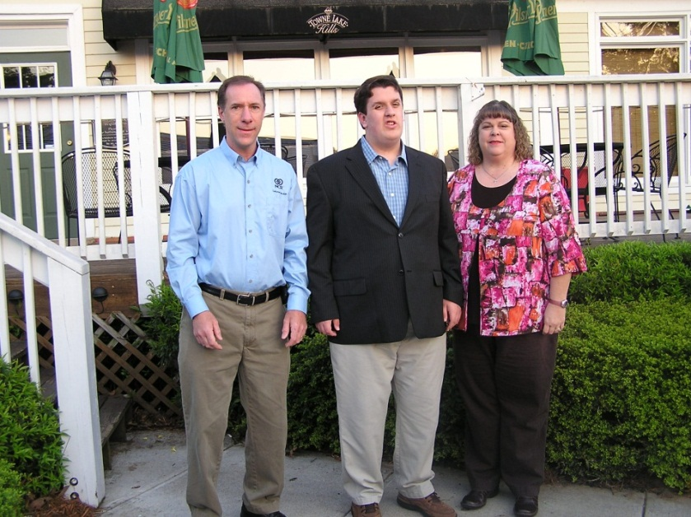
Parent Mentors are parents of a special needs child themselves whose children attend a Cherokee County School.

Slide 3
What do we do
PMP is a data-driven national model for family/school/community collaboration. The Georgia Parent Mentor Partnership encourages families of students with disabilities and/or other academic risks to be critical players in the school improvement process. The Georgia Department of Education launched this determined and energetic partnership to engage families of students with disabilities in the education process. Today, the state/local partnership boasts nearly 90 trained parent leaders partnering with local school systems in family engagement initiatives.
Together with educators and a group of family partners, the Parent Mentor Partnership (PMP) reaches more than 75 percent of the state’s students with Individualized Education Programs(IEPs), and thousands of other students considered at risk because of factors such as English as a Second Language, poverty and/or family social issues. This includes children in the RTI, SST process and a partnership with Title I.
The Parent Mentor Partnership is a springboard for change with the combined goals of increasing
the graduation rate for students with disabilities and engaging families in the education of their own children.

Slide 4
We follow the National PTA Standards
as a basis to all of our work

Slide 5
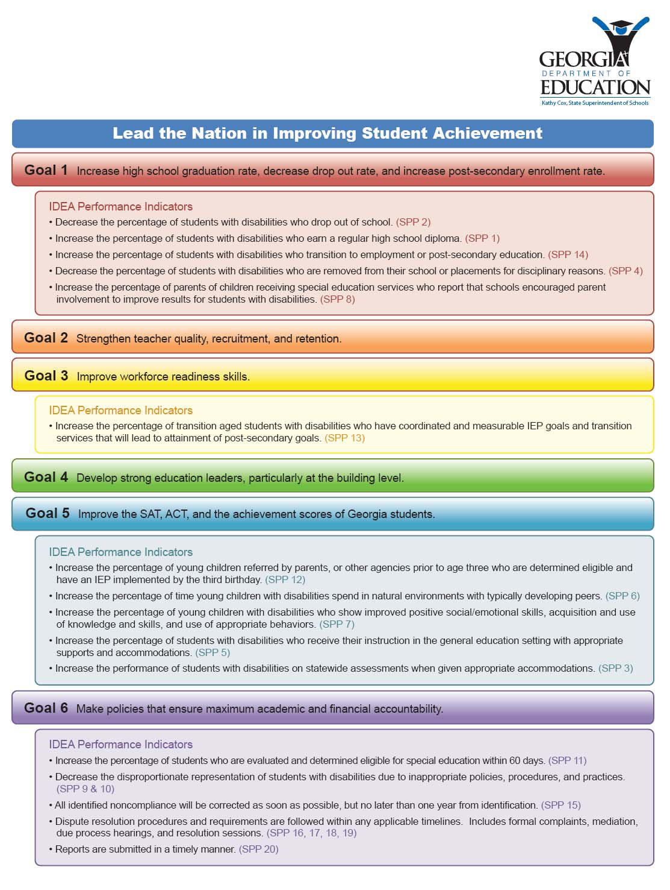
We work on the State Department
Indicators and partner with our schools
to achieve them.

Slide 6
Parent Mentors provide training and resources on a array of topics including Positive Behavior Support and Effective Communication among many others.
Mentors attend several trainings throughout the year to stay current on Special Education issues as it relates to both Federal and State areas; curriculum changes and graduation requirements. Many of these trainings are facilitated by the Georgia Department of Education.

Slide 7
Self- Determination
Empowering your child...how much do they
know about their disability?
What is Self-determination?
Let us explain it in plain English….
Knowing and believing in yourself
Knowing what you want in the future AND making plans to achieve your goals
Knowing and asking for the supports you need to help you achieve your goals
Knowing how to make choices and decisions to improve your quality of life.

Slide 8
How does Self-determination develop
Making choices about everyday activities
Knowing your rights and responsibilities
Understanding your strengths, challenges, likes and dislikes
Understanding your accommodations
Setting goals for the future
What will your child gain
Understanding of the team effort of people working to help them be successful
IIncreased self-esteem, self-advocacy skills and social skills
Greater interest in achieving their goals-their “buy in”

Slide 9
Bridge Law: IGP
Individual Graduation Plan
What is the IGP
An individual Graduation Plan that is required for all students by the Bridge Law (May 2010).
It is developed with the student, parents, guardians or individuals appointed by the parents or guardians to serve as their designee.
The IGP is focused on career awareness, career interest inventories and information to assist students in evaluating their academic skills and career interests.
(Career Cruising)
This plan is flexible enough to allow changes in the course of study and still meet graduation requirements.

Slide 10
The IGP must………
Be based on the student’s selected academic and career focus area as approved by the student’s parent or guardian.
Include experience based, career oriented learning experiences.
Include post-secondary opportunities through dual enrollment and joint enrollment.
Align educational and career goals to the student’s course of study.
(Career Pathways)

Slide 11
Working Together
Understanding the difference
IGP: (Individual Graduation Plan)
-Information is used to create the pathway to successful post-secondary outcome for all students.
IEP: (Individual Education Plan)
-Uses information from the IGP to inform the transition IEP process.

Slide 12
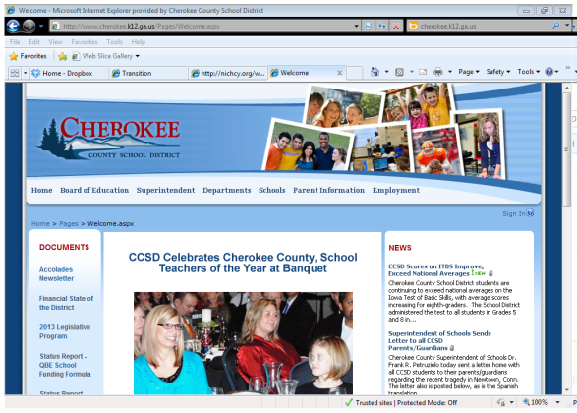
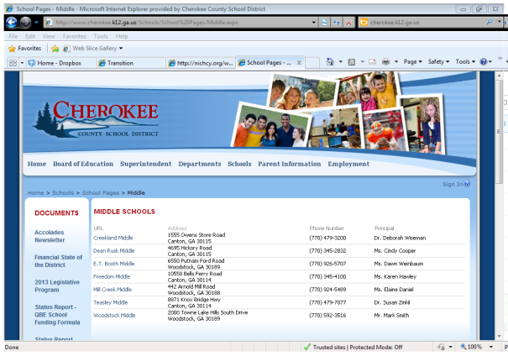
Check School District website
and your school website often
Cherokee County School District
http://www.cherokee.k12.ga.us/Pages/Welcome.aspx
Stay connected
District Forms
District Information
District/State Reports
Announcements
Student handbooks
Parent Portal
District Calendar
Testing Calendar
School Activities
Tutoring Info
School Clubs
Teachers Website
PTSA Information
Supply lists
School Calendar of Events

Slide 13
Communication, Communication, Communication
Know your
child’s Guidance
Counselor
Check Parent Portal frequently for grades and attendance
Stay in touch with teachers and visit their websites frequently for assignments, updates and information
Know Graduation Requirements and choices for Career Pathways
Attend Open House, Curriculum Night, Parent Information Nights, etc.

Slide 14
Know your child
Do you know what they’re playing and with who?
Limit “screen” time

Slide 15
Who are your child’s friends?
Peer influence/pressure can make a difference
Notes:
Do you know what your children are doing on line, who they are texting, what sites they are visiting? Do you know what they are saying to their friends and who their friends are? Are you limiting their “screen time”?

Slide 16
Attendance is key
You can’t learn if you are not there!!
There are new laws tired to getting a Learner’s Permit. Familiarize yourself with them. Attendance and grades affect this.

Slide 17
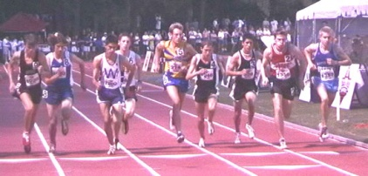
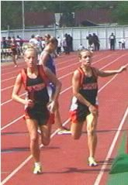
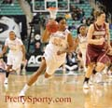
Keep them involved
There’s something for everyone
No club to match your child’s interest, start one!!!

Slide 18
FIELD TRIP
If possible, visit the school over the summer and allow your child to look around and become familiar with the new setting.
Make sure to call the school to see if you can arrange this.
Visit important areas of the school; lunchroom, library, counselors office, etc.
**not all high schools have a school nurse. Check with your school as to who will administer your child’s medication.

Slide 19
Its’ a Partnership
It’s a Partnership

Slide 20
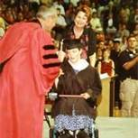
Together we can do it!

Slide 21
Resources
Parent to Parent of Georgia
www.p2pga.org
Parent Mentors
www.parentmentors.org
NICHY: Students Guide to the IEP:
http://nichcy.org/wp-content/uploads/docs/st1.pdf
Bridge Law/IGP: (also called Bridge Bill)
http://www.gadoe.org/Curriculum-Instruction-and-Assessment/CTAE/
Pages/Presentations.aspx
Transition to Post-Secondary:
http://www.gadoe.org/Curriculum-Instruction-and-Assessment/Special-Education-Services/Pages/Transition-.aspx

Slide 22
FOUR YEAR PLAN OF STUDY for Class of 2013 and 2014
SUBJECT UNITS REQ. | 9TH GRADE | 10TH GRADE | 11TH GRADE | 12TH GRADE
LITERATURE 4 * indicates EOCT requirement | 9th Lit/Comp* 9th Lit/Comp (Honors)* | 10th Lit/Comp 10th Lit/Comp (Honors) | American Lit/Comp* American Lit/Comp (Honors)* | 12th Lit/Comp Advanced Comp AP Lit
MATHEMATICS 4 * indicates EOCT requirement | Math I* --------------------------- Acc. Math I --------------------------- Acc. Math 2* | Math 2* GPS Geometry --------------------------- Acc. Math 2* --------------------------- AP Stats (2013) Acc. Math 3 (2014) | GPS Adv. Algebra GPS Adv. Algebra --------------------------- GPS Acc. Pre-Calculus --------------------------- GPS Pre-Calculus (2013) AP Stats or AP Calculus (2014) | 4th Year of Math (Pre-Calculus, Calculus, AP Stat, AP Calc, Bus. Math) *Math Support can count as a 4th year of Math for the Classes of 2013 & 2014 --------------------------- AP Calculus or AP Stats
SCIENCE 4 * indicates EOCT requirement | Biology _______________ Biology or Honors Bio* --------------------------- Physical Science* | Physical Science ________________ Chemistry or Honors Chem. --------------------------- Biology* | Environmental Science ___________________ Physics or Honors Physics --------------------------- Environmental Science | Human Anatomy Environ. Science Zoology Earth Systems AP Science Other Lab Sciences
SOCIAL STUDIES 3 * indicates EOCT requirement |  | World History Honors World History AP World History | US History* Honors US History* AP US History* | Government/ Economics* Honors Gov. /Honors Econ* AP Govt./AP Econ*
P.E. AND HEALTH 1 Personal Fitness and Health OR (ROTC – 3 Consecutive Units fulfill this requirement) | Personal Fitness/Health ________________ ROTC 1 | X ________________ ROTC 2 | X ________________ ROTC 3
REQUIRED ELECTIVES 3 Foreign Language, Fine Arts and/or Technical classes. *4 yr GA and out-of-state colleges require 2 years of the same FL but encourage 3 yrs of the same FL | Foreign Language (Not all students begin FL during 9th grade YR) --------------------------- Fine Art or Tech | Foreign Language (Must start 1st year of FL if did not start in 9th grade AND wants to attend a 4 yr college) --------------------------- Fine Art or Tech | Foreign Language --------------------------- Fine Art or Tech | Foreign Language (Complete 3rd year of FL if started in 10th grade) --------------------------- Fine Art or Tech
MISC. ELECTIVES 4 *Select students | Elective | Elective | Elective | Elective
TOTAL UNITS 23 | 6 | 12 | 18 | 24

Slide 23
FOUR YEAR PLAN OF STUDY for Class of 2015
SUBJECT UNITS REQ. | 9TH GRADE | 10TH GRADE | 11TH GRADE | 12TH GRADE
LITERATURE 4 * indicates EOCT requirement | 9th Lit/Comp* 9th Lit/Comp (Honors)* | 10th Lit/Comp 10th Lit/Comp (Honors) | American Lit/Comp* American Lit/Comp (Honors)* | 12th Lit/Comp Advanced Comp AP Lit
MATHEMATICS 4 * indicates EOCT requirement | GPS Algebra* --------------------------- Acc. Algebra/Geometry* --------------------------- Acc. Geometry/Adv. Algebra* | GPS Geometry* --------------------------- Acc. Geometry/Adv Algebra* --------------------------- AP Stats | GPS Adv. Algebra --------------------------- GPS Acc. Pre-Calculus --------------------------- GPS Pre-Calculus | 4th Year of Math (Pre-Calculus, Calculus, AP Stat, AP Calc, Bus. Math) --------------------------- AP Calculus or AP Stats
SCIENCE 4 * indicates EOCT requirement | Biology* _______________ Biology or Honors Bio* --------------------------- Physical Science* | Environmental Science ________________ Chemistry or Honors Chem. --------------------------- Biology* | Physical Science* ___________________ Physics or Honors Physics --------------------------- Environmental Science | Human Anatomy Environ. Science Zoology Earth Systems AP Science Other Lab Sciences
SOCIAL STUDIES 3 * indicates EOCT requirement |  | World History Honors World History AP World History | US History* Honors US History* AP US History* | Government/ Economics* Honors Gov. /Honors Econ* AP Govt./AP Econ*
P.E. AND HEALTH 1 Personal Fitness and Health OR (ROTC – 3 Consecutive Units fulfill this requirement) | Personal Fitness/Health ________________ ROTC 1 | X ________________ ROTC 2 | X ________________ ROTC 3
REQUIRED ELECTIVES 3 Foreign Language, Fine Arts and/or Technical classes. *4 yr GA and out-of-state colleges require 2 years of the same FL but encourage 3 yrs of the same FL | Foreign Language (Not all students begin FL during 9th grade YR) --------------------------- Fine Art or Tech | Foreign Language (Must start 1st year of FL if did not start in 9th grade AND wants to attend a 4 yr college) --------------------------- Fine Art or Tech | Foreign Language --------------------------- Fine Art or Tech | Foreign Language (Complete 3rd year of FL if started in 10th grade) --------------------------- Fine Art or Tech
MISC. ELECTIVES 4 *Select students | Elective | Elective | Elective | Elective
TOTAL UNITS 23 | 6 | 12 | 18 | 24

Slide 24
FOUR YEAR PLAN OF STUDY for Class of 2016
SUBJECT UNITS REQ. | 9TH GRADE | 10TH GRADE | 11TH GRADE | 12TH GRADE
LITERATURE 4 * indicates EOCT requirement | CCGPS 9th Lit/Comp* 9th Lit/Comp (Honors)* | CCGPS 10th Lit/Comp 10th Lit/Comp (Honors) | CCGPS American Lit/Comp* American Lit/Comp (Honors)* | CCGPS 12th Lit/Comp AP Lit
MATHEMATICS 4 * indicates EOCT requirement | CCGPS Algebra* --------------------------- Acc. CCGPS Alg/Geom* --------------------------- Acc. CCGPS Geom/Adv Alg* | CCGPS Geometry* --------------------------- Acc. CCGPS Geom/Adv. Alg --------------------------- AP Stats | CCGPS Adv. Algebra --------------------------- Acc. CCGPS PreCalculus --------------------------- Acc. CCGPS PreCalculus | 4th Year of CCGPS Math (PreCalculus, AP Stat, AP Calc, Adv.Decision Making) --------------------------- AP Calculus
SCIENCE 4 * indicates EOCT requirement | Biology* --------------------------- Honors Biology* | Environmental Science or Chemistry --------------------------- Honors Chemistry | Physical Science* or Chemistry (Honors) or Physics (Honors) --------------------------- AP Science | Human Anatomy Environ. Science Food Science Forensic Science Earth Systems AP Science
SOCIAL STUDIES 3 * indicates EOCT requirement |  | World History Honors World History AP World History | US History* Honors US History* AP US History* | Government Economics* AP Government/US AP Microeconomics*
P.E. AND HEALTH 1 Personal Fitness and Health OR (ROTC – 3 Consecutive Units fulfill this requirement) | Personal Fitness/Health ________________ ROTC 1 | X ________________ ROTC 2 | X ________________ ROTC 3
REQUIRED ELECTIVES 3 Foreign Language, Fine Arts and/or Career Pathway. *4 yr GA and out-of-state colleges require 2 years of the same FL but encourage 3 yrs of the same FL | Foreign Language (Not all students begin FL during 9th grade YR) --------------------------- Fine Art or Career Pathway | Foreign Language (Must start 1st year of FL if did not start in 9th grade AND wants to attend a 4 yr college) --------------------------- Fine Art or Career Pathway | Foreign Language --------------------------- Fine Art or Career Pathway | Foreign Language (Complete 3rd year of FL if started in 10th grade) --------------------------- Fine Art or Career Pathway
MISC. ELECTIVES 4 *Select students Can Include Foreign Language or Fine Arts | Elective *AP Human Geography *Math Support 1 (1.0) | Elective *Math Support 2 (1.0) | Elective | Elective
TOTAL UNITS 23 | 6 | 12 | 18 | 24

