Slide 1


Cherokee County
Parent Mentors
Georgia Parent Mentor Partnership
Present:
Transition:
High School to
Post-Secondary

Slide 2

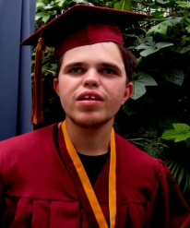
What do we do
PMP is a data-driven national model for family/school/community collaboration. The Georgia Parent Mentor Partnership encourages families of students with disabilities and/or other academic risks to be critical players in the school improvement process. The Georgia Department of Education launched this determined and energetic partnership to engage families of students with disabilities in the education process. Today, the state/local partnership boasts nearly 90 trained parent leaders partnering with local school systems in family engagement initiatives.
Together with educators and a group of family partners, the Parent Mentor Partnership (PMP) reaches more than 75 percent of the state’s students with Individualized Education Programs(IEPs), and thousands of other students considered at risk because of factors such as English as a Second Language, poverty and/or family social issues. This includes children in the RTI, SST, and 504 process and a partnership with Title I.
The Parent Mentor Partnership is a springboard for change with the combined goals of increasing
the graduation rate for students with disabilities and engaging families in the education of their own children.

Slide 3
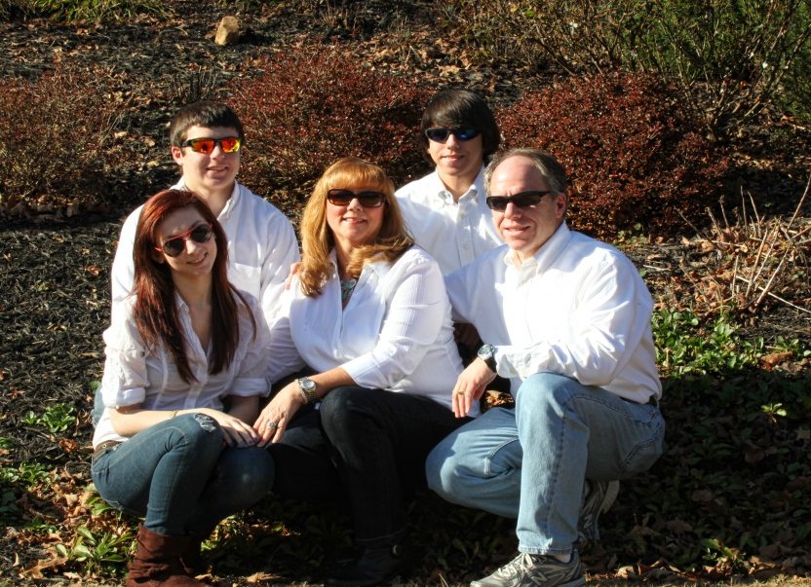
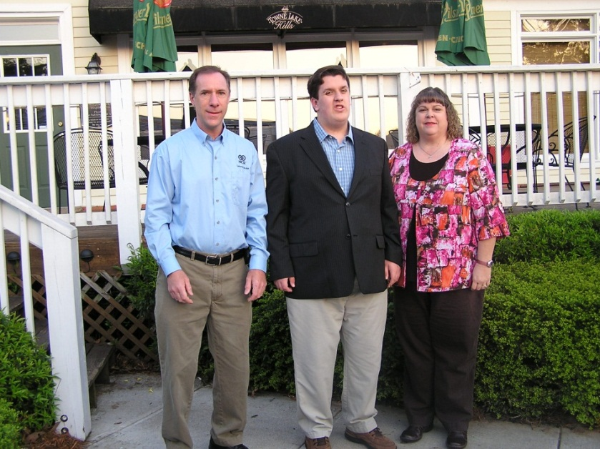
Parent Mentors are parents of a special needs child themselves whose children attend a Cherokee County School.

Slide 4


We follow the National PTA Standards
as a basis to all of our work

Slide 5

We work on the GaDOE Strategic Plan and Federal Indicators for Students with Disabilities with our schools.
Goal 1 - Increase high school graduation rate, decrease dropout rate, and increase post-secondary enrollment rate.
Goal 2 - Strengthen teacher quality, recruitment, and retention.
Goal 3 - Improve workforce readiness skills.
Goal 4 - Develop strong education leaders, particularly at the building level.
Goal 5 - Improve the SAT, ACT, and the achievement scores of Georgia students.
Goal 6 - Make policies that ensure maximum academic and financial accountability.

Slide 6


Parent Mentors provide training and resources on a array of topics including Positive Behavior Support and Effective Communication among many others.
Mentors attend several trainings throughout the year to stay current on Special Education issues as it relates to both Federal and State areas; curriculum changes and graduation requirements. Many of these trainings are facilitated by the Georgia Department of Education.

Slide 7


Self- Determination
Empowering your child...how much do they
know about their disability?
What is Self-determination?
Let us explain it in plain English….
Knowing and believing in yourself
Knowing what you want in the future AND making plans to achieve your goals
Knowing and asking for the supports you need to help you achieve your goals
Knowing how to make choices and decisions to improve your quality of life.

Slide 8



How does Self-determination develop
Making choices about everyday activities
Knowing your rights and responsibilities
Understanding your strengths, challenges, likes and dislikes
Understanding your accommodations
Setting goals for the future
What will your child gain
Understanding of the team effort of people working to help them be successful
Increased self-esteem, self-advocacy skills and social skills
Greater interest in achieving their goals-their “buy in”

Slide 9

Bridge Law: IGP
Individual Graduation Plan
What is the IGP
An individual Graduation Plan that is required for all students by the Bridge Law (May 2010).
It is developed with the student, parents, guardians or individuals appointed by the parents or guardians to serve as their designee.
The IGP is focused on career awareness, career interest inventories and information to assist students in evaluating their academic skills and career interests.
(Career Cruising)
This plan is flexible enough to allow changes in the course of study and still meet graduation requirements.

Slide 10


The IGP must………
Be based on the student’s selected academic and career focus area as approved by the student’s parent or guardian.
Include experience based, career oriented learning experiences
Include post-secondary opportunities through dual enrollment and joint enrollment
Align educational and career goals to the student’s course of study.
(Career Pathways)

Slide 11

Working Together
Understanding the difference
IGP: (Individual Graduation Plan)
-Information is used to create the pathway to successful post-secondary outcome for all students
IEP: (Individual Education Plan)
-Uses information from the IGP to inform the transition IEP process.

Slide 12
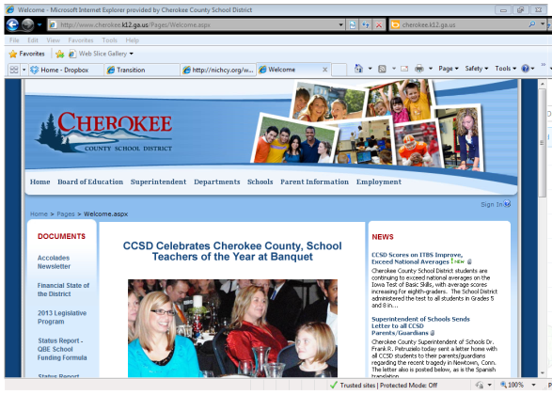
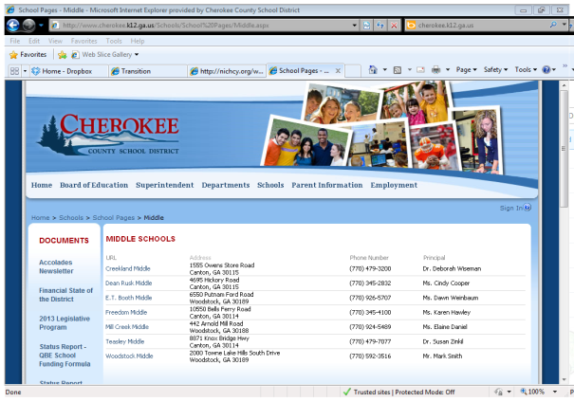
Check School District website
and your school website often
Cherokee County School District
http://www.cherokee.k12.ga.us/Pages/Welcome.aspx
Stay connected
District Forms
District Information
District/State Reports
Announcements
Student handbooks
Parent Portal
District Calendar
Testing Calendar
School Calendar of Events
Tutoring Info
School Clubs
Teacher Websites
School Activities
Announcements

Slide 13


Who Am I? Where Am I Going? How Do I Get There From Here?
Deciding whether or not you want or need more schooling (in today's world, EVERYONE needs to continue his/her education beyond high school) or what kind of school you need to go to will depend largely on the nature of the careers in which you're interested.
Many people choose the college they want to attend and then go about trying to whittle a career out of what they are taking. By knowing yourself, your likes & dislikes, strengths & weaknesses the more likely you are to find a career that suits you. Talk with people who know you and begin to explore the areas, careers, and jobs they suggest.

Slide 14
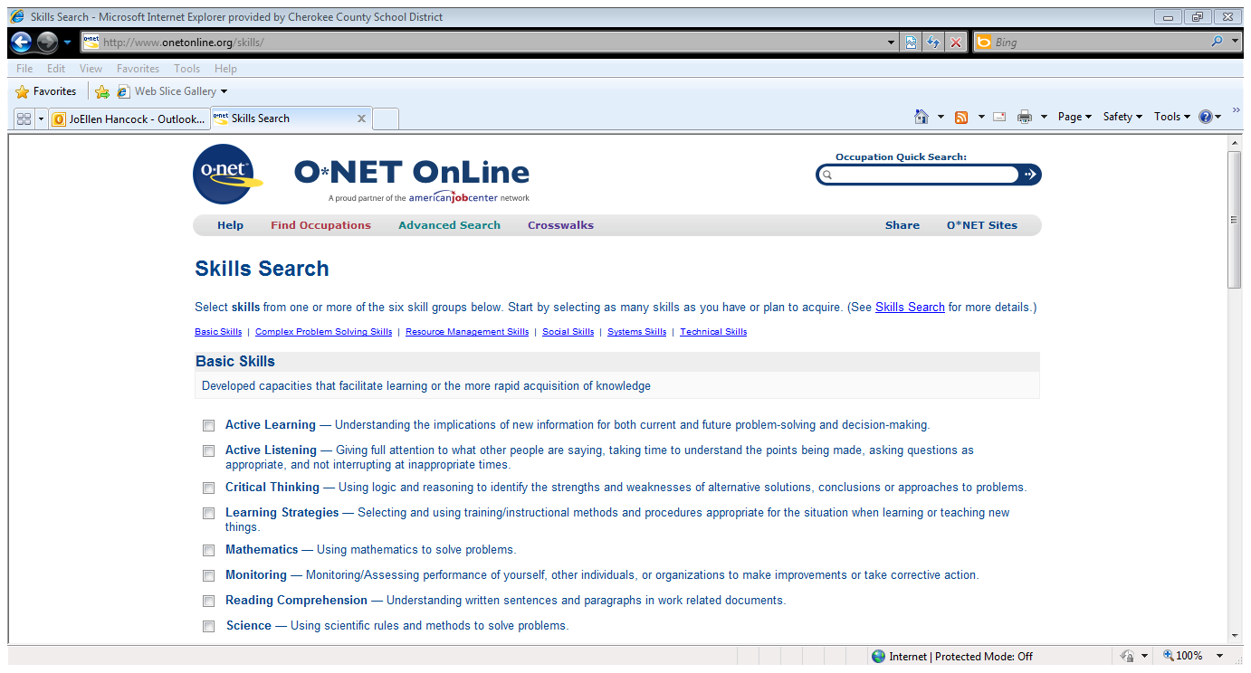
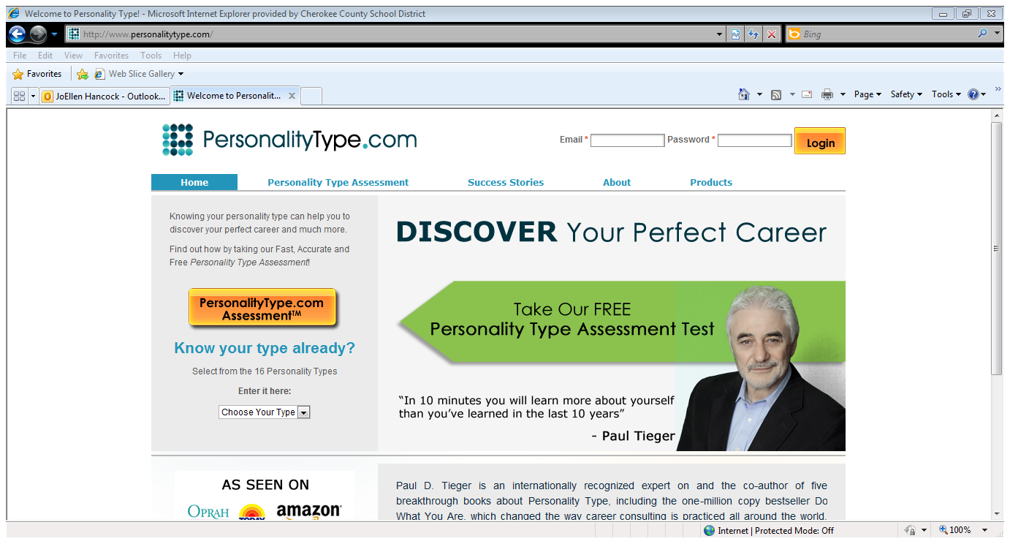
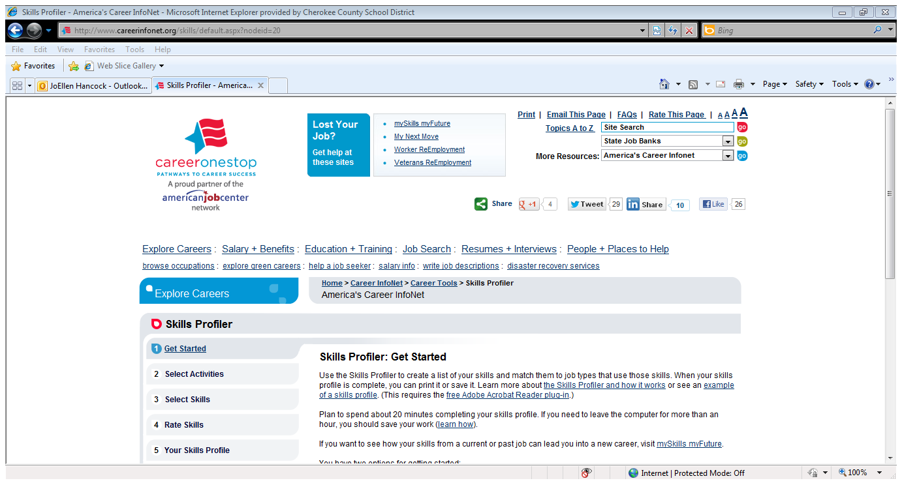
A Skills Inventory will help with your decisions
http://www.onetonline.org/skills/
http://www.personalitytype.com/
http://www.careerinfonet.org/skills/default.aspx?nodeid=20

Slide 15
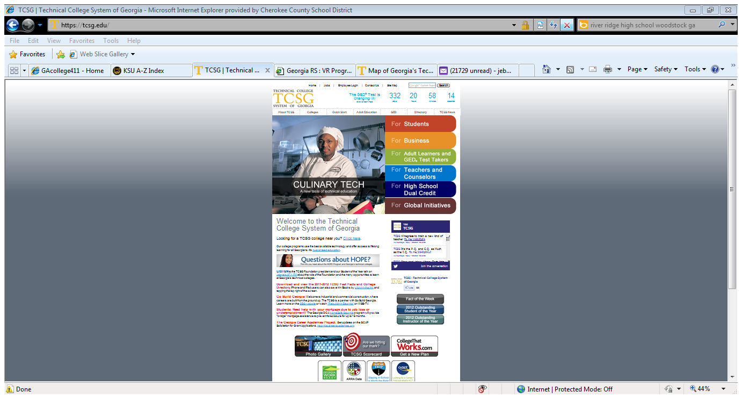
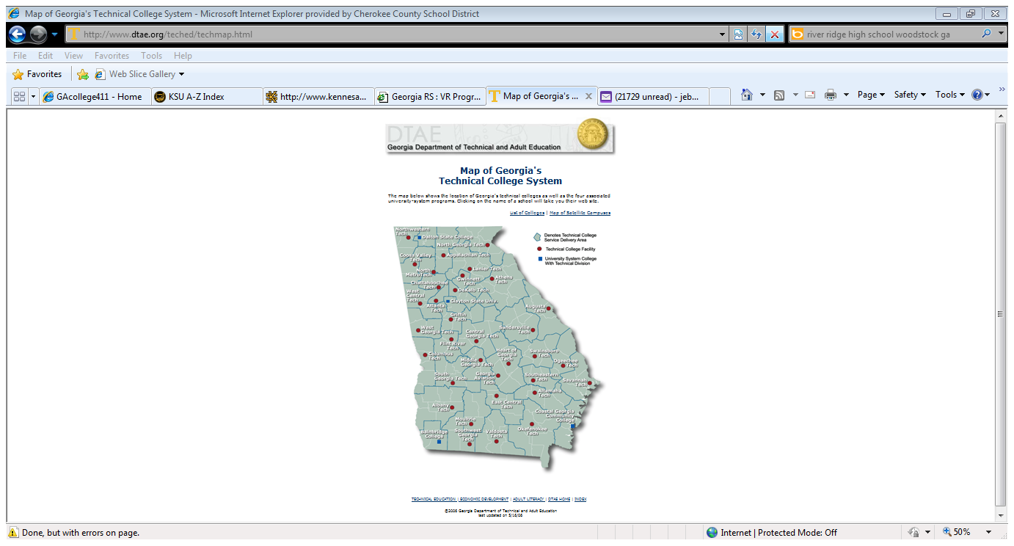
CHOICES…….
Not everyone will go to a typical 4 year college
http://www.dtae.org/teched/techmap.html
https://tcsg.edu/

Slide 16
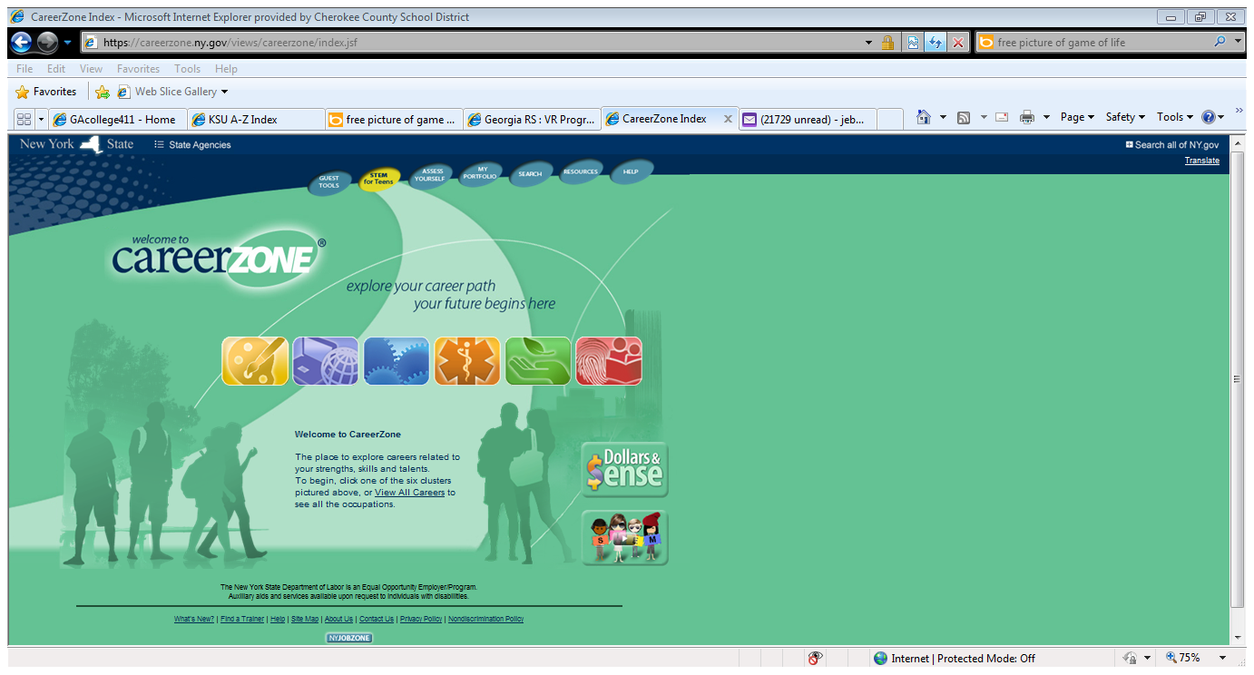
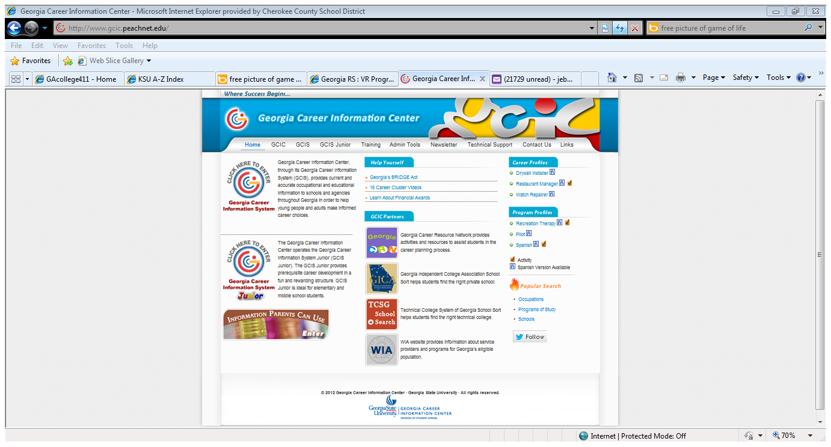
https://careerzone.ny.gov/views/careerzone/index.jsf
http://www.gcic.peachnet.edu/

Slide 17

If your child is working toward a GAA Diploma
Beginning at age 16, make sure your child’s transition plan is appropriate. The transition plan should drive the IEP from this point forward.
Work closely with your child’s transition case holder.
Apply for NOW/COMP Medicaid Waiver Program and adult services.
Look for recreational activities to enhance socialization.
Reinforce independent living skills at home.

Slide 18
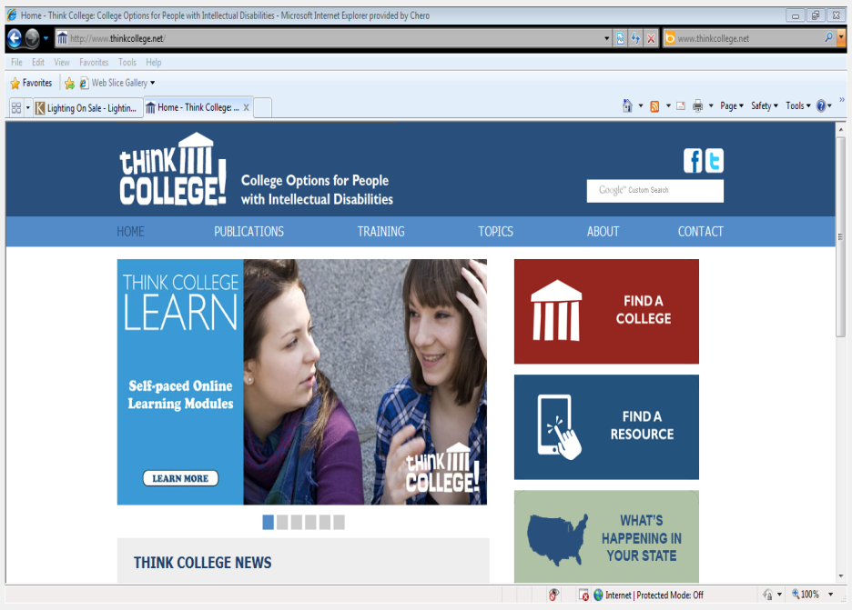
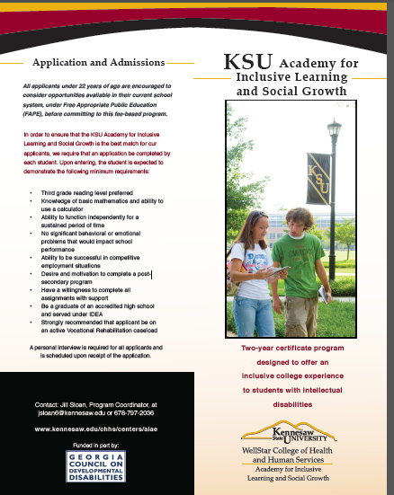
Additional Options
www.kare11.com/video/2130238689001/1/Funding-fight-for-college-classes-for-disabled-students
www.thinkcollege.net
Jill Sloan, Program Coordinator 678-797-2036
www.kennesaw.edu/chhs/academy/Forms/Brochure%203-1-2011.pdf

Slide 19

Canton VR Office
P.O. Box 4188
Canton, Georgia 30114-0206
Phone 770-720-3570
Fax 770 720-3577
When Ability Counts. . .
Count on Rehabilitation Services
What is the Vocational
Rehabilitation Program?
The Vocational Rehabilitation Program is a combination State/Federal program designed to assist people with disabilities to work.
The Cooperative School Program is collaboration between the Georgia Vocational Rehabilitation Agency’s Vocational Rehabilitation Program (VR) and the State Department of Education. The goal is to work with students with disabilities whose goal is to transition from school to work. The counselor takes applications and determines eligibility for VR services.
Who can receive VR services?
To qualify for VR services an individual must have a permanent disability. The disability must present a barrier to employment. The individual must be able to benefit from VR services to prepare for, engage in, retain or regain employment.
Most students who have an IEP and receive Special Education Services or who are being served under a 504 Plan would be considered to have a disability. For some disabilities there are other specific criteria that also must be considered. The individual must also be able to benefit from the provision of VR services.
Some students will have a disability so severe as to limit their ability to work. The VR program will work with other adult service providers to assess the student’s ability to benefit from
Supported Employment Services. Some services also require the student to meet Financial Eligibility criteria.

Slide 20
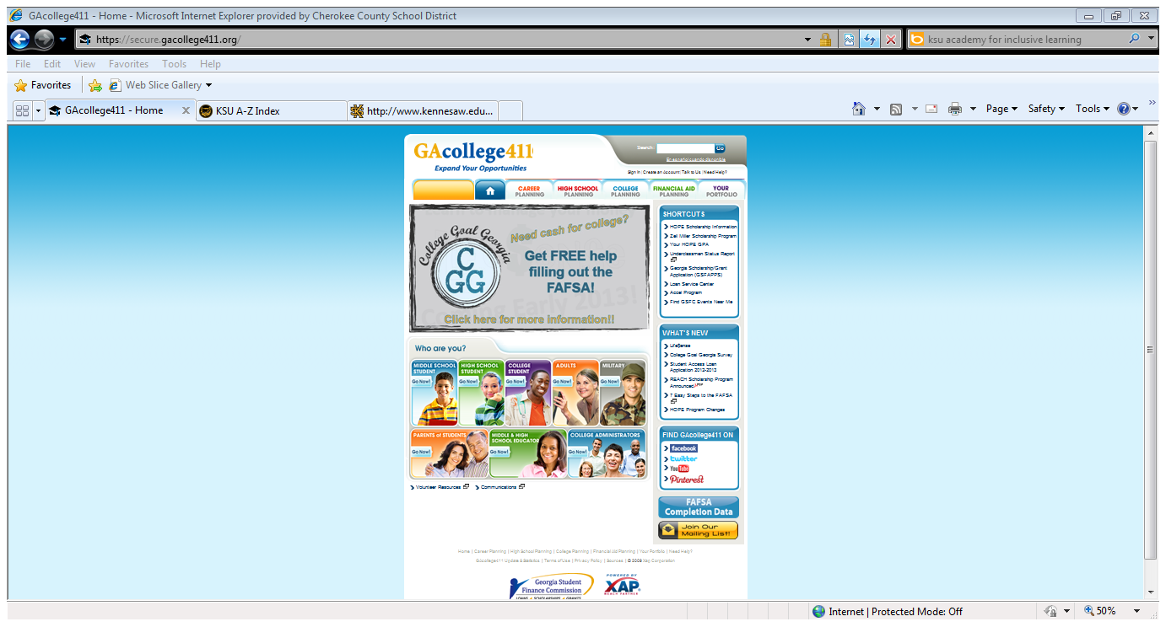
Get started early
https://secure.gacollege411.org/

Slide 21
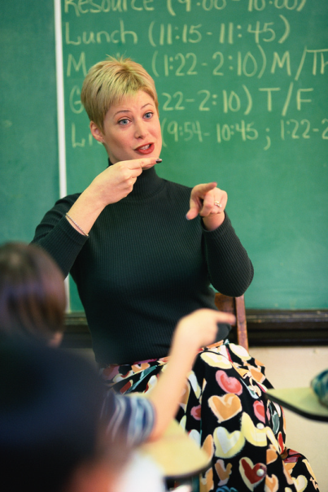



Communication, Communication, Communication
Be in constant contact with
Counselor to insure graduation requirements are being met.
Check Parent Portal frequently for grades and attendance.
Stay in touch with teachers and visit
their websites frequently for assignments,
updates and information.
Attend local college fairs.
Stay on top of deadlines for HOPE Scholarship.
Attend Parent Information Nights at your school.

Slide 22













ROAD TRIP
Visit Colleges of interest over the summer.
Most of them have a tour you can sign up for to see the campus and the dorms/housing.
Find a school that fits your students needs.
Speak with the office for students with special needs.
Must have a Psychological Evaluation within one year of college entrance.
This can be done through the Board of Regents and usually is a cost of around $500.
http://www.usg.edu/academic_affairs_handbook/section3/C679
Cost of Evaluations
  Students are assessed a $500 fee for each evaluation (subject to annual review).
  Payment schedules may vary across RCLDs.
  Evaluation scholarships may be available at individual RCLDs and/or referring institutions.
  Students may contact their local Georgia Department of Labor, Rehabilitation Services to determine if they qualify for services, which may include funding to offset evaluation costs.

Slide 23
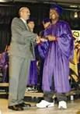







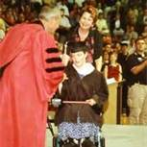
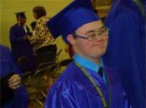
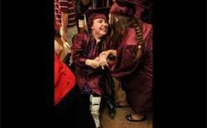
Together we can do it!

Slide 24
Resources
Parent Mentors
www.parentmentors.org
NICHY: Students Guide to the IEP:
http://nichcy.org/wp-content/uploads/docs/st1.pdf
Bridge Law/IGP: (also called Bridge Bill)
www.gadoe.org/Curriculum-Instruction-and-Assessment/CTAE/Pages/Presentations.aspx
Transition to Post-Secondary:
www.gadoe.org/Curriculum-Instruction-and-Assessment/Special-Education-Services/Pages/Transition-.aspx
Parent to Parent of Georgia
www.p2pga.org

Slide 25

Resource - Scholarships
http://www.fastweb.com/
http://www.schoolsoup.com/
http://www.cappex.com/
http://www.finaid.org/scholarships/protecting.phtml
http://www.collegenet.com/elect/app/app
https://www.collegeanswer.com/
http://www.scholarshipexperts.com/apply.htx
http://www.cappex.com/scholarships/index.jsp;jsessionid=776C8B6D62FE1F23D0787C6A73C4618A.server1
http://www.meritaid.com/

