Slide 1

Welcome to
Chat
A conversation on Transition For
Your Special Needs Child
With your Cherokee County
Parent Mentors
Sharon Jones & Jo Ellen Hancock

Slide 2
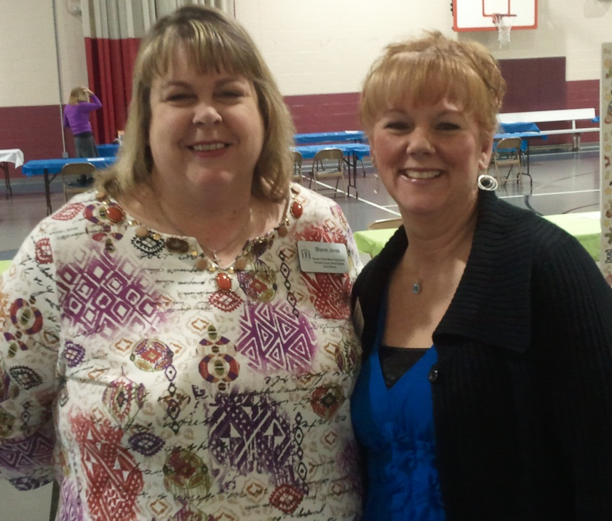
Cherokee County
Parent Mentors
Sharon Jones
sharon.jones@cherokee.k12.ga.us
Jo Ellen Hancock
joellen.hancock@cherokee.k12.ga.us
770-721-8503

Slide 3

10 Steps to Success
Transitioning to Adulthood

Slide 4







Step One
Waivers
GET ON THE WAITING LIST!!
BH & DD Regional Office
706-802-5272 Main Office (Rome)
877-217-4462 Intake & Evaluation (Cartersville)
Apply for Waiver
http://dbhdd.georgia.gov/portal/site/DBHDD/
NOW & COMP Waivers
Types of Funding
Criteria & Services
Highland Rivers-Family Support
Lisa Dodd
706-295-6425 x108

Slide 5

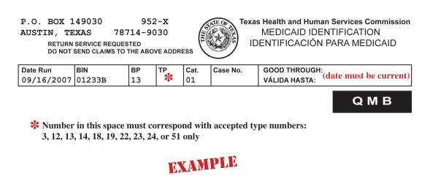

Step Two
Medicaid
DFCS (Department of Family & Children’s Services)
770-720-3610
At age 18 becomes Adult Medicaid
Upon retiring becomes Medicare
Food Stamps

Slide 6


Step Three
SSI (Social Security)
800-772-1213
Benefits Navigator
404-350-7598 Curtis Rodgers curtis_rodgers@shepherd.org
404-350-7589 Sally Atwell sally_atwell@shepherd.org
www.benefitsnavigator.org
Step Sheet
Lease –charge adult children rent if living with you

Slide 7


Step Four
Special Needs Trust & Wills
If you don’t decide, the state of georgia will decide for you
Interview Attorneys
Parent to Parent of Georgia –Roadmap to Services
http://parenttoparentofga.org:8080/AdvSearch.htm
www.P2P.org 1-800-229-2038

Slide 8



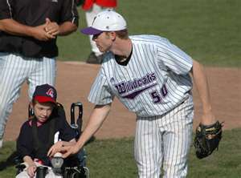
Step Five
Community Activities
Cherokee Outdoor YMCA
770-591-5820
http://coy.ymcaatlanta.org/
YMCA -Canton
770-345-9622
http://cantonfamilyymca.org/
Cherokee Recreation & Parks Association
770-924-7768
www.crpa.net
Kim Watt
Cherokee County Navigator Team
http://cherokeenavigator.org
AMF Bowling Lanes-Woodstock
770-926-2200
http://www.amf.com/woodstocklanes/center
Next Step Ministries
770-592-1227
http://nextstepministries.net/
Cherokee County Special Olympics
770-356-3062
www.cherokeecountyspecialolympics.org

Slide 9






Step Six
Networking
When we fall off the cliff, we want to land on our safety net of friends and community
Support Groups
Navigator Teams
Volunteer Opportunities
Futures Planning
State Issued ID
http://www.dmv.com/ga/georgia/apply-id-card

Slide 10

Step Seven
Employment
Briggs & Associates
404-290-6857
www.briggsassociates.org
Cherokee Day Training Center
770-345-5821
www.cherokeetrainingcenter.com
Vocational Rehabilitation
When Ability Counts. . .
Count on Rehabilitation Services
770-720-3570
www.vocrehabga.org
Transitional Manual
http://gadoe.org/ci_exceptional.aspx?PageReq=CIEXCTransition
Full Life Ahead Workbook
205-439-6543
http://www.fulllifeahead.org
Self Determination
ASPIRE
Active Student Participation Inspires Real Engagement
Futures Planning
Person Centered Planning
MAPS

Slide 11


Step Eight
Housing
Start with baby steps
Make Multiple Plans (A-B-C)
Research Options
Group Home or Assisted Living
Host Home

Slide 12


Step Nine
Transportation
Cherokee Area Transportation System
770-345-6238
http://cats.cherokeega.com/
Taxi/Cabs
Royalty Transportation
Non emergency in Woodstock Area
678-445-5152

Slide 13

Step Ten
Guardianship
Do I need guardianship of my child?
Obtaining Guardianship
770-704-2610
www.gaprobate.org
Keith Wood, Probate Judge
Georgia Council on Developmental Disabilities
www.gaprobate.org
Georgia Council on Develomental Disabilities Guardianship Guide
GCDD Guardianship Guide
Hard copies can be obtained through the GCDD main phone line at (404) 657-2126.
Georgia Council on Develomental Disabilities Proxy Care Guide
GCDD Proxy Care Guide
Hard copies can be obtained through the GCDD main phone line at (404) 657-2126. -http://www.gcdd.org/resources/real-support-resources.html#guides

