Slide 1
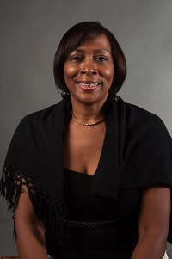
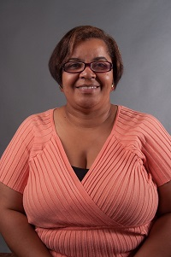
Working to Connect Families, Schools and Communities
The Georgia Parent Mentor Partnership is parents and professionals working together to improve outcomes for students with disabilities by enhancing communication and collaboration between families, educators and the community.
Based on information from http://www.parentmentors.org/
Notes:
Currently, over 100 parent mentors are working in 90 school districts to improve outcomes for children and youth with disabilities and their families
Funded by Georgia Department of Education (GaDOE) Division for Special Education Services and Supports.
Parent mentors are parents of children with disabilities who are employed by the districts to support other parents by providing information and resources to help their children succeed in school and transition from school to adult life.

Slide 2
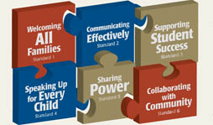
Our Work
Our Work with Families
Tools
Resources
Strategies
Notes:
Our Work with Families - Parent mentors work with families of students with disabilities on a daily basis providing them with tools, resources, and strategies that they can use to support their children at home, at school, and in the community. As parents of children with disabilities themselves, parent mentors are committed to providing parents with timely access to information and family-friendly resources on a variety of topics and issues.
In response to questions from parents, mentors provide information on a variety of topics through telephone calls, letters, email, and face-to-face meetings. For example, mentors may be asked to assist parents in identifying funding sources for specialized equipment or in locating medical and therapeutic services within the community. They may also be asked to assist in obtaining resources that parents can use to help their children in reading and math. Because each parent mentor works with their school district the types of services they provide vary according to the needs in their district.
Tools – Forms
Resource – Information
Strategies – PTA Standards - Print Document

Slide 3
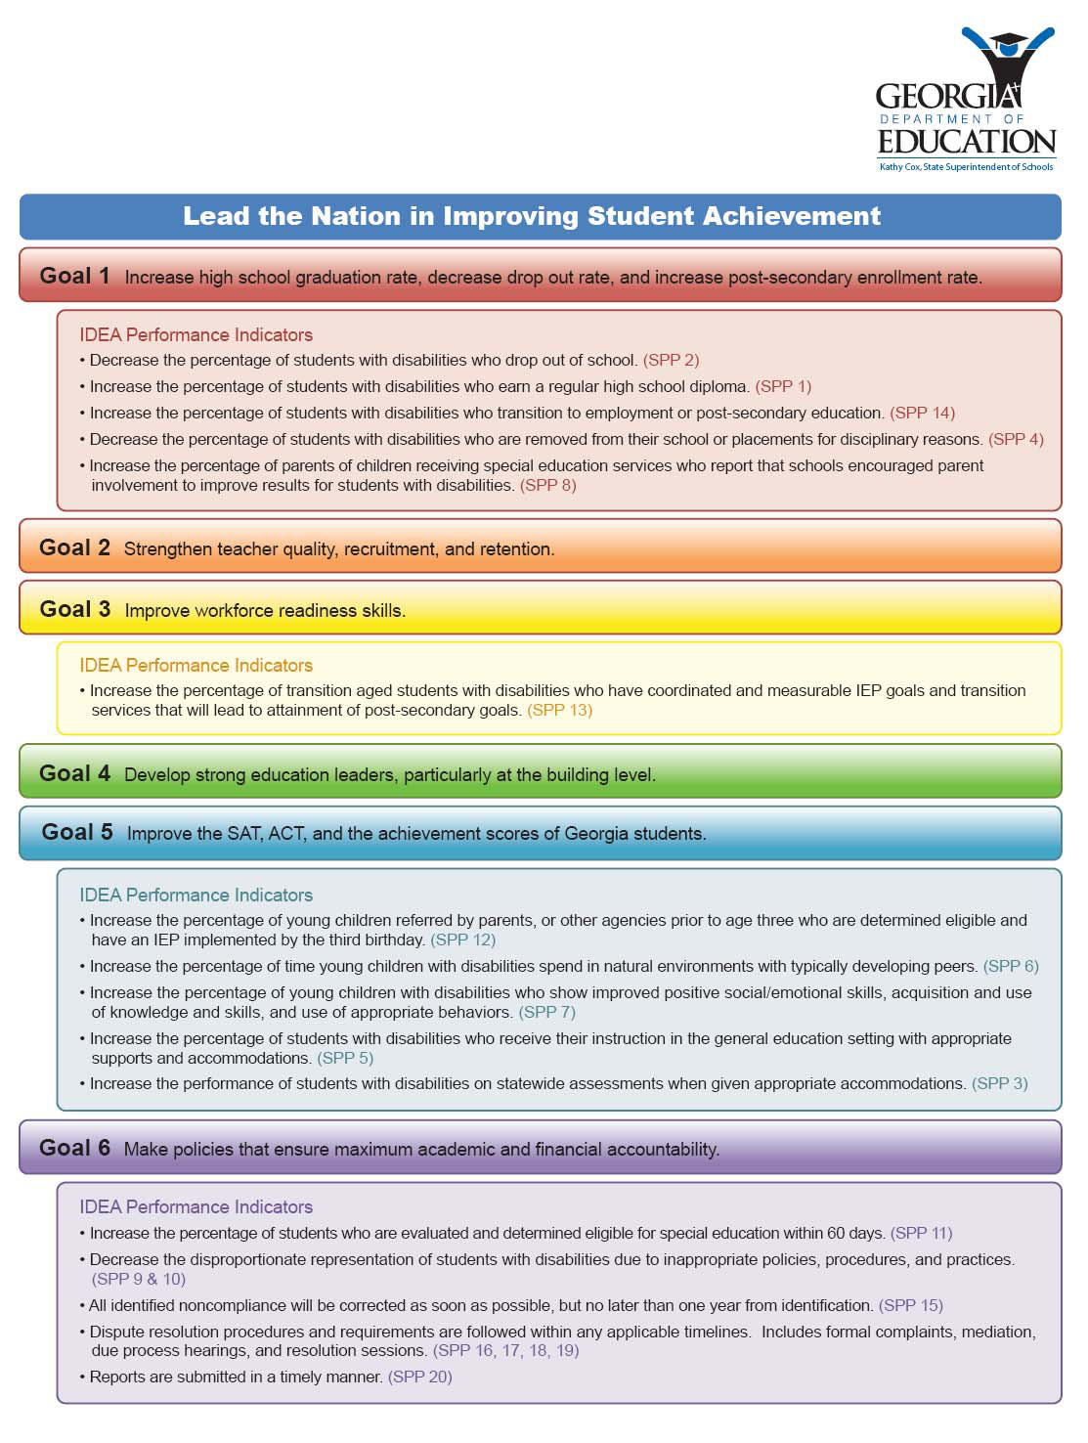
Our Work with Schools
help children succeed in school
transition from school to adult life
Notes:
Our Work with Schools
Parent mentors provide information and resources to parents to empower them to help their children succeed in school and transition from school to adult life. Often this support begins when children are first referred to special education, and parents are learning about the special education process. Mentors encourage parents to be actively engaged in their child’s education and to participate in Individualized Educational Program (IEP) meetings. As students grow older, parent mentors provide resources and supports to parents that are related to effective transition planning, helping parents and students plan transition programs and services that will improve their post-school outcomes.
Across the state, mentors have had an important role in projects that address improving reading and math achievement. These mentors have worked with teachers and administrators to provide additional supports needed to support struggling students, and they have helped parents learn to use strategies at home to support math and reading success. Mentors also partner with over 700 Title I Parent Involvement Coordinators to align their work with district family engagement activities for at-risk students.
Many parent mentors have also worked with families, teachers, administrators and community partners in projects designed to improve transition planning, decrease the number students with disabilities dropping out of school, increase the number of students who graduate with a high school diploma, and improve post-school outcomes. Many of these initiatives, such as GraduateFIRST, are funded through Georgia’s State Personnel Development Grant (SPDG).
Over the past five years, mentors have worked with school and community partners in participating Graduate First schools to engage families in the school’s efforts to keep students in school and working toward a diploma. In some districts, parent mentors have coordinated Circles of Adults Focusing on Education (C.A.F.E.s,), a dialogue method that engages school staff, parents, and community members in guided conversations about the factors contributing to students dropping out of school and in identifying creative ways to work together to address these factors.

Slide 4
Our Work
Our Work with Communities
work to build community partnerships that focus on issues effecting students with disabilities and their families.
developed strategies that remove barriers and support inclusion of students with disabilities in the community
Notes:
Parent mentors, in collaboration with teachers and administrators, work to build community partnerships that focus on issues effecting students with disabilities and their families. In some communities, mentors have developed strategies that remove barriers and support inclusion of students with disabilities in the community. In these efforts, parent mentors have identified and implemented strategies designed to improve vocational training and job opportunities as well as after school care and recreational options for students. As a result of these activities, students and their families have more opportunities for participation and inclusion in their home communities.
In some districts, parent mentors work with private and public organizations in the community to improve graduation rates of students with disabilities through implementing programs designed to keep students in school and working toward a general education diploma. Through Georgia’s Graduate First project, several parent mentors have led C.A.F.E.s, Circles of Adults Focusing on Education, to engage a circle of critical stakeholders including parents, special education and general education administrators, and community members in small group problem solving sessions to share views and common concerns and find solutions to improving graduation rates of students with disabilities

Slide 5
Our Partners
Georgia Parent Leadership Coalition (PLC):
Babies Can’t Wait – Skilled Credentialed Early Interventionists
Bright from the Start: Georgia Department of Early Care and Learning
Center for Leadership in Disabilities at Georgia State University
Georgia Council on Developmental Disabilities
Georgia Department of Behavioral Health and Developmental Disabilities
Georgia Department of Education, Division for Special Education Supports and Services; Parent Mentor Partnership
Georgia Family Connection Partnership
Institute on Human Development and Disability at the University of Georgia
Parent to Parent of GA – Georgia’s Parent Training Information Center (PTI)
Notes:
Our Partners
Parent mentors work to build effective family, school, and community partnerships that lead to greater achievement for students, especially those with disabilities. At the school, district and state levels, these partnerships are essential to the success of parent mentors and ultimately to the enhanced outcomes for students and their families.
Parent mentors partner with parents to support them in becoming more engaged in their children’s educational programs. They share information, encourage participation in IEP meetings, and help identify needed resources and services. In schools, parent mentors partner with teachers, administrators, and other school staff to integrate family engagement into school and district activities. They provide information about the needs of students and their families, they collaborate with teachers to implement reading and math initiatives, and they work with teams focusing on reducing dropout and increasing graduation rate. Mentors also partner with over 700 Title I Parent Involvement Coordinators to align their work with district family engagement activities for at-risk students. Parent mentors also work with community partners to increase vocational training and job opportunities as well as recreational options for students.
Parent mentors also collaborate with personnel from a variety of agencies to support families of students with disabilities. They work with staff from Parent to Parent (P2P) of Georgia, the state’s Parent Training and Information Center, to make information available on a large number of topics in a variety of formats including the project’s website at http://www.p2pga.org/. The Georgia Parent Mentor Partnership, is a founding member of the Georgia Parent Leadership Coalition (PLC) a collaborative effort between organizations representing families of children and adults with disabilities in Georgia. The Coalition is focused on building, supporting and strengthening parent leaders across the state.

Slide 6
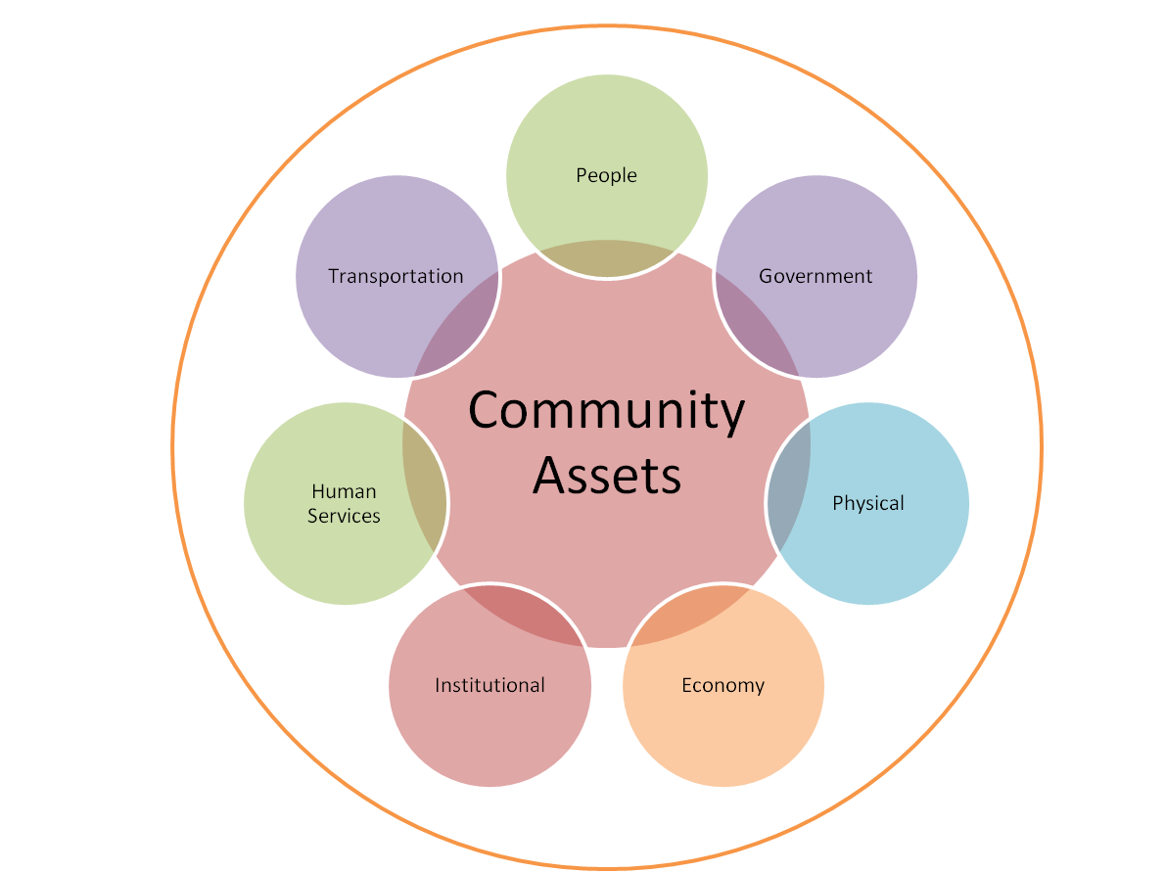
Our Resources
Community Resources
State
City
NPU (Neighborhood Planning Unit)
Neighborhood
County
Zip Code
Notes:
One of the main goals that parents mentors team up with parents, schools and communities is to work to improve graduation rates for students with disabilities. C.A.F.E.s are one of the ways that team approach evolves, read more:
Dropout Prevention — C.A.F.E. Circles of Adults Focused on Education GaDOE initiates C.A.F.E. DIALOGUE Pilots for Dropout Prevention Georgia’s State Personnel Development Grant, (SPDG) aimed at reducing dropout, focused on dropout prevention through C.A.F.E. DIALOGUEs in three high schools as part of its work with the National Dropout Prevention Center for Students with Disabilities at Clemson University. A document produced through federal research and published by the National Dropout Prevention Center Network in 2008 is the basis of the shared work in the C.A.F.E. DIALOGUE pilots. Statewide SPDG stakeholder members worked with the IDEA Partnership, also a SPDG partner, to understand the Dialogue process and then to develop reaction and application questions that reflect what is important for persons in the field and families. Meriwether, Bibb and Elbert County School Systems are leading the pilots as part of their SPDG team work. To learn more about the work of the SPDG and what is happening with C.A.F.E. teams go to the GraduateFirst website http://graduatefirst.com
The links below offer several parent mentor recommended resources for community leaders:
External Links:
GraduateFIRST
Dropout prevention
Guide for Emergency Planners
Disaster Preparedness for People with Disabilities
Disability Statistics
Cornell University's Disability Statistic Reports By State
Special Olympics of Georgia
Special Olympic activities and support around the state

Slide 7
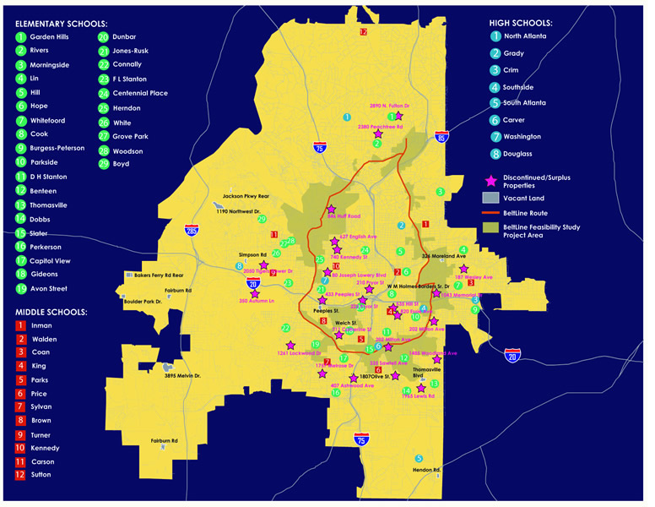
Our Resources
School Resources
State
quarterly publication for Georgia Special Education teachers. To sign up for this free newsletter, send a blank email to join-specialeducation@list.doe.k12.ga.us
District
http://www.atlantapublicschools.us/page/179
Cluster
Title 1 Collaboration - http://www.atlanta.k12.ga.us/Page/33245
School
PTSA Special Needs Committee - https://pta.org/content.cfm?ItemNumber=2100
Notes:
Here are a few of the resources that Parent Mentors use most often
One of our favorite resources is the quarterly publication for Georgia Special Education teachers. To sign up for this free newsletter, send a blank email to join-specialeducation@list.doe.k12.ga.us
External Links:
Georgia Department of Education
Georgia Department of Education Implementation Manual, forms and eligibility requirements
Georgia Department of Education
Dept. of Special Education Services and Supports Contact list
Georgia Department of Education
Teacher Resource Link
Georgia Department of Education
Family-Friendly Schools Initiative

Slide 8
Our Resources
Family Resources - Circle of Support
Identify person(s) with traits of a support person
The Rock: A person(s) who will remain in your life during difficult times and continue to love you unconditionally.
The Wise: A person(s) who will always tell the truth even when it is not what you want to hear.
The Passenger: A person(s) who will learn alongside of you.
The Helping Hand: A person(s) who understands and is aware when you may need a break and steps in to assist.
A person(s) who will always stand up for you and continue to support you.
Created by Heather Bench
Notes:
Family Resources – isolation is the number one enemy to living or supporting someone with a disability.

Slide 9
Our Appreciation
Thank you! We can be reached at :
Edith Abakare
Phone: 404-802-3607
Email: eabakare@atlanta.k12.ga.us
Rose Calloway
Phone: 404-802-2633
Email: rcalloway@atlanta.k12.ga.us
Notes:
Family Resources – isolation is the number one enemy to living or supporting someone with a disability.

