Slide 1
Youth Self Determination and Leadership : Plan. Lead. Succeed.
April Lee, Wayne County Parent Mentor
Notes:
Participant introduction with April recording their answer to this question: As a teacher I feel self-determination skills are vital for every student. I feel one skill that is extremely important for my students to learn is: ______________________________ and Why.

Slide 2
Self-Determination
All individuals have the right to direct their own lives
Increases successfulness of transition to adulthood, including employment and independence
Based on student needs and take into account student interests and preferences
NCSET
Notes:
By definition…

Slide 3
When IT’S Accomplished
person acts autonomously, regulates his or her own behavior, initiates and responds to events in a manner indicating psychological empowerment, and behaves in a manner that is self-realizing.
person acts in ways that make positive use of knowledge and understanding about his or her own characteristics, strengths, and limitations.
person is one who sets goals, makes decisions, sees options, solves problems, speaks up for himself or herself, understands what supports are needed for success, and knows how to evaluate outcomes.
NCSET
Notes:
Research based outcomes of self-determined individuals.

Slide 4
Why IT’S Important
Related to positive transition outcomes
greater number of positive adult outcomes
expressed a preference to live outside the family home, have a savings or checking account, and be employed for pay
higher likelihood of being employed and earning more per hour
NCSET
Notes:
Transition is always occurring; while in Elementary, Middle, High Schools, or Beyond. In school we are preparing them for the Beyond part of life; seeking the very best outcomes for each student based on their strengths, supports, and skills.

Slide 5
Self-determination at All Ages
Choice making
Identify strengths, interest, and learning styles
Teach youth about their disability
Listen often to children and youth
Exploration of Possibilities
Talk about future jobs, hobbies, and family lifestyles
Involve children and youth in service learning
Problem Solving
Teach problem solving skills
Hold class meetings to identify school and community problems
NCSET
Notes:
Refer to handout.
These are areas of self-determination we considered when working with students this year and preparing them for leadership roles.

Slide 6
Self-determination at All Ages
Self-Advocacy
Encourage communication
Develop opportunities for self-advocacy
Provide opportunities for leadership
Self-Esteem
Sense of belonging in school and community
Provide experiences for youth to use talents and gifts
Provide opportunities for contributing to school and community
Identify caring adult mentors
NCSET

Slide 7
Self-determination at All Ages
Goal Setting and Planning
Teach family values, priorities, and goals
Demonstrate the steps of reaching goals
Show road map including short term and long term goals
Understanding Abilities and Disabilities
Self-identity
Identify unique abilities, gifts, and talents
Explore support systems
NCSET
Notes:
Teachers may ask…”When is it possible to teach these skills in a classroom setting?”
Jay…

Slide 8
Mapping a Positive Future
Inclusive Student Leadership Program
Student, Family, and Community Engagement
Mentoring
C.A.F.E (Circle of Adults Focusing on Education)
Leadership/Self-determination Activities
Impact: Youth Leadership
Person Centered Planning
Personal MAPS Developed
Community Building with Roving
Youth in Community Summit 2013
Notes:
Our program and how each step was a building block for the next leadership opportunity.

Slide 9
Leadership Activities
Identifying Blocks to Communication pg 23
Building a Reasonable Expectation pg 29
Stress and Conflict pg 43
When the Easy Way Out Made Things Worse pg 51
Gifts Identification pg 52
Something I Did I am Proud Of pg 54
Solution Circle pg 70
Let’s Do One Together!
Coping with Anger pg 13
Notes:
Briefly describe each of the activities. A handout for each one will be at each table for participants to share.
We will then do the Coping with Anger activity as 3 groups as there are 3 scenarios on the worksheet.

Slide 10
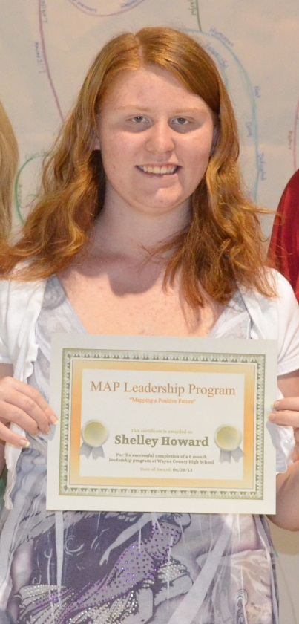
Personal MAPS
Notes:
April will talk about Person Centered Planning and the MAPS tool.

Slide 11
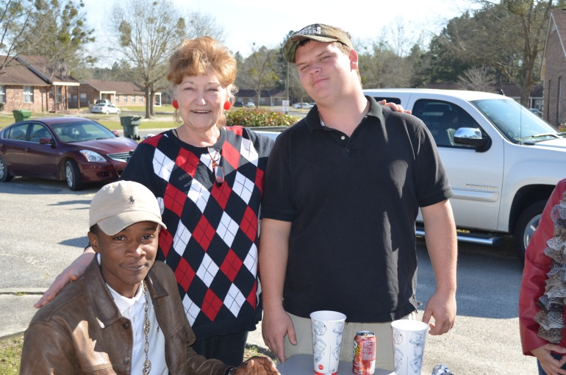
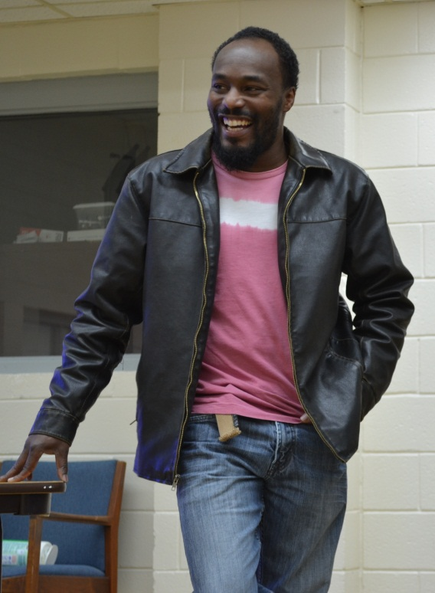
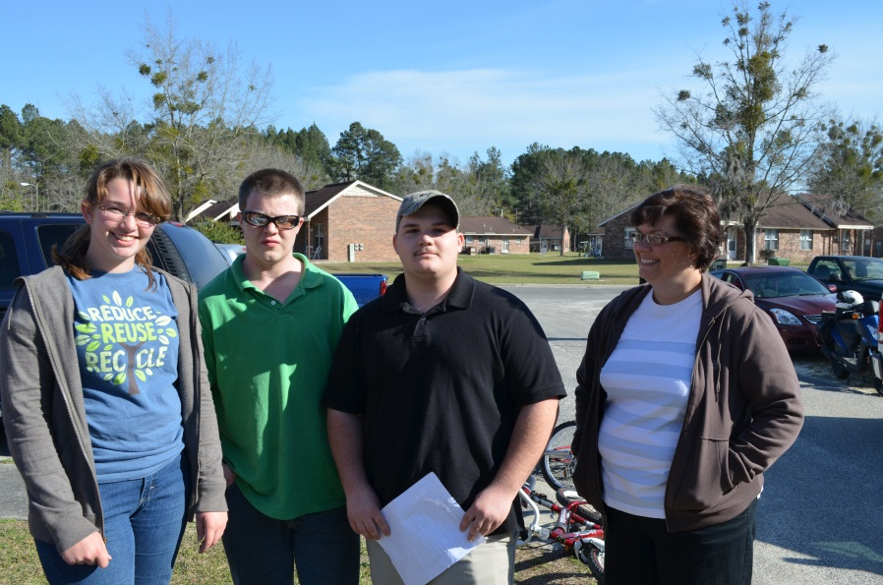
Community Building/Experiences
Notes:
April will talk about relating gift contributions and gift discovery to leadership, communication practice, and community building.

Slide 12
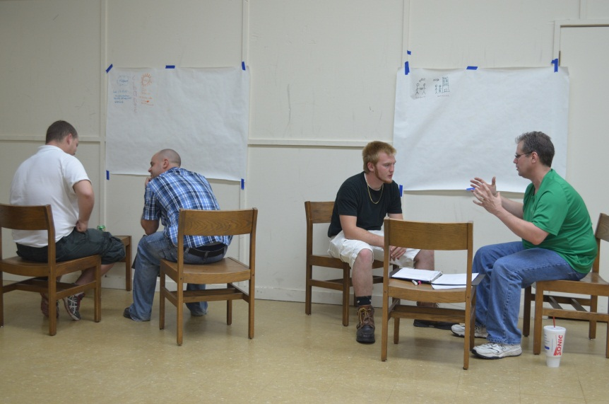
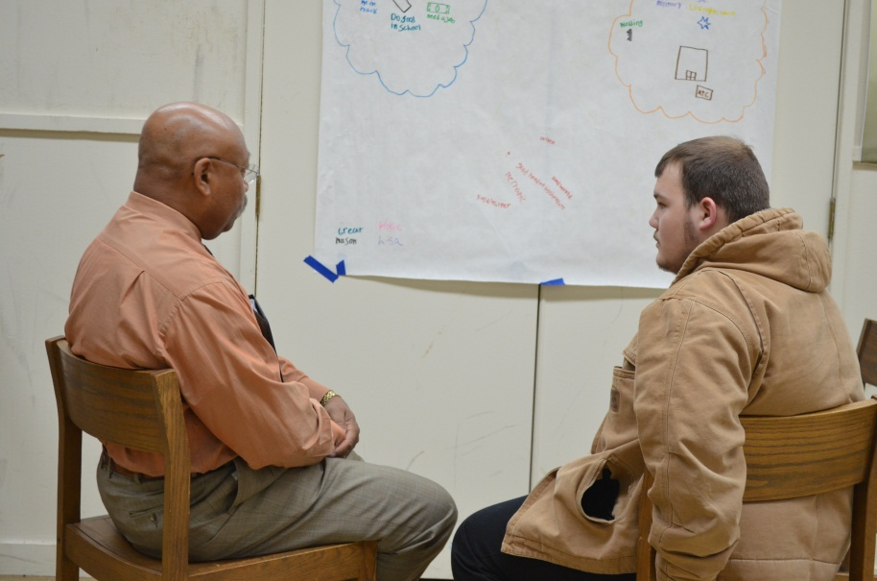
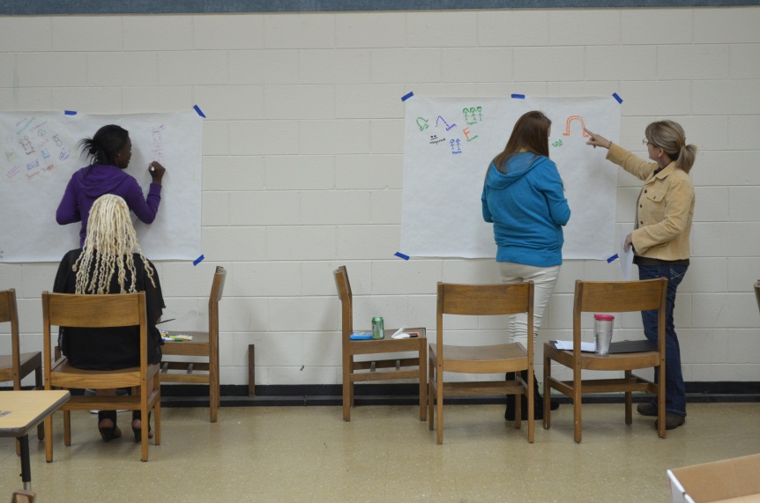
Partnerships for Success - Mentoring
Notes:
Mr. Brinson will discuss the community engagement plan of the school to include mentoring and the benefits of mentoring related to school attendance and acheivement.

Slide 13
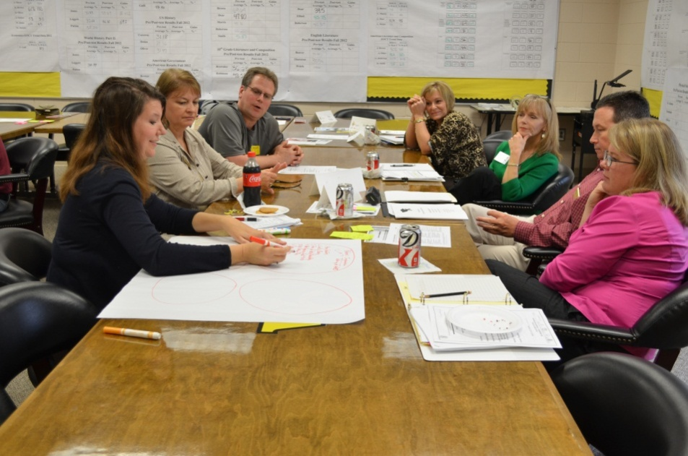
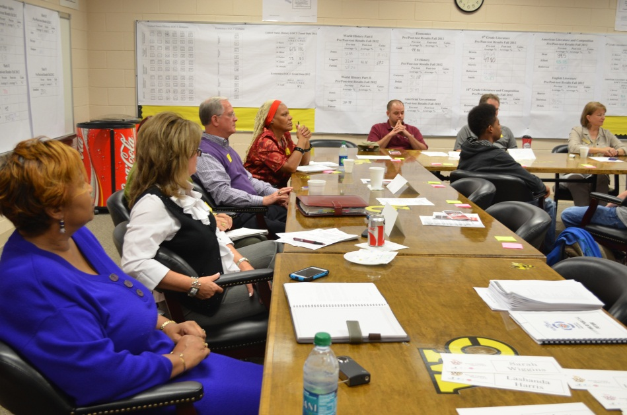
Partnerships for Success – C.A.F.E.
Notes:
Mr. Brinson: Will discuss the creation of the CAFÉ, its efforts, and the importance of partnering with families and community for student success.

Slide 14
A View by Video
Notes:
Show the video

Slide 15
Youth in Community Summit 2013
Student-led Workshops
Five Skills Taught
Goal Setting
Decision Making
Problem Solving
Gift Identification/Community Building
Dreaming Graphically
Conversation Topics
Drug/Alcohol Abuse
School Environment
Bullying
Homelessness
Work and College Readiness
Financial Planning
Notes:
April: will highlight what the YIC Summit was all about

Slide 16
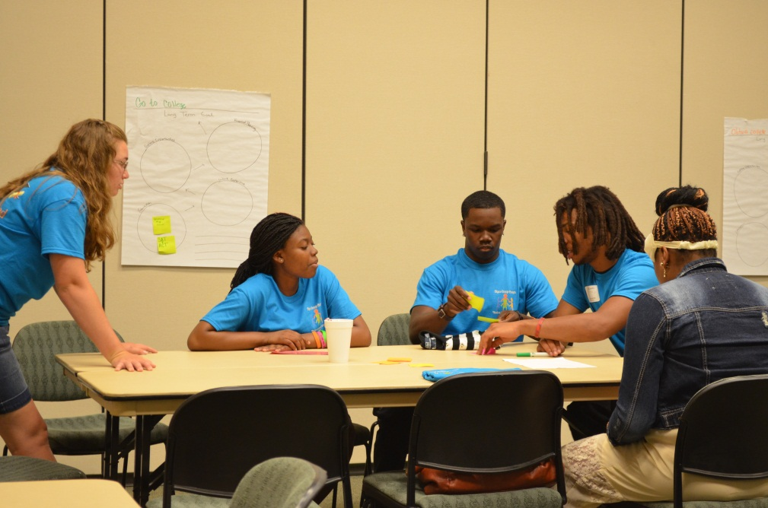
Youth in Community Summit 2013
Youth Lead Conversations Empowering Peers to Use Leadership Skills

Slide 17
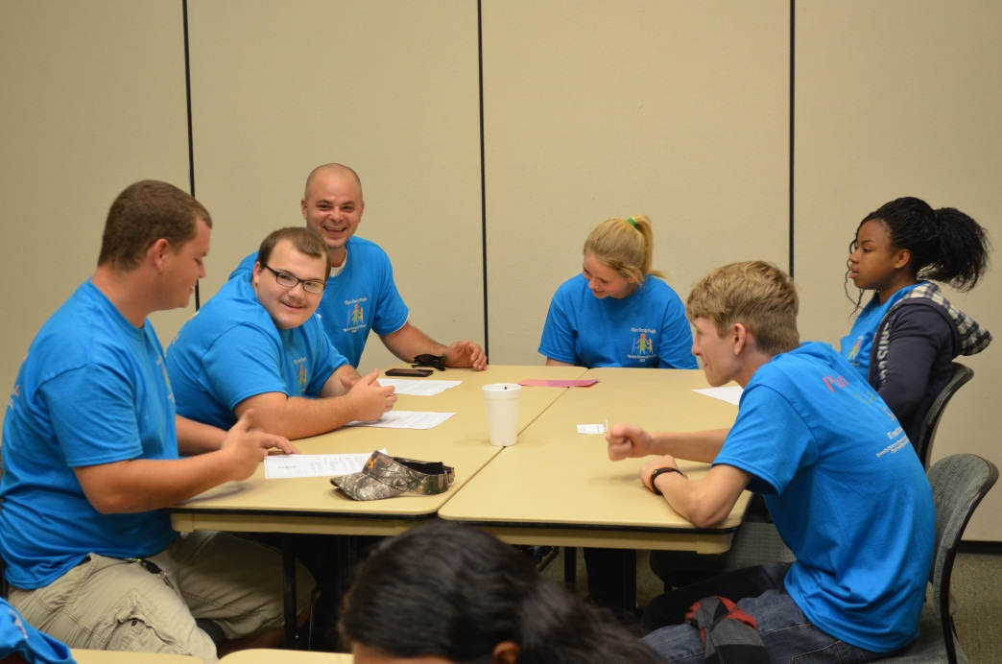
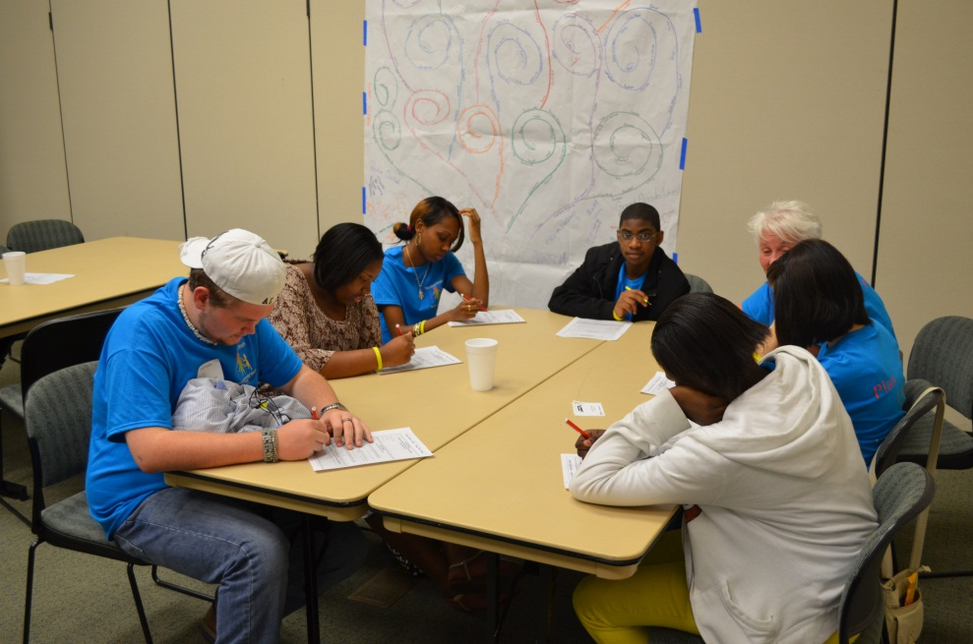
YIC Summit Sessions
Discover gifts you and your neighbor should contribute to make your community better!
Students worked independently and with a peer to look for gifts and talents meant to share.
Learning steps to making decisions,
thinking about the end and all the steps
in-between. Topics and scenarios were
related to drug and alcohol abuse and
how this impacts decision making and
future decisions.
Notes:
Introduce briefly each activity.
On the tables will be 3 copies of each of the 5 lesson plans.
These lesson plans with tools and scenarios will be available online with presentation.

Slide 18
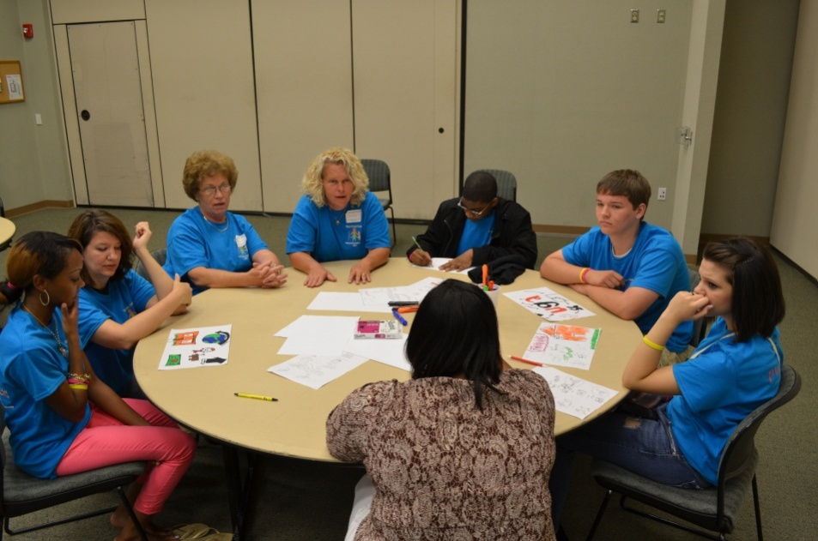
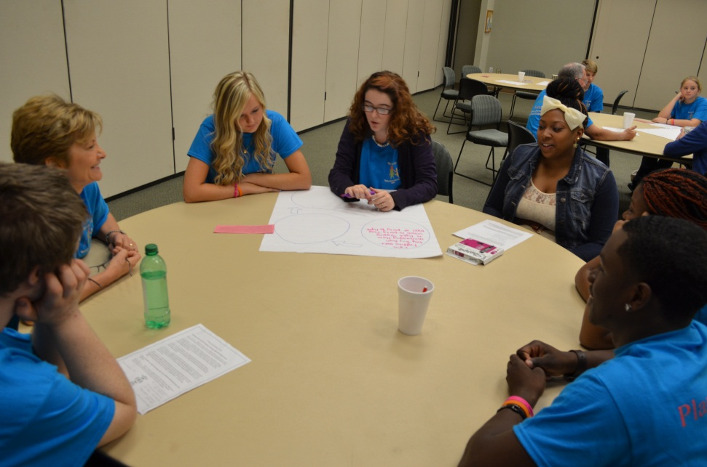
YIC Summit Sessions
Problem solving using the Solution Circle. Students worked as a support network discussing a problem related to bullying and school atmosphere issues for real solutions that students could get involved in.
Graphically recording your dream… What will your life look like when you have met your goals?

Slide 19
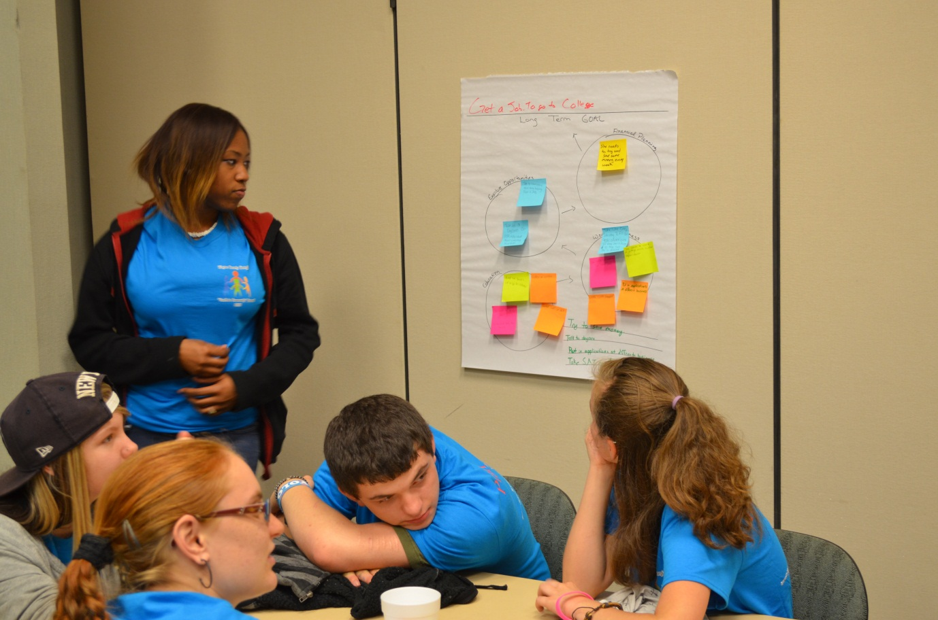
YIC Summit Session
Let’s practice Goal Setting…
Work Readiness
Financial Planning
Education
Exploring Opportunities
Notes:
Time permitting we will lead this lesson regarding Goal Setting.

Slide 20
Continuing Action
C.A.F.E. partners met to review student’s work from YIC Summit
Action steps created
Engaging student, family, and community in action next school year
Example: If students felt a step in eliminating bullying at the high school would be to have an early education program at an elementary or middle school, how could the community be involved in supporting them accomplish that program creation and implementation?
Students will review suggestions at beginning of next school year.
There will be a Youth in Community Summit 2014!!!
Notes:
Update of what has happened since YIC Summit and our hope for next year.

Slide 21
Testimonials
Students said:
“I found future planning activity helpful as it showed me a different way to look at my goals”.
“Next year I would like to work on something related to helping students not turn to drug and alcohol abuse to fill voids”.
“I think planning for your future and learning more about work is worth doing more about”.
“Goal setting is important because I have plans I want to reach”.
“Decision making is helpful skill to learn because I sometimes let my words/emotions get the best of me”.
“When I did the gift identification activity it made me realize who I am”.

Slide 22
Testimonials
Parents said:
“I see more confidence in him for himself”.
“I have seen amazing progress”.
“He has been more respectful and not as confrontational”.
“He has a will to fight for what is right and maintain a great grade point average. He finally learned how to respect himself”.
“My child has expressed goals he would like to accomplish”.
“My child is more focused on his future”.
“I have seen behavior changes”.
“He believes in himself. Started off not interested and angry, now he is more respectful and determined”.

Slide 23
Testimonials
Community Members said:
My student enjoyed hearing what others saw in her that she did not recognize as a gift”.
“He was able to explain why he has the goals/dreams that he has for his future”.
“Is using critical thinking skills to think beyond his current environment”.
“She identified her goals and wants to pursue them”.
“She not only was able to create a plan for her future but was able to identify who could support her along the way”.
“This student is a ‘born leader’ and she doesn’t realize it… but look at her with her peers, she is great!”
“Student stepped up on his own to lead his peers to the outcome we were looking for”.

Slide 24
Questions

Slide 25
Resources
The National Center on Secondary Education and Transition (NCSET). Self-Determination: Supporting Successful Transition
http://www.ncset.org/publications/viewdesc.asp?id=962
Impact Curriculum (1993) – Innerchoice Publishing, PO Box 1185, Torrance, CA. 800-662-9662
Leadership 2000 (1994) – Proed Publishishing, 8700 Shoal Creek Blvd, Austin TX. 800-897-3202

