Slide 1
When a Band-aid Isn’t Enough:
Responding to Youth in Crisis
Cheryl Benefield
Parent Mentor
Haralson County Schools

Slide 2
A Collaborative Partnership
NATIONAL COUNCIL
for Community Behavioral Healthcare
Maryland State Department of Health and Mental Hygiene
Missouri Department of Mental Health
Notes:
Developed in Australia in 2001 under the auspices of the University of Melbourne. The National Council brought it to the US in 2008 – chose it because of the research behind it. There have been several research studies in the US and it is on the National Registry of Evidence-based Programs and Practices.

Slide 3
Completing Youth Mental Health First Aid training provides you with the certification necessary to diagnose mental health issues in youth ages 12-18.

Slide 4
What Is Mental Health First Aid?
The help provided to a person developing a mental health problem or experiencing a crisis until professional treatment is received or the crisis resolves.

Slide 5
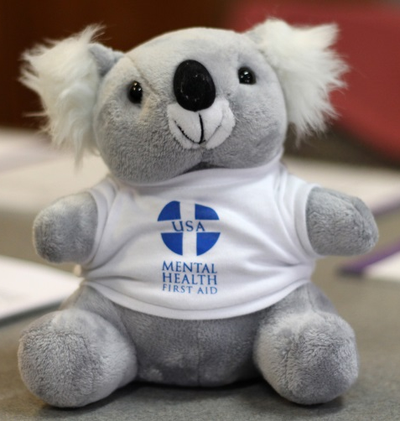
ALGEE
Assess for risk of suicide or harm
Listen nonjudgmentally
Give reassurance and information
Encourage appropriate professional help
Encourage self-help and other support strategies

Slide 6
YMHFA Objectives
To understand the prevalence of various mental health disorders impacting youth and the need for reduced stigma in communities
To recognize the warning signs of mental health problems that may impact youth, primarily those ages 12-18
To understand the risk and protective factors that can impact a youth’s mental health and resiliency
To apply a 5-step action plan encompassing the skills, resources and knowledge to assess the situation, to select and implement appropriate interventions, and to help the youth in crisis connect with appropriate evidence-based treatment and supports
Identify and access the community resources available to support youth and their families

Slide 7
Youth and young adults face and experience mental health challenges the same as adults.
Notes:
YMHFA was established because symptoms of the same mental disorders can look different in children and adults.

Slide 8
Mental health challenges are more prevalent in adults.
Notes:
ADD, ODD, CD, and other disruptive behavior disorders are likely to be more prevalent in children and young adults.

Slide 9
U.S. Youth with a Mental Disorder during Adolescence (Age 13-18)
 | Prevalence (%) | With severe impact (%)
Anxiety disorders | 31.9 | 8.3
Behavior disorders | 19.1 | 9.6
Mood disorders | 14.3 | 11.2
Substance use disorders | 11.4 | 11.4
Overall prevalence (with severe impact) |  | 27.6
3
Notes:
As many as 5% of children and 8% of adolescents in the US have depression.
Anxiety disorders are among the most common mental health challenges that occur in children and adolescents
AD/HD affects an estimated 4.1% of youth ages 9-17.
Approximately 3@ of adolescents in the US have eating disorders, including anorexia and bulimia.

Slide 10
Diversities and Differences
2000 – 86.9 million race and ethnicity other than
2010 – 111.9 million non-hispanic white
=29% growth
78% Christian – including Protestants, Catholics, and Jehovah’s Witnesses
4.7% Other – Judaism, Buddhism, Muslim, and Hinduism
16% not affiliated with any religious tradition
Differences within groups – income, age, sexual orientation, beliefs, traditions, practices
Is it the source of strength or the origin of the emotional distress?
Notes:
2010 Census – 1/3 of the US population reported race and ethnicity as something other than non-Hispanic White (i.e., minority)

Slide 11
Disparities and Disproportionalities
African Americans – more likely to experience a mental disorder, less likely to seek treatment
Asian Americans/Pacific Islanders – 25% as likely as Whites, 50% as likely as African Americans and Hispanics to seek Outpatient Care
American Indians/Alaska Natives – more depression and substance abuse
Youth – grades 7-12 who identify as lesbians, gay, or bisexual are more than twice as likely to have attempted suicide than their heterosexual peers
Notes:
AA – More likely to use the emergency room for Mental Health care, more likely than Whites to receive inpatient care
Asians – less likely to receive Inpatient care – more likely to be misdiagnosed as problem free
Aindians – Overly represented in inpatiend care compared with non-Indians and non-Natives, but not in private psychiatric hospitals

Slide 12
Scenarios and Role Play
Teacher
Coach
Youth group leader
Parent
School
Practice
Church
Scene 1
Scene 2
Scene 3

Slide 13
Jordan Burnham "Unbreakable"

Slide 14
We Get Real
2011
2013

Slide 15
What Is Youth Mental Health First Aid?
“If more people were prepared when I went into a crisis it would never have been called a crisis. It would have been a meaningful conversation about what my needs were in that moment and how the people who were closest could support me through it.”
- Brianne Masselli
Youth M.O.V.E. National
Notes:
National Technical Assistance Center at Georgetown in 2011 - Adaptation of the Mental Health First Aid manual and curriculum

Slide 16
Mental health problems are more common than heart disease.
Notes:
More common than heart disease, lung disease, and cancer combined.

Slide 17
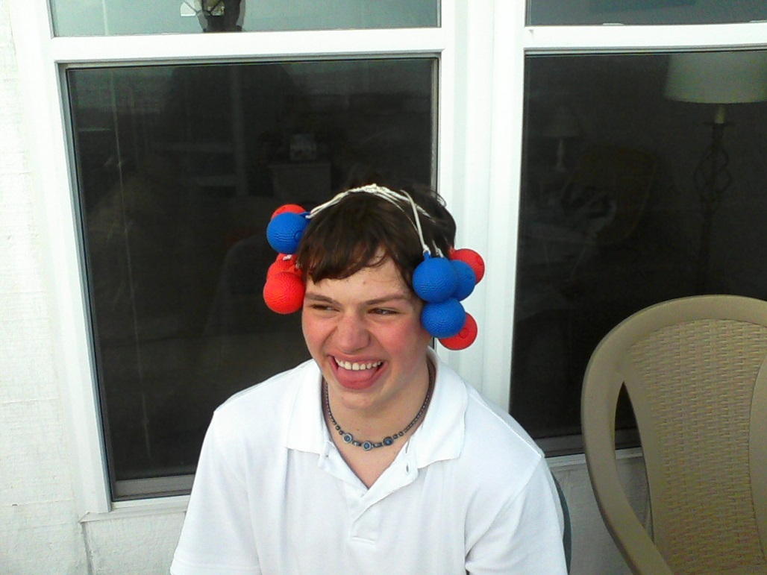
Youth Mental Health First Aid will train you to diagnose mental health issues in youth and young adults.

Slide 18
For More Information…
cheryl.benefield@haralson.k12.ga.us
Youth Mental Health First Aid
Mental Health First Aid
DBHDD Children and Adolescents Community Mental Health
DBHDD Suicide Prevention
DBHDD Substance Abuse Prevention

