Slide 1
What a Family Really Wants
Family Engagement for Success
April Lee – Wayne County Parent Mentor

Slide 2
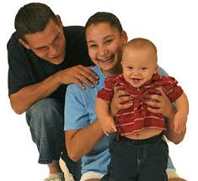
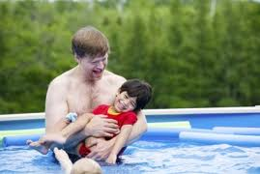
A Family…
Every family wants their child to be healthy,
Happy with opportunities for success!
When a baby is born there are both expectations and possible disappointments.
Every family wants life to be what they see in friends, families, or in the movies.
Both joy and fear revolve around tasks and duties of the day.
Same as all parents – “Have fun, be safe, and grow up to be somebody.”

Slide 3
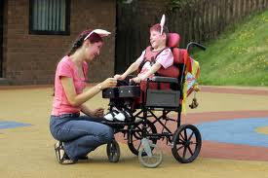
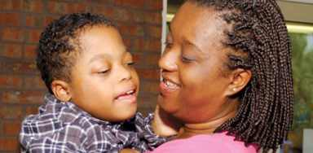
Families’ Hopes and Dreams
To be successful at whatever he chooses to do in life.
I want her to overcome any obstacle that comes her way.
To be able to speak so that her wants and needs can be voiced.
To know that she is loved.
To gain independence and confidence to be all she can be.
To live life to its fullest.
Enjoy a profession and excel.
To concentrate on herself yet be respectful and tolerate others.
To live her life to improve the world around her.
To make changes as well as to gracefully accept changes.
To develop her skills and use them accordingly.
To understand that with God all things are possible.
I don't want her to say "I can't" until she's given her best effort.
That she'll have more joys than sorrows.
May she be fortunate enough to have sincere friendship in her life.
To not be limited by what others say.
To be tolerant and compassionate.
To love and be loved by others.
Parent’s Hopes and Dreams Wall – Columbus Ohio

Slide 4
Families on Education
Some families share our value of education and others....
What about those that do not?
If that is true for the family, what about the student?

Slide 5
Falling Through the Cracks

Slide 6
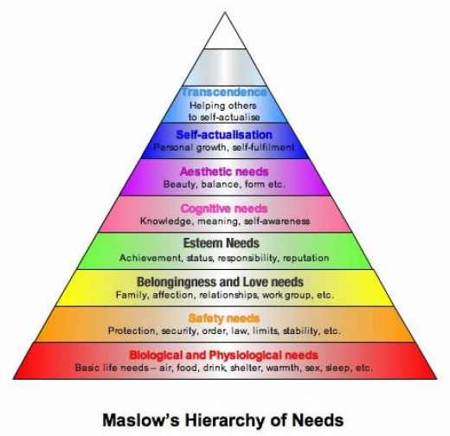

Slide 7
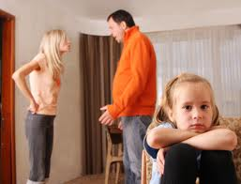

Slide 8
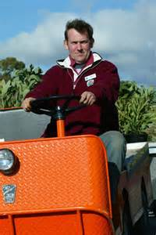
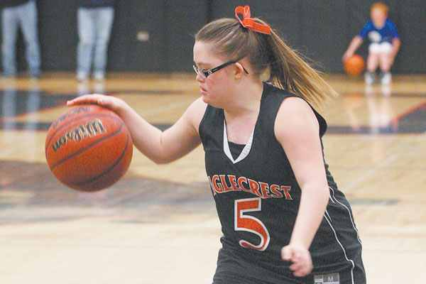
Get Set for Success
Students need:
Relevancy: leadership, social skills, work ethics, and collaboration
Choices: motivated by having a voice
Set the bar: expect more than they think they have
Role models: mentoring, peer support, and real connections
Opportunities for success: “feel of victory”
Part of a whole: belonging and service to others
Teach how to learn: individual and group activities

Slide 9
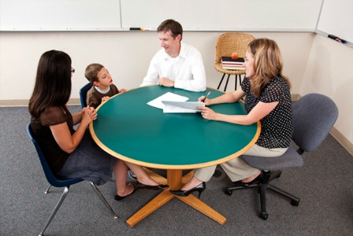
Improved Communication
More negative than positive leads to the opposite involvement.
Get ideas for at home conversations and support.
Building confidence and appreciation for education.
Students motivated to learn, improved behavior and attendance, and positive attitudes.
Teachers learn about needs and home for better support.
With:
Home Visits
Homework Helps
Workshops
Website Helps
Newsletters
Resource Share

Slide 10
Awareness of Needs and Resources
Be culturally aware of families.
Build relationships with families and students to identify needs and supports.
Parents are part of the solution, not part of the problem.
Move away from deficit based thinking toward asset based thinking.
Share resources and make connections that will support success.

Slide 11
Go for the Supports
Participation
Find common ground with success of child as goal
Positive Contacts
Not just a phone call but purposeful connections
Share Feedback
Expectations, resources, and checkpoints
Share Understanding
What is new and how it may apply

Slide 12
What Parents Say
About Mapping a Positive Future
“I see more confidence in him for himself”.
“I have seen amazing progress”.
“He has been more respectful and not as confrontational”.
“He has a will to fight for what is right and maintain a great grade point average. He finally learned how to respect himself”.
“My child has expressed goals he would like to accomplish”.
“My child is more focused on his future”.
“I have seen behavior changes”.
“He believes in himself. Started off not interested and angry, now he is more respectful and determined”.

Slide 13
Resources
Columbus Parent: Parents share hopes, dreams for children @ http://www.columbusparent.com/content/stories/2008/08/30/cp_rs_education_edge.html
Student Motivations and Attitudes by Karin Kirk @ http://serc.carleton.edu/NAGTWorkshops/affective/motivation.html
Building Parent-Teacher Relationships by American Federation of Teachers @ http://www.readingrockets.org/article/19308/

Slide 14
April Lee Wayne County Parent Mentor alee@wayne.k12.ga.us

