Slide 1
Embracing Positive Behavioral Interventions and Support (PBIS)
Presented by: Shannon hammond
Notes:
Welcome everyone to Day 1 of PBIS training. The next couple of days will be packed with information and activities. We hope you enjoy the beginning of the journey.

Slide 2
Welcome!
Who is here?
  Parent Mentors
  Administrators
  Counselors
  School Psychologists
  Teachers
  Speech Language Pathologists

Slide 3
Agenda
Overview of Positive Behavior Interventions and Support (PBIS)
Engaging Parents in PBIS
Resources

Slide 4
Learning Objectives
Participants will…
  understand the basic principles of PBIS and how families can play a positive role within their student’s school
  have knowledge about the PBIS resources

Slide 5
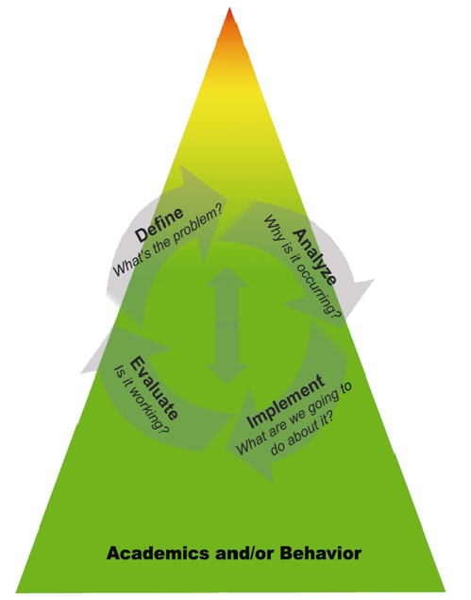
Tiered System of Supports
ACADEMIC and BEHAVIOR SYSTEMS
Tier 3/4: Intensive, Individualized
Interventions & Supports/SST
The most intense instruction and intervention based
on individual student need, in addition to and
aligned with Tier 1 & 2 academic and behavior
instruction and supports.
Tier 2: Targeted, Supplemental
Interventions & Supports
More targeted instruction/intervention and supplemental support, in addition to and aligned with the core academic and behavior curriculum.
Tier 1: Core, Universal
Instruction & Supports
General academic and behavior instruction and support provided to all students in all settings.
Notes:
5
5

Slide 6
What is “PBIS?”
Science
Values
Practices that work
Practices that impact quality of life
PBIS
Vision
Practices that are doable, durable and available
Notes:
What is PBS, anyway? It’s not a program, it’s a process that relies on science, values, and vision. There is no “ONE intervention;” it’s how school personnel approach student behavior and citizenship.

Slide 7
Positive Behavioral Interventions and Support…
Aims to build effective environments in which positive behavior is more effective than problem behavior
Is a collaborative, assessment-based approach to developing effective interventions for problem behavior
Emphasizes the use of preventative, teaching, and reinforcement-based strategies to achieve meaningful and durable behavior and lifestyle outcomes
Notes:
PBIS is not..
A quick fix to complex problems
A packaged program
A reinforcement system only
Discipline that does not include consequences for misbehavior
Classroom management only
New
Unique to Georgia

Slide 8
PBIS is NOT…
A quick fix to complex problems
A packaged program
A reinforcement system only
Discipline that does not include consequences for misbehavior
Classroom management only
New
Unique to Georgia

Slide 9
Supporting Social Competence &
Academic Achievement
OUTCOMES
Supporting
Staff Behavior
SYSTEMS
DATA
Supporting
Decision
Making
PRACTICES
PBIS Integrated
Elements
Supporting
Student Behavior

Slide 10
Why PBiS?
Over 19,000 schools across the country and almost 400 in Georgia are implementing PBIS because:
  It can be adapted to fit your particular school
  It can coexist with most school-wide programs (Character Counts, etc.)
  It is consistent with research-based principles of behavior
  It is the intervention of choice in federal legislation
Notes:
This slide answers the question: Why tier 1 PBS and not something else?

Slide 11
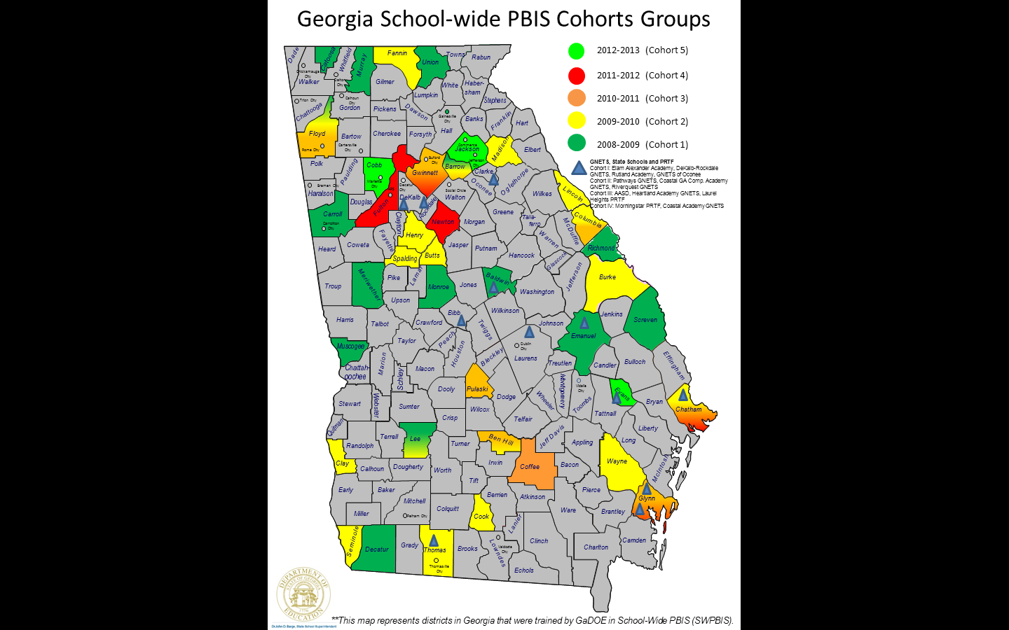
Since 2008, 29% of Georgia’s LEA’s, including 400 schools/programs, have been trained by the GaDOE PBIS Unit in School-wide Positive Behavior Supports.

Slide 12
What will you see in a
PBIS school?
The school develops and uses school-wide Expectations & Rules in settings across campus to teach students appropriate behavior.
Discipline referral Processes & Procedures are consistent throughout the school.
Data are used to help track progress and identify areas to target for intervention.
Notes:
If the school-wide setting becomes more positive, predictable, preventive,…that is, a positive school-wide climate is established, the likelihood of achieving these outcomes is high.
Of course, the real question is how to create durable school environments that enable a positive school climate that maximizes achievement of these features?
We’ve talked about district level commitment but here is what PBIS actually looks like in the individual schools. Some people have tried to describe PBIS as merely rewarding students for “doing what they’re expected to do”. Notice that consequences are a part of PBS and it is the consistency among all students and staff that is different.
Also discuss the fact that change does not occur within a vacuum. Change takes time, and the critical elements of PBIS will help develop a more positive and proactive environment but it is not a “magical pill.” Change takes the effort of all school stakeholders, who place emphasis on the importance of data-based decision-making, evidence based practices, and on-going staff development and support to support the needs of all students.
Another important element to discuss is the administrative support. Educational leaders must strive to lead and support development of sustainable and positive school climates.

Slide 13
What will you see in a
PBIS school?
An Acknowledgement System is used to encourage and model appropriate behavior.
Effective Consequences are developed and used to discourage inappropriate behavior.
Teaching of appropriate behavior.
Notes:
If the school-wide setting becomes more positive, predictable, preventive,…that is, a positive school-wide climate is established, the likelihood of achieving these outcomes is high.
Of course, the real question is how to create durable school environments that enable a positive school climate that maximizes achievement of these features?
We’ve talked about district level commitment but here is what PBIS actually looks like in the individual schools. Some people have tried to describe PBIS as merely rewarding students for “doing what they’re expected to do”. Notice that consequences are a part of PBS and it is the consistency among all students and staff that is different.
Also discuss the fact that change does not occur within a vacuum. Change takes time, and the critical elements of PBIS will help develop a more positive and proactive environment but it is not a “magical pill.” Change takes the effort of all school stakeholders, who place emphasis on the importance of data-based decision-making, evidence based practices, and on-going staff development and support to support the needs of all students.
Another important element to discuss is the administrative support. Educational leaders must strive to lead and support development of sustainable and positive school climates.

Slide 14

Grace Snell Middle-Gwinnett County
Notes:
Gladden Middle School in Murray County

Slide 15
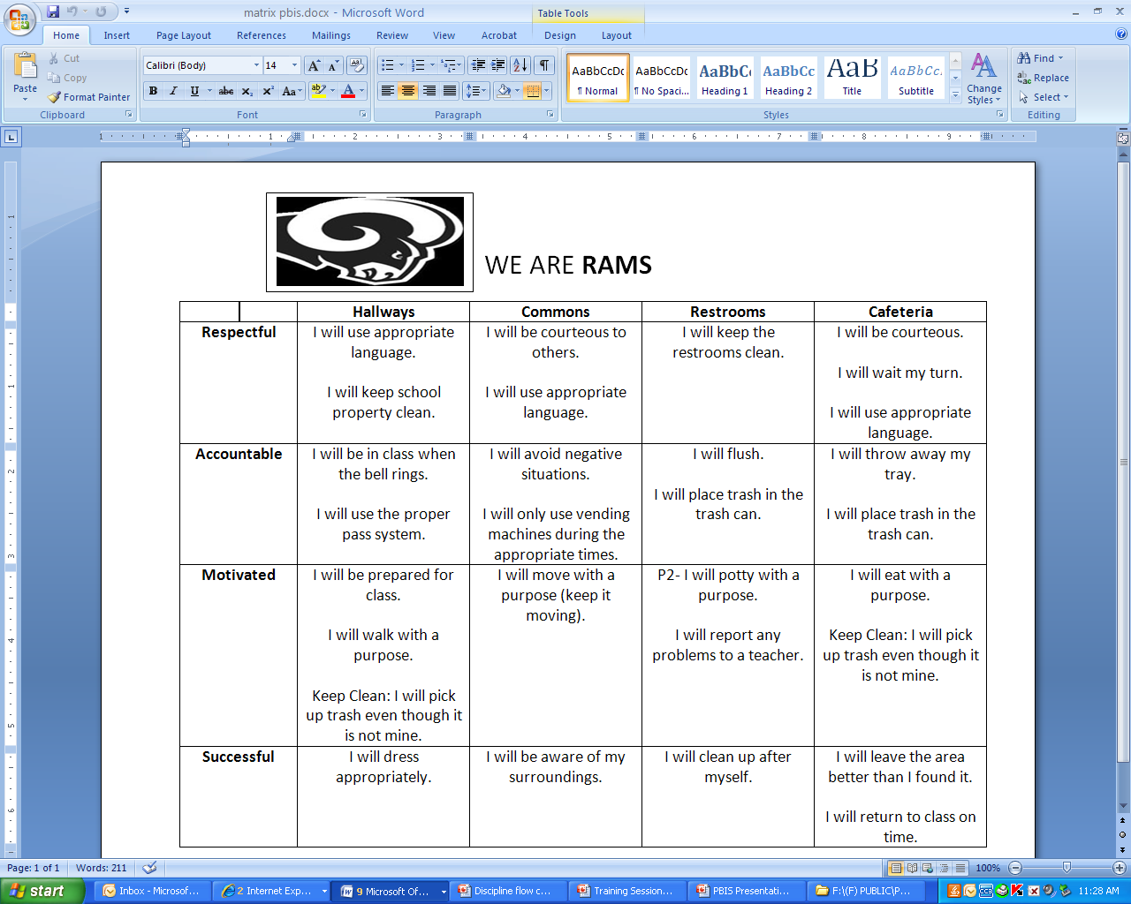

Slide 16
GNETS of Oconee
Expectations | I am Respectful | I am Responsible | I care about Others
Classroom | I use kind language and quiet voice tone I wear my school uniform I follow classroom procedures | I follow directions given by adults I complete assignments I use materials properly | I work cooperatively with others I help my peers
Hallway | I am quiet in the hall I keep hands and feet to myself I admire hallway displays | I stay in my assigned area I walk on the right side of hall I keep hallways neat and clean
Restroom | I keep the restroom clean I keep my hands to myself | I use toilets/urinals correctly I flush ☺ I adjust my uniform to dress code | I give others privacy I wash and dry my hands after use
Lunchroom | I stand quietly in line I speak in a soft voice when seated I use good manners | I clean up my area I bring all items and money needed for lunch | I keep my hands and feet to myself
Recess/ Outside | I use encouraging and kind words I accept feedback without arguing or complaining | I follow directions given by adults I share and use equipment appropriately I stay in my designated area | I take turns and cooperate I play fairly I include others I use my hands and feet appropriately
Notes:
Example of a behavior matrix

Slide 17

Acknowledging Appropriate Behavior
Tied to specific behaviors
Delivered soon after the behavior
Age appropriate (actually valued by student)
Delivered frequently
Gradually faded away

Slide 18
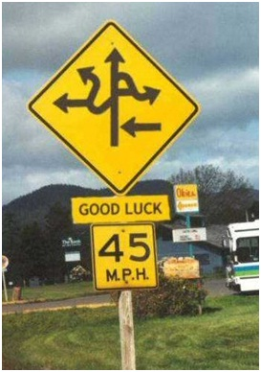
Effective Discipline Procedures
Consistent definitions of specific behaviors
Classroom-managed vs. office-managed
Alternatives to exclusion
Effective consequences and interventions (considering function)
Develop a process to build consistent responses

Slide 19
How does a PBIS school engage families?
Provide PBIS information
  Open house, registration, brochures, web-sites, PBIS newsletter, new parent orientation
Share PBIS principles and strategies
  Develop PBIS videos for parents, PTA meetings, parent conferences
Provide parent education
  Extending PBIS expectations into the home
Decision Making
  Invite parents to join PBIS Team, Local School Council, PTA
Notes:
This is what we train our schools to do

Slide 20
What should families expect from
School-wide PBIS?
Opportunities to provide feedback and input on School-wide PBIS practices (e.g., expectations, reward system, discipline procedures)
Information and updates on School-wide behavior data
Clearly stated and defined expectations and rules that are taught to all students
Administration (Principal, AP) participation in PBIS implementation and encouragement for family and community member participation
Notes:
Use this slide to clarify what parents can expect as a result of Tier 1 PBS implementation.
Note: you may need to refresh parents on what Tier 1 PBS implementation includes (all students, staff, and families; all settings; expectations and rules; preventing problematic behaviors and teaching and reinforcing appropriate behaviors).

Slide 21
How can families engage in
School-wide PBIS….
Know the school’s School-wide expectations.
Reinforce the School-wide expectations at home.
Demonstrate the School-wide expectations when attending the school or interacting with others from the school.
Notes:
***Be sure these practices align with your school’s vision for family engagement in PBS** Add or edit family engagement behaviors listed to reflect your school

Slide 22
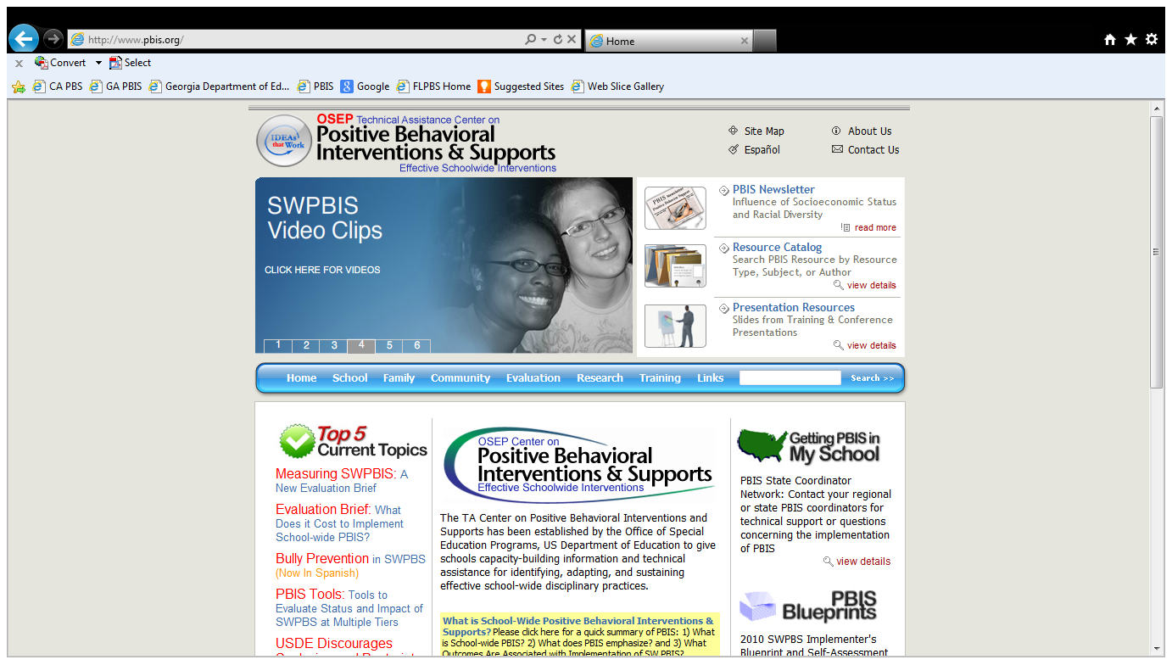
www.PBIS.org

Slide 23
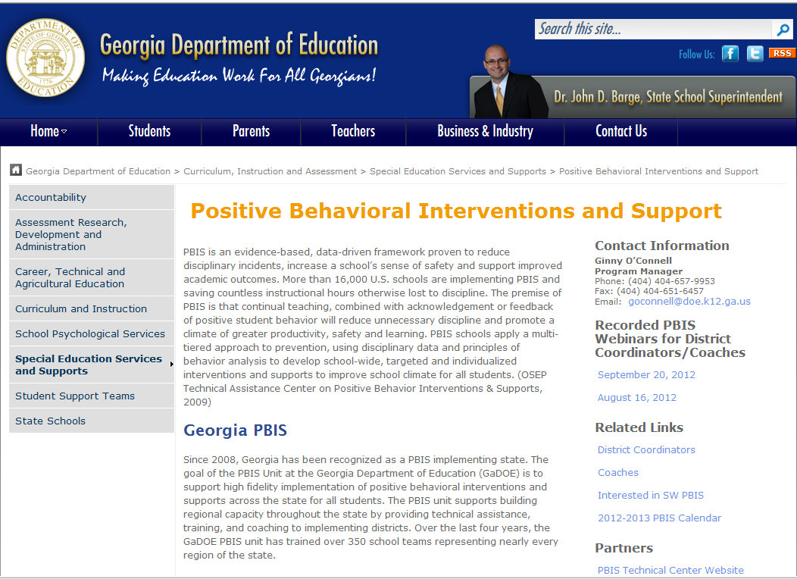

Slide 24
Resources and References
Sugai, G., Horner, R. H., Dunlap, G. Hieneman, M., Lewis, T. J., Nelson, C. M., Scott, T., Liaupsin, C., Sailor, W., Turnbull, A. P., Turnbull, H. R., III, Wickham, D. Reuf, M., & Wilcox, B. (2000). Applying positive behavioral support and functional behavioral assessment in schools. Journal of Positive Behavioral Interventions, 2, 131-143.
Sugai, G and Simonsen, B. (2012). Positive Behavior Interventions and Supports: History, Defining Features, and Misconceptions, www.pbis.org.
www.modelprogram.com
www.flpbs.fmhi.usf.edu
www.challengingbehavior.org

