Slide 1

ENCORE:
The Road Trip of Lifetime!
Supporting Georgia families of children
with disabilities & special healthcare needs

Slide 2


Who we are . . .
We are Georgia’s Parent Training and Information Center (PTI) – providing information to families so that they can be equal partners in the educational decision-making process.
We are Georgia’s Family to Family Health Information Center (F2F) – providing information to families so they can make better health-related decisions.
We are the Central Directory for Georgia’s Babies Can’t Wait (Part C) Program - assisting families of children in need of early intervention services with information and resources.
We are the State Affiliate of Parent to Parent USA – providing research-based best practice emotional support.
Notes:
P2P is a state wide organization! We have offices, staff, and volunteers across the state. Families can call us toll-free from anywhere in Georgia. We serve ALL disabilities and ALL special health care needs. We offer assistance to any parent or individual no matter how rare the diagnosis or how difficult the situation.
As Georgia’s Parent Training and Information Center, we work to make sure that families get training and information on their rights, responsibilities, and protections under the Federal Law called IDEA or the Individuals with Disabilities in Education Act. Every state is required to have a Parent Training Information Center (PTI). The school is responsible for educating children and we are responsible for educating parents.
Georgia’s health system is hard to figure out! Our Family to Family Health Information Center provides health information, training and support to families of children with special health care needs. We have information about services, resources and projects available to families across the state.
As the Central Directory for Babies Can’t Wait, the organization responsible for serving families of children from birth to 3 with special needs, we help families throughout the state of Georgia get connected with the BCW Coordinator assigned to their resident county. And we maintain a database of resources specifically for parents of children with special needs. We’ll talk more about this later in the presentation.
And as the State Affiliate of Parent to Parent USA, we help legitimize that emotional support is critical to families!
So, now that you know “Who We Are,” let’s talk about “What We Do” and what these services look like for families.

Slide 3
7 Core Services
Special Needs Database
Roadmap to Success
Supporting Parents
One-On-One Assistance
Navigator Project
Free Trainings
On-Line Opportunities
Notes:
As I mentioned earlier, we want parents to know that they have choices. P2P offers families choices about how they can get connected with our services. Some people like to talk with another person over the phone. Others prefer to surf the web or attend a group training. Parents can choose what works best for them.
Regardless of how people reach us, here’s an list of all the services we offer to help families build their capacity and empower them to effectively advocate for the needs of their child. Let’s take a closer look at each of these services. Let’s start with the P2P Special Needs Database….

Slide 4
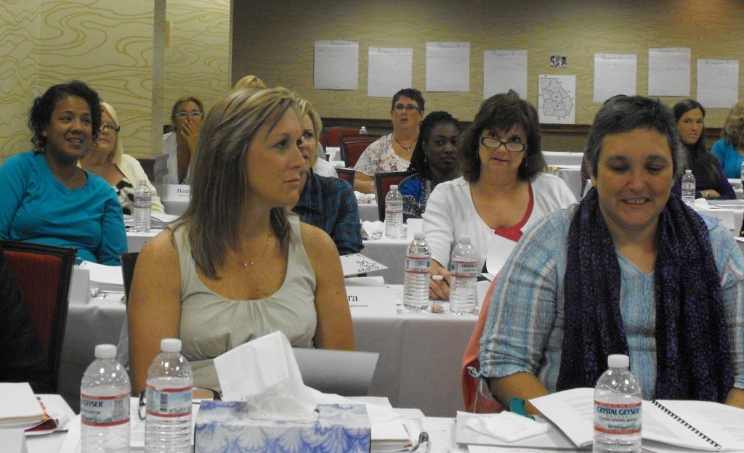
6. Free Trainings
Just pick up the phone and our trainers can come to you!
P2P Provides
The trainer/trainers
Full curriculum including PowerPoint and handouts
Fliers for the host to use
Advertising on our calendar of events
Call Toll Free 1-800-229-2038
Notes:
Did you know we provide 2- and 4- hour trainings on a variety of topics? All of our trainings are FREE of charge to parents and available in many languages. They are also offered anywhere in the state!
We continue to develop new curriculum for parents, and we update existing curriculum as information changes. Visit the training calendar on our website to see what is coming to your area. Register for our email list that sends out information monthly about the trainings and webinars that are occurring close to you. Trainings are listed by county, but families can attend any training regardless of the county they live in!

Slide 5
P2P Trainings…2-hour sessions
Education
A Brief Overview of Special Education
Parental Rights
Effective Communication
Inclusion in Schools
Transitions
Transition at Age 3
Transition from High School
Keys to Help Your Teen Get A First Job
Health Care
Medicaid and Home and Community-Based Services
Medicaid and Care Management Organizations (CMOs)
Transition to Adult Healthcare
Assistive Technology
Assistive Technology for Youth
Assistive Technology for Young Children
Notes:
Note to Presenter:
DO NOT READ each presentation title. This is meant to move quickly.
Some of our foundation courses focus on Education. Parents can learn about their rights under the IDEA, learn how to navigate the special education system and effectively advocate for their children.
We also have trainings that focus on Health Care. As you know, navigating Georgia’s health care systems can be complicated. These trainings provide basic information to help you understand the system and programs that may be available to you.
Note to Presenter:
Depending on time, you may choose to highlight one or two trainings. Which trainings you choose would depend on your audience. For example, if you are talking to parents of young children who are in Babies Can’t Wait, you may want to highlight the “Movin Up: Transition at Age 3” training. If you have parents of high school kids, you may choose “Transition from High School” or “Transition to Adult Healthcare.”
Depending upon your audience, it may be appropriate to also share this:
For those of you who might work with Babies Can’t Wait, several of our training topics have been approved for Babies Can’t Wait continuing education credit hours, so we can help you get the training you need for your job too!

Slide 6
P2P Trainings…other options
Interactive 4-hr Workshops
Understanding the School Discipline Process
Focusing on a Vision and Strengths to Get to Measurable Goals
Dream Bigger, Aim Higher: Empowerment from Infancy to Adulthood
Webinars
Topical Sessions on a wide variety of topics taught by professionals in the field
Parenting Sessions with parents who share their experiences
Notes:
Most of our trainings are geared towards parents, but we do have an 8-module course devoted to helping prepare youth for the future. It’s called ENCORE! ENCORE:
Helps high school students, including those with disabilities, begin to prepare for their future
Gives students skills and tools they will need to advocate for themselves
Was designed by and with young adults with disabilities.
Is interactive and offers activity-based learning
Can be offered during school, after school, or on weekends
In addition to classroom trainings, we also offer on-line classes called webinars. We have 1 hour webinars that are presented by subject matter experts. The live webinars are interactive with participants asking questions through a “chat box” or microphone on their computer. Some of the topics we have offered have included “Emergency Preparedness” and “Tax Preparation.” We also offer 30 minute webinars that are presented by parents for parents of children with disabilities and special healthcare needs. The topics for those webinars are focused on parenting challenges….like handling resentment between siblings or talking to your child about his disability.
Webinars are uploaded to our website several weeks after the original presentation so that families can re-watch the presentation or share it with others who could not attend. You can view & access our archived webinars by clicking on Education Tab on our website’s home page.

Slide 7
TRAINING FOR YOUTH
ENCORE! Planning the Road Trip of a Lifetime!
An 8 module series designed by young adults with disabilities.
Helps students begin to prepare for their future after high school.
Co-taught by an adult and youth with a disability.

Slide 8
TRAINING FOR YOUTH
ENCORE!
Helps high school students, including those with disabilities, begin to prepare for their future
Gives students skills and tools they will need to advocate for themselves
Was designed by and with young adults with disabilities.
Is interactive and offers activity-based learning
Can be offered during school, after school, or on weekends
.

Slide 9
ENCORE: PLANNING THE ROAD TRIP OF A LIFETIME!
ENCORE! is a series of interactive modules for high school students. The goal of this project is to think about your goals and dreams for life after high school. Sessions will cover topics that include thinking about your skills, talents, and passions. Students will discuss options for the future such as going to college, getting a job, types of employment, living away from home and the tools you need to make these goals a reality. Students will explore self-awareness, self-advocacy, self-confidence and other ways to gain greater decision-making and independence skills. Activities will include filling out job applications, making a resume, spending money wisely and preparing for a job interview.

Slide 10
8 MODULE CURRICULUM OUTLINE
Who’s Ready for a roadtrip?
What’s in your bag?
What else will you need for the trip?
What’s the plan?
Do you need more school?
Do you want to go straight to work?
Every traveler needs spending money!
Who’s driving this car anyway?

Slide 11
LOCATIONS HOSTING ENCORE!
Bulloch County
Atlanta Public Schools
Candler County
South DeKalb County
North Fulton County
Dodge County
South Fulton County
Gwinnett County
Thomas County

Slide 12

PRESENTS A FREE TRAINING
Encore: Planning the
Road Trip of a Lifetime!
Saturday, May 4, 2013
and
Saturday, May 11, 2013
10:00 am – 2:00 pm
Professional Learning
Center PLC
Thomas County School
200 N. Pinetree Blvd.
Thomasville, GA 31792

Slide 13
Parent Letter
September 2013
Dear Parent,
Parent to Parent of Georgia is very excited to be bringing our self-advocacy project to the families in your community for your high school or middle school student very soon. We want to thank you for your interest and hope you will allow your student to participate in “ENCORE: Planning the Road Trip of a Lifetime.” We ask that you make sure your student comes to all ENCORE! sessions so they can get the full benefit of these interactive modules designed to talk about life after high school. Every student will get a folder with all the ENCORE slides and handouts. We encourage you to review this folder and talk to the student about the materials. At the end of the eight ENCORE! sessions each student will get a Certificate of Participation.
Sincerely,
Robin Blount
Education Services Director

Slide 14

. . .
Keys to Help Your Teen Get A First Job
This training will focus on the employer’s perspective on hiring and employing individuals with disabilities, the current employment outlook for people with disabilities, workplace accommodations and practical tips for families to help their
teen get a job.
Date: Thursday, May 9, 2013
Time: 5:30 – 7:30 PM
Location: Thomas County School Board
200 North Pinetree Boulevard, PLC Bldg.
Thomasville, GA 31792
For more information, please contact Eloise Wells at 229-977-5026 or Candy Delaney at 229-403-2671.
Or call Parent to Parent at 1-800-229-2038.

Slide 15
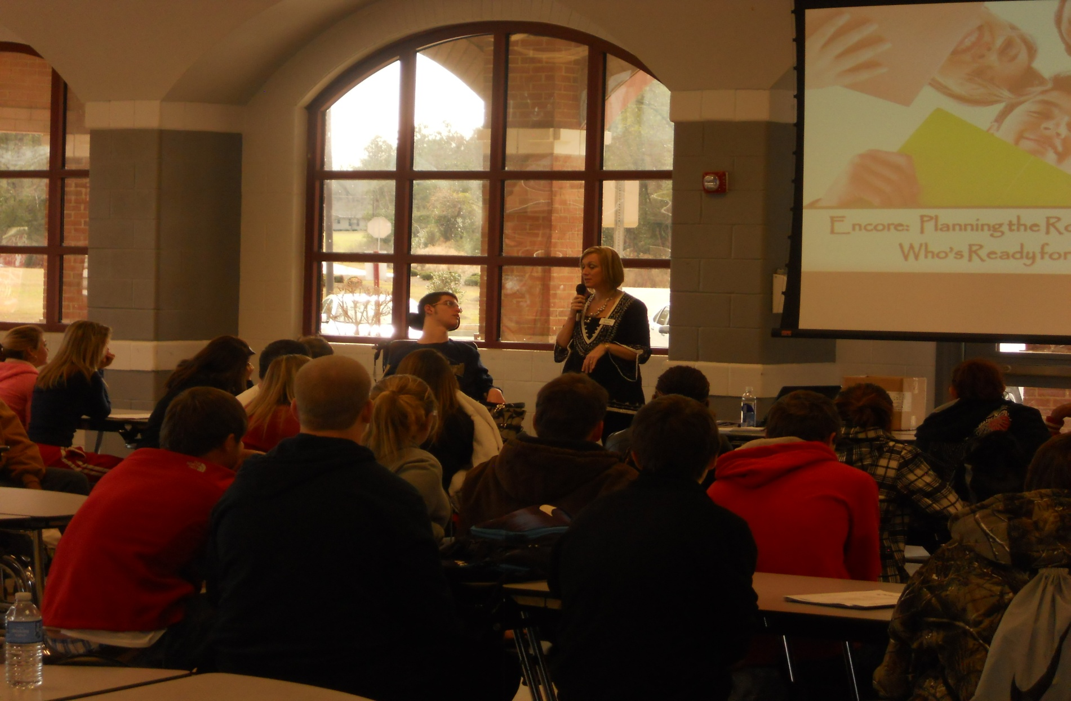

Slide 16
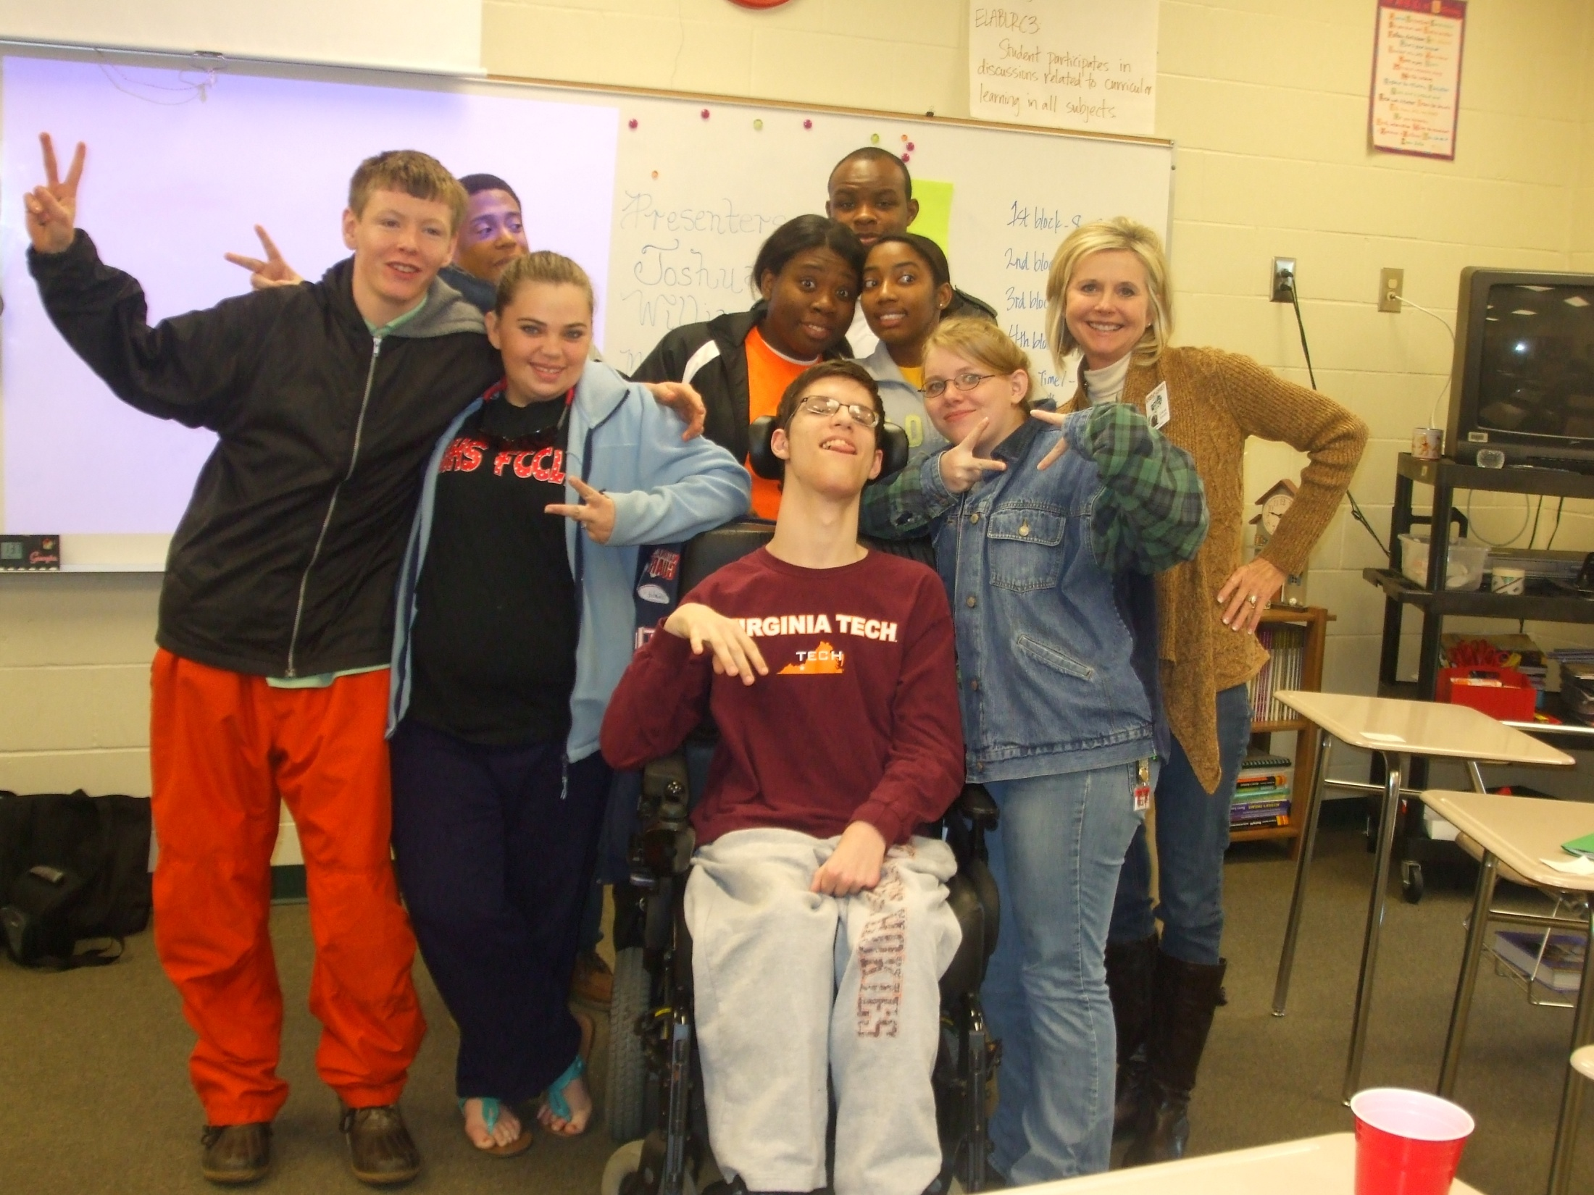
. . .

Slide 17
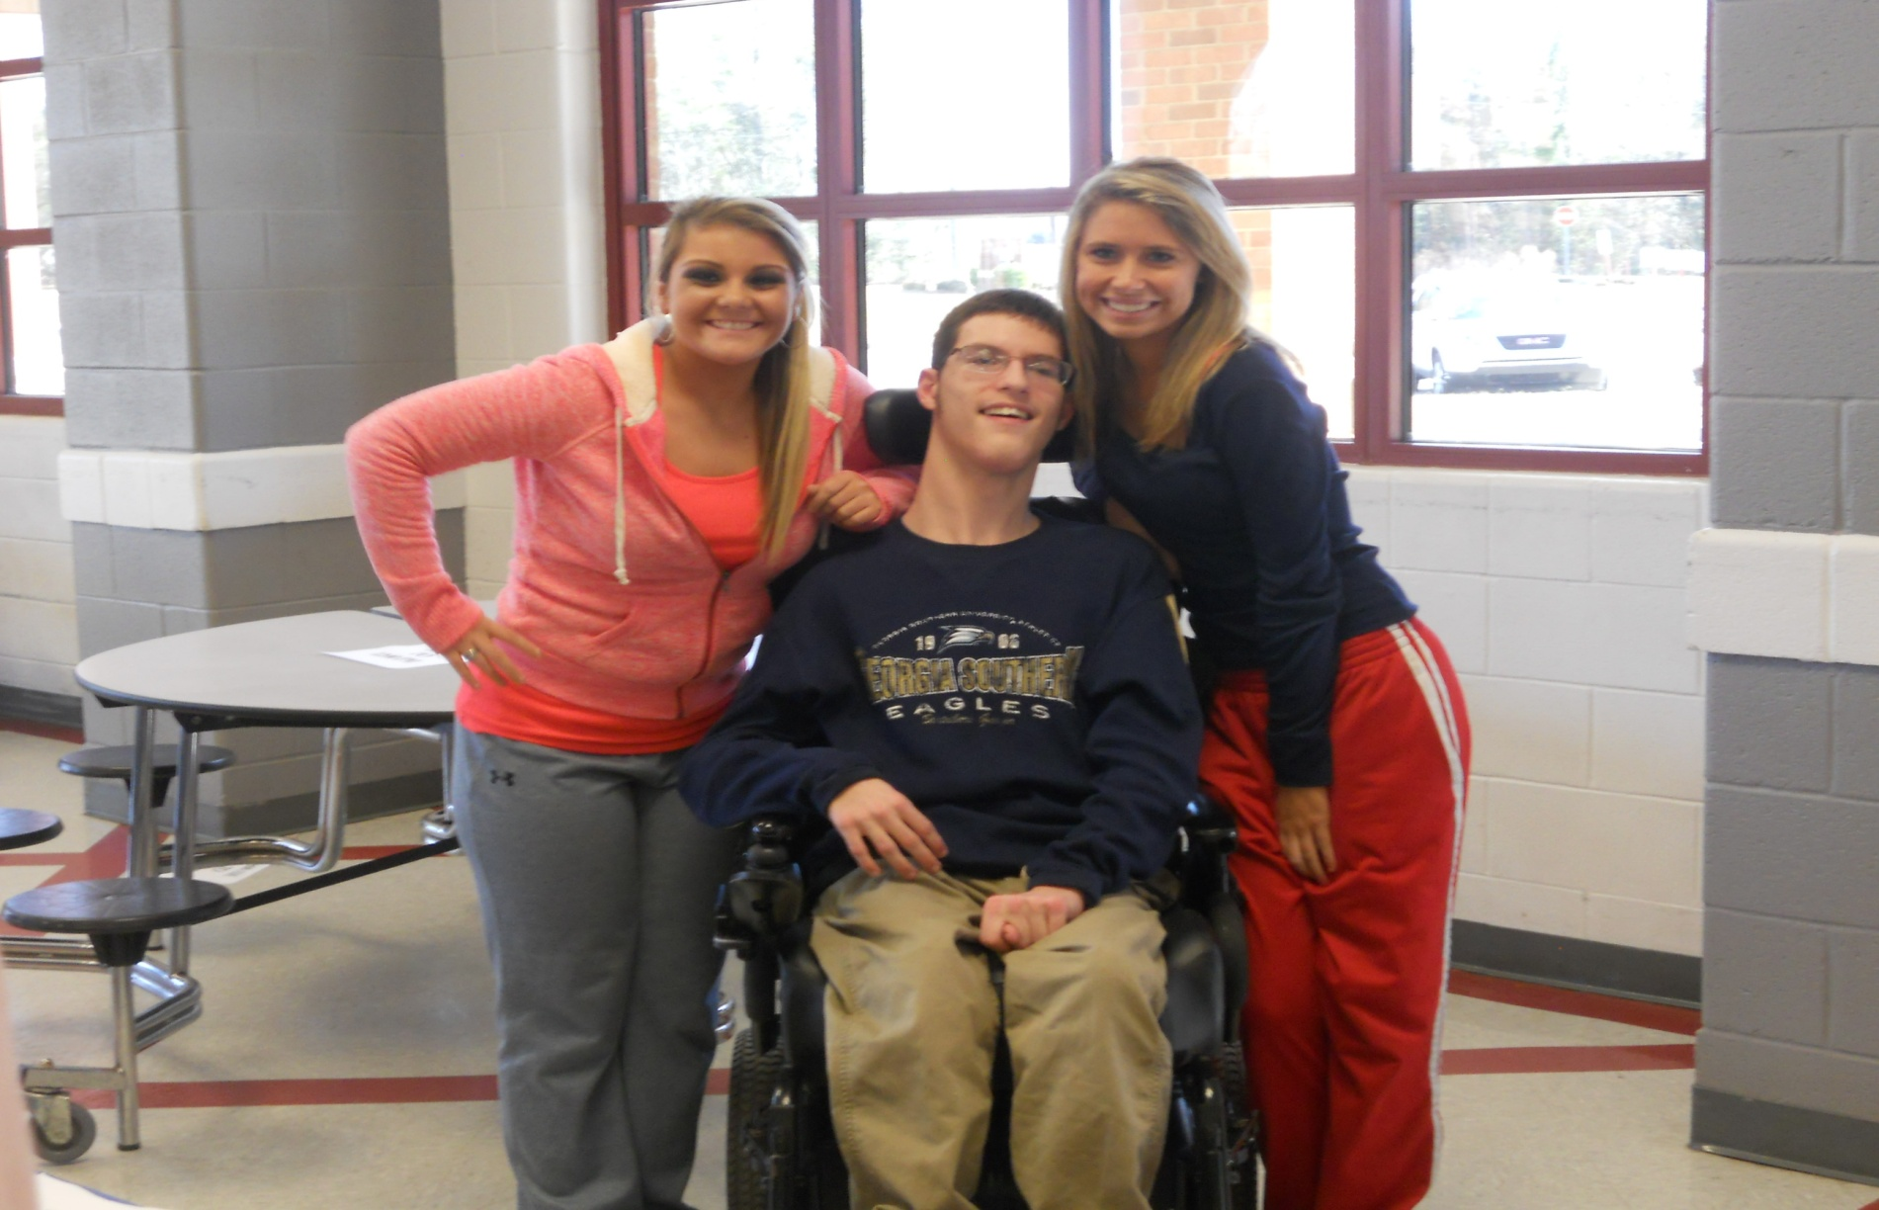
. . .

Slide 18
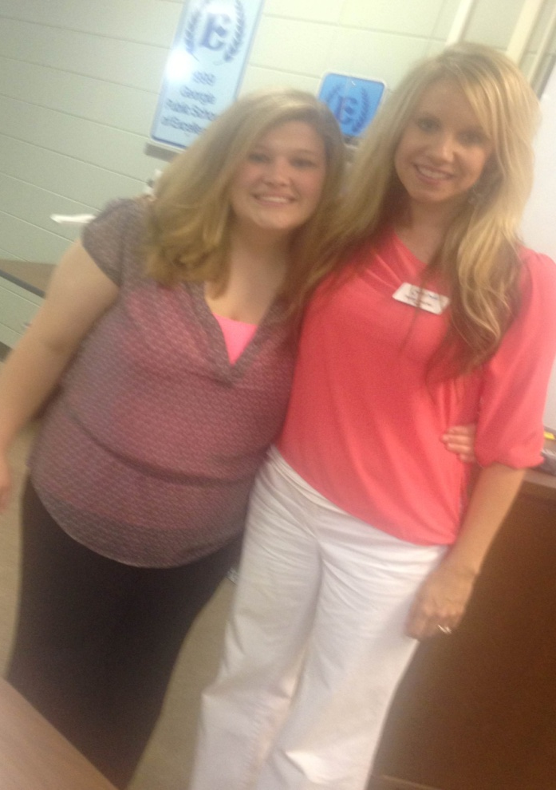
Notes:
Thank you (Host Name) for allowing me to share with you today. I’ve had fun! (Note to presenter: sound like you had fun!)
We have __ minutes left for your questions and I’ll be glad to hang around afterwards and answer any questions we may not have time for or you may not want to share with the group.
Note to Presenter:
It’s important to end on time. Pay attention to time during the presentation and adjust your speed accordingly. Try to leave at least 10 minutes for questions and if you have a lot of questions, remember you can always refer them back to the 800 number for answers.

Slide 19
. . .
ENCORE! FEEDBACK FROM PARTICIPANTS
“Joshua's attitude”
“ I can do stuff for myself”
“Start Monday getting help with Math; try harder”
"I will use it to be better in life”
"You should treat everybody the same way”
“Loved mock interview”
“Information I received will help me make better choices”

Slide 20
. . .
ENCORE! FEEDBACK FROM PARTICIPANTS
"Job interview was very useful“
"I liked learning how to fill out college application”
"Information about difference between college and high school was helpful”
“Information I received will help me make better choices”
“Food”
“Keep working on making it even more interactive”

Slide 21
Thank you for listening and learning
more about P2P and ENCORE:
The Roadtrip of a Lifetime!
800-229-2038
www.p2pga.org
Notes:
Thank you (Host Name) for allowing me to share with you today. I’ve had fun! (Note to presenter: sound like you had fun!)
We have __ minutes left for your questions and I’ll be glad to hang around afterwards and answer any questions we may not have time for or you may not want to share with the group.
Note to Presenter:
It’s important to end on time. Pay attention to time during the presentation and adjust your speed accordingly. Try to leave at least 10 minutes for questions and if you have a lot of questions, remember you can always refer them back to the 800 number for answers.

