Slide 1


The Georgia Parent Mentor Partnership (GaPMP)
Led by the Georgia Department of Education, (GaDOE) Division for Special Education Services and Supports
Rookie Training Guide
A Training Tool for New Parent Mentors & Administrators
MISSION: To Build Effective Family, School, and Community Partnerships that Lead to Greater Achievement for All Students, Especially those with Disabilities.
OBJECTIVE: To Impact Student Achievement through
Family Engagement Strategies

Slide 2

Mission and Vision
Mission Statement: Build effective family, school and community partnerships which lead to greater student achievement for all students, especially those with disabilities.
Vision Statement: Parent mentors and special education administrators will lead the way in Georgia to bridge the gap between home, school and community partnerships.

Slide 3
Our Story
The Georgia Parent Mentor Partnership (GaPMP) is celebrating over a decade of working together to increase achievement for all students, especially those with disabilities.
The Partnership, started in late 2001 by Phil Pickens, Special Education Director, Georgia Department of Education, (GaDOE), with Family Engagement Specialist Patti Solomon and a small group of parents and administrators, now boasts more than 100 parent mentors helping families raising children with learning, behavioral and/or physical challenges. Parent Mentors have charted more than one million contacts.
The GaPMP is supported by the Division for Special Education Services and Supports (DSESS). The parent leaders, moms and dads of children with disabilities, are hired by local school districts, state schools and the Department of Juvenile Justice to work with families, school teams, teachers, and the community. The goal is to build a bridge of communication between home and school that leads to more successful outcomes for students. Parent Mentors partner with families to increase their engagement in education, address individual concerns and also to support initiatives designed to improve all children’s achievement levels. Although the Partnership under the leadership of the DSESS hosts a statewide conference each fall, it is unique how the Parent Mentor agenda is locally driven, which allows each program to meet the needs of its unique area. The DSESS also coordinates regional meetings four times a year and typically offers an annual University Session specific to Parent Mentor’s leadership training needs.
Mentors do many things such as: build connections for families in the community; concentrate on the transition needs of middle and high school students as well as pre- kindergarten students; lead task forces; organize training sessions; collaborate with teachers; serve as leaders on community boards; stakeholder groups; collaborate with Title I Parent Involvement Coordinators; and create family engagement activities in schools.
Most importantly, the mentors listen to both parents and educators, and use their unique knowledge of both worlds to overcome obstacles in communication. The DSESS Family Engagement Specialist coordinates the Partnership statewide by leading trainings, communication and statewide collaboration efforts with other agencies.
In 2015, Parent Mentors are implementing evidence based practices to support their district’s improvement plans to increase the number of students with disabilities who graduate from high school with a general education diploma.

Slide 4
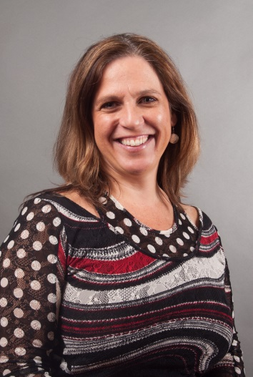
Getting Started
Anne Ladd, Family Engagement Specialist Office
404-657-7328
aladd@doe.k12.ga.us
Other Names to Know:
Richard Woods
State Superintendent of Schools
Debbie Gay
Director, Division for Special Education Services and Supports
Lynn Holland
Program Manager
GaDOE
404-656-2800

Slide 5
Next Steps
Send all your contact information (name, title, email address, mailing address, office phone number) to us by filling out the Rookie Contact Form. The form is located in the password protected site for mentor access called the Learning Curve. Go to parentmentors.org and click on the Learning Curve tab. User is partnership, password is mentor. Click on the Rookie Resources tab and scroll down to download the Rookie Contact Form then email it to info@parentmentors.org . This will provide us with information to post on your Find A Mentor page on the parentmentors.org website and on the GaPMP Listserve.
Locate office space, set up the office, telephone, computer, email etc.
Facilities vary widely based on factors such as the district size, tax base, location, demographics, etc. It is generally expected that there will be office space in the district for the Parent Mentor; it is helpful if it is near other staff who may be working with families. It is best if parents can call a private voicemail message box so parents may call you directly.
Read the school district’s Policies & Procedures Manual. Discuss the local district’s policies and procedures for: attendance, work hours, personnel actions, phone and email use, dress codes, internet use, travel approval, reporting suspected child abuse, and expense reporting. Some of it may apply only to full time employees, but the information will still be useful. You now represent your school district and professional conduct is expected.
Discuss professional protocols with your Special Education Director. For example, how are media contacts to be managed, who needs to approve letters, brochures, or other materials before they are distributed, who approves travel requests, how is time documented, the dress code, managing schedule changes, reporting deadlines, travel and expense reports, call-in procedures etc.

Slide 6
Mandatory Trainings
Orientation – Aug. 16-17, 2016
Annual GaPMP Kick-Off Conference Sept. 14-16, 2016
Four Regional Meetings - scheduled throughout the school year, your Region Rep will inform you about when and where
Parent Mentor School online training and webinars
*Administrators have an open invitation to attend all mentor trainings and meetings. Directors are encouraged to attend the Orientation session or send another administrator with the mentor. Directors are strongly encouraged to attend the Annual GaPMP Kick-Off Conference.
The more you know about what is expected and about mentors’ successes and challenges, the better you can support your mentor and the more your district will benefit from having a mentor.

Slide 7
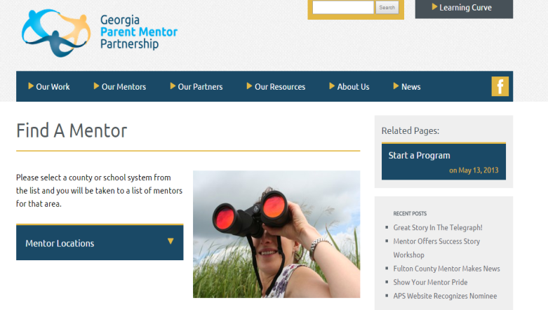
Introducing Yourself
Send in your completed Rookie Contact Form so you can be part of:
GaPMP listserve if you are having difficulties with signing up for the listserve, contact aladd@doe.k12.ga.us and ask that you be added to our listserve, parentmentors_georgia@yahoogroups.com.
The listserve is a professional communication tool. Parent to Parent of Georgia (GaP2P) leadership are also on our listserve to share information. We work very hard to collaborate with GaP2P,our state’s Parent Information Training Center (PTI), funded by the US Department of Education under IDEA.
GaPMP website www.parentmentors.org Send a professional photo and contact information to jane.grillo@white.k12.ga.us to be added the Find A Mentor pages. You will also want to refer to the Learning Curve, the password protected section of the website, which offers mentors access to the forms, documents and other resources you will need to complete annual reporting requirements and, also find shared materials you can use for your work. To access the Learning Curve: click on the tab and then type user name: partnership and password mentor.
Link www.parentmentors.org, the official web site,
to your school district’s special education page. Does the
District have a Facebook Page and what are the protocols for
friending parents and staff?
Work with the district to promote the
parent mentor on the districts’ special education page,
along with contact information and office hours.
Order business cards with your name, title, and contact information.

Slide 8
Being a Professional
ALWAYS re-read texts, facebook posts, emails and other correspondence as though the family involved or your director are looking at it. Make sure you spell check and read for continuity and clarity. It’s hard to take it back once it goes out there. Don’t share confidential information!!!
Unlike volunteers, Parent Mentors are trained professionals working with families in your district. Confidentiality and trust are key.
You will also need to earn the trust of staff.

Slide 9
Elevator Speech Activity
Your elevator speech should answer three questions:
Who are you?
What do you do?
Where do you want to go, or what are you looking for?
You need to know exactly what you want to achieve or no one can help you get there.
Take a minute to jot down some bullet points to practice: (use the back if needed)
My name is:
I am the parent mentor for: ______________________________________
My job is to: _______________________________________________
__________________________________________
Read more: http://www.businessinsider.com/how-to-tell-your-story-in-30-seconds-2013-11#ixzz3jALoGJFa

Slide 10
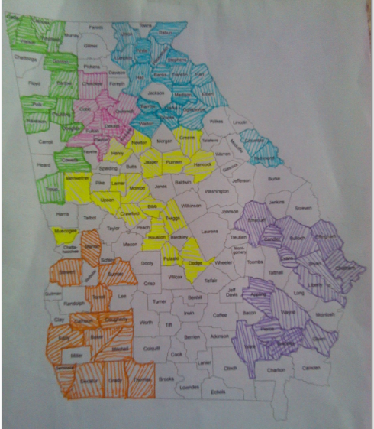
Where We Live and Work
The GaPMP consists of six regions served by a regional representative who will help mentors with mandatory accountability reporting and quarterly contacts
The Regional Reps are:
Northeast –Jodie Zeuke, Oglethorpe
Northwest - Rene Davis, Douglas
Metro – Ashley Gellis, Marietta
Middle –Kathy Simmons, Dodge
Southeast - Lori Bonds, Emmanual
Southwest - Shanitha Jones, Marion

Slide 11
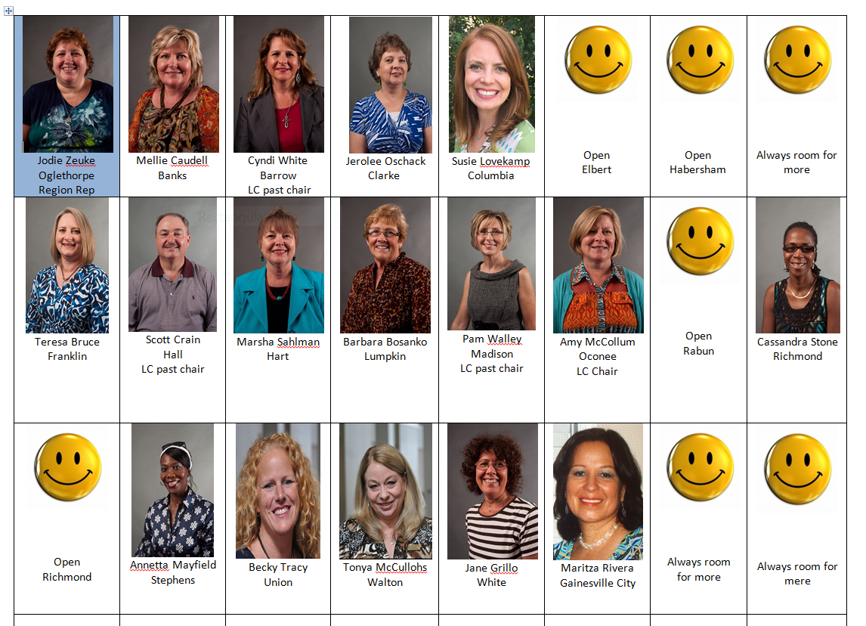
Northeast Mentors

Slide 12
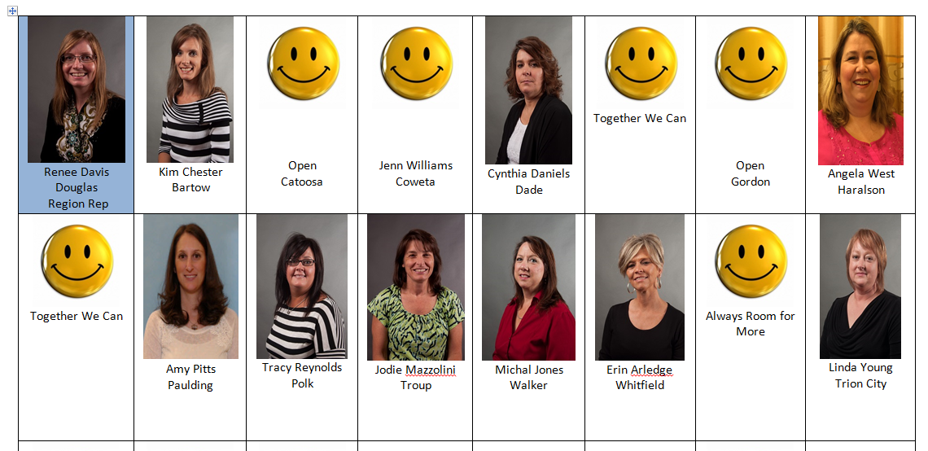
Northwest Mentors

Slide 13
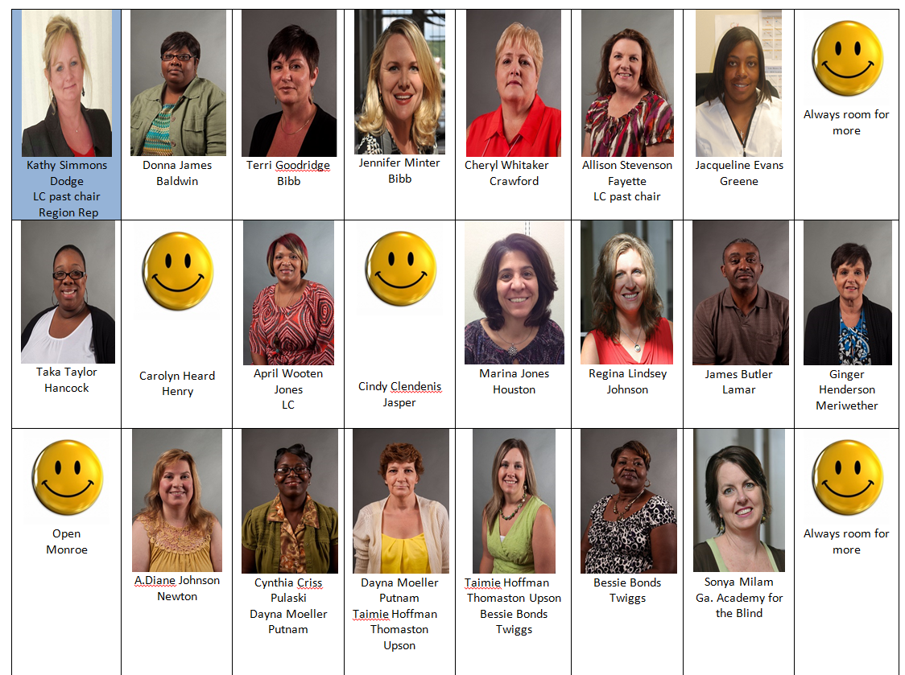
Middle Mentors

Slide 14
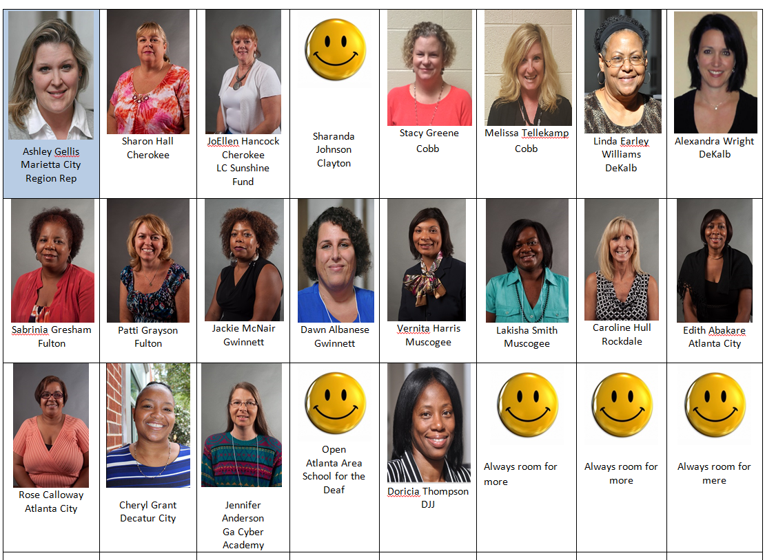
Metro Mentors

Slide 15
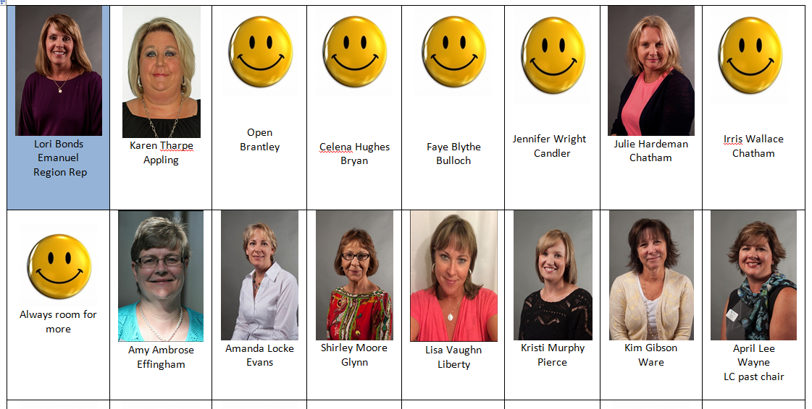
Southeast Mentors

Slide 16
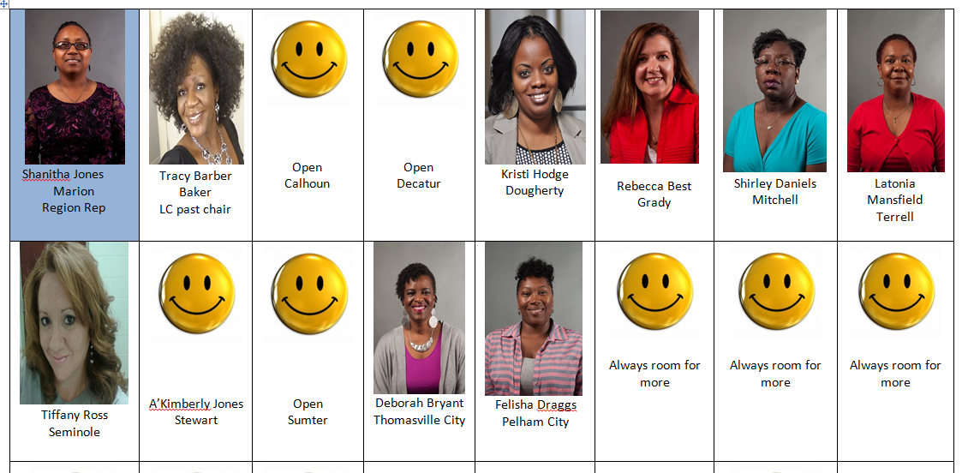
Southwest Mentors

Slide 17
Helpful Hints
Find your own “mentor” within your department, someone who can introduce you to key people in the district. If possible, work with the director and this local mentor to make a plan for introductions.
Focus on building the important relationships and partnerships, beginning with everyone in your department and moving out into the schools, the district, and the community.
Confidentiality safeguards are important to remember. As an employee, you may not talk about any students with disabilities with anyone unless that person also works with that student. This includes others within the school district, family or friends. It’s easy to get excited about your work and accidently share confidential information. Be careful!!
Boundary setting is critical. As a professional and a school district employee, you must also stay within the boundaries of your job. You can give advice and suggestions as a parent to other parents, but you are not a counselor, teacher, lawyer, or psychologist. You have an important role as a parent who mentors other parents, but it is important to honor the boundaries and not stray into another’s role.
Reporting possible or suspected child abuse: Find out what your school district’s procedures are for reporting suspected child abuse. By state law you are a mandated reporter: http://oca.georgia.gov/mandated-reporter
Respect co-workers by ensuring that you:
Are prepared for meetings with talking points and questions
Arrive on time for meetings and be sure your meetings begin and end on time
Wear district name tag/carry business cards with you
Dress appropriately
Communicate in an open and responsive manner
Respect different perspectives and learn from them
Honor each other’s expertise and experience
Safeguard confidentiality
Maintain accountability at the local and state level

Slide 18
Taking On Your New Role
Special Education Family Handbook/Manual
Most districts offer a special education manual to families as a valuable resource. This may be on the district website. You should print or obtain a hard copy and keep it for reference. It explains how the Individuals with Disabilities Education Act (IDEA) and the State Board of Education Rules for special education are followed in your school district. It provides the foundation for interactions between the school district and families, as their child is evaluated, eligibility for special education services is considered, the Individualized Education Program is developed, and the IEP is reviewed each year. It also outlines how to handle disagreements between parents and the school district. As a Rookie Parent Mentor, you should be very familiar with everything in this handbook/manual.
GaDOE Website
If your district does not have an existing handbook, then you may want to go to the GaDOE website to obtain generic information. Go to www.gadoe.org
Hint: The GaPMP website offers access to information about your region on the Learning Curve.

Slide 19
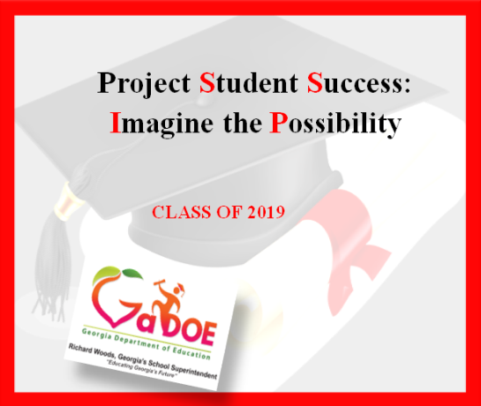
Taking On Your New Role
Georgia Student Success Improvement Plan SSIP also known as Indicator 17 - The Office of Special Education Programs (OSEP) has required that each State Educational Agency (SEA) develop a State Systemic Improvement Plan that includes a comprehensive, multi-year focus on improving results for Students with Disabilities. Each state must develop a plan that will outline the development of strategies to increase state capacity to structure and lead meaningful change in Local Educational Agencies (LEAs). While the primary focus of the plan is on improvement for Students with Disabilities, the State must also address in its SSIP how the State will use its general supervision systems to improve implementation of the requirements of Individuals with Disabilities Education Act (IDEA). Georgia will implement a systemic plan, “Student Success,” in FY16 to improve graduation outcomes for Students with Disabilities.
Learn more: https://www.gadoe.org/Curriculum-Instruction-and-Assessment/Special-Education-Services/Pages/SSIP-.aspx
Links to this webpage are also on the GaPMP website’s Learning Curve.

Slide 20
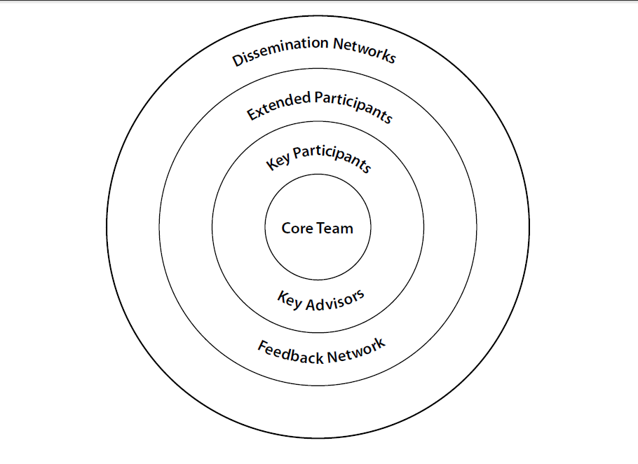

Authentic Stakeholder Engagement
Sustainable change depends on having people with the problem internalize the change.
_{Heifetz and Linsky, 2002}
Sustainable change depends on having people with the problem internalize the change.
_{Heifetz and Linsky, 2002}

Slide 21
Taking On Your New Role
The Implementation Manual explains the state special education rules in parent friendly terms and also provides school districts guidance in how to implement them. Most districts also provide a handbook for teachers that could provide useful information on how teachers are expected to implement special education rules.
The GaDOE website also includes a wealth of information about education in general and about special education, including eligibility, services, IEPs, assessment, Parents’ Rights, discipline, rules, resources, training etc.
Make sure you know how to find the Parents’ Rights (on the Special Education page. Here you’ll find descriptions of Parents’ Rights under the Individuals with Disabilities Education Act (IDEA) in seven different languages, as well as videos in English and Spanish explaining the rights.
Consolidated Application/ Local Improvement Plan (CLIP)
Your school district also has an annual plan called the Consolidated Application that includes a special education plan for meeting these statewide Performance Goals and Indicators. You’ll want to review it also. Most, if not all, of your activities should relate directly to helping the school district meet the parent involvement Goal and at least one of the other statewide Goals. A key part of the role of the Parent Mentor is to assist the school district in engaging parents in their student’s education, providing information and resources that will enable them to make informed decisions.

Slide 22
Taking On Your New Role
The Parent Survey
The Georgia Department of Education distributes a Parent Survey annually to the parents at randomly selected schools in order to raise success rates for students with disabilities. The GaDOE asks parents to answer questions to help assist with helping local schools find ways to better partner with families. All Parent Mentors are asked to assist with the distributing the surveys and facilitating the return of as many surveys as possible. Large districts will distribute surveys to some schools each year. Medium and small districts will have surveys done some years with no surveys during other years. The schools are randomly selected to achieve a fair representation of Georgia parents so it is important that the surveys get to the schools that are indicated each year.
Hint: Tips on how to assist your district with survey collection and using survey data are on the GaPMP website Learning Curve.
IEP Attendance Data
All school districts maintain records each year on the percentage of parents of students with disabilities who attend their child’s IEP meeting. As a Parent
Mentor, you can help ensure parents attend the meetings by providing information and training on the parents’ role in the IEP meeting and how to prepare to contribute at the IEP meeting. The district will report data each year on the percentage of parents of students with disabilities who attend the IEP meeting.
The PTA Family Engagement Standards
The PTA Standards are a list the six types of involvement for successful partnerships with families. There are standards for welcoming, communicating, supporting all students speaking up for each child, sharing power, and
collaborating with the community; they should be the bedrock upon which you build all of your family engagement initiatives and activities.

Slide 23
Taking On Your New Role
Introductions at Central Office Staff meetings and Coordinator, Lead Teacher meetings.
Find opportunities to tell your individual story to central office staff so colleagues can understand the challenges a parent faces and feels raising a child with a disability.
Your local special education director can send a letter of introduction to school administrators, counselors, teachers, therapists, psychologists, school district partners, etc., describing your role and providing your contact information.
Create or customize an existing Parent Mentor Brochure with your information.
With your Director’s approval, get a sufficient quantity printed for distribution. (Check the Parent Mentor “Learning Curve” online for samples of existing introductory brochures).
Meet with principals, counselors, and social workers in each school. Plan visits based on your district’s goals and priorities.
Attend family and community meetings and listen. Make sure you introduce yourself at the meetings.
Meet with individual school PTA/PTOs. Determine if ALL parents are being included and how you can help. Contact the partners on your community map. Call the GAP2P representative for your area and introduce yourself.
Build relationships and partnerships with leaders to work towards including ALL parents in their activities – especially Title I and English Language Learners programs.
Provide information about the Parent Mentor program to local newspapers, with prior approval from your Director and district Media Coordinator/Public Relations Director. Learn the approval protocol for any flyer, news item etc. and never distribute any information without first obtaining approval according to the local policy. Also find out what to do if a member of the media contacts you directly. Often you will need to refer the call to the Media Coordinator/Public Relations Director before responding to any requests for information or interviews.
PTA/PTO newsletters, again with prior approval as required by your school district.
Mail an introduction letter to every family with a student who has an IEP and/or send a letter to every teacher. By now you know you need prior approval to send the introductory letter.
Decide with your director what services you are able to provide the first six months. Don’t promise services you are not yet ready to provide.
Distribute your contact information to intake staff, social workers, psychologists, counselors and diagnosticians to be given to parents at the time of referral or evaluation.

Slide 24
Taking On Your New Role
The Individuals with Disabilities Education Improvement Act of 2004 focuses on the need for families of children with disabilities to partner with educators to create better outcomes for students. In order to support the important role of families in the educational process, staff from the Divisions for Special Education and from other divisions such as Title 1 partner with individuals from state and private agencies to support families on a daily basis. In addition, the Divisions partner with parents through the State Advisory Panel for Special Education, the Georgia Parent Mentor Partnership, and school districts' special education stakeholder groups. The Divisions also collaborate on leadership training and communication resources with the state's major parent/family education and advocacy groups. A family engagement specialist on staff advises the Divisions on ways to increase parent engagement and build partnerships between educators and parents ultimately leading to better student outcomes. It is the goal of Georgia's parent initiatives to create a collaborative community of parents and educators to increase student achievement for students with disabilities. Part of the work includes collaborating with members of the Parent Leadership Coalition, which includes family engagement partners within the GaDOE, particularly Title 1 Parent Involvement Coordinators, and other state agencies and organizations.
Partnerships Inside the School District
After School Tutoring programs
Career -Technical and Agriculture Education (CTAE)
Communities In Schools – connecting community resources with schools
English to Speakers of Other Languages (ESOL) program
High school Graduation Coaches (limited)
Media Specialists
PTA/PTO
Parent - Teacher Resource Centers (Often funded by Title I)
School Improvement
Title I Parent Involvement Program
Title I Parent Involvement Unit offers excellent resources to Parent Mentors and also extends invitations to its regional meetings.
Partnerships with Other Agencies within the Community
Parent to Parent of Georgia (GaP2P) – Georgia’s federally funded Parent Information and Training Center. This is a key partner and a great source of information for parents. Please spend some time on their excellent website to familiarize yourself with GaP2P and the services and resources available. Most important to begin is to travel on their
Road Map to Services and Supports.
Parent Leadership Coalition Agencies: Sharing information and resources to create better outcomes for children
Bright from the Start - Georgia Department of Early Care and Learning, Childcare
Inclusion and Pre-K Coordinators
Children with Special Needs, Babies Can't Wait, Project SCEIs, Parent Educators, Georgia Department of Education, Division for Special Education Services and Supports and Title I Parent Outreach
Georgia Council on Developmental Disabilities (GCDD)
Georgia Department or Behavioral Health & Developmental Disabilities (DBHDD)
Georgia Family Connection Partnership
Institute on Human Development and Disability (IHDD)
Leadership Institute on Developmental Disabilities, Georgia State University
State PTA
State Parent Information Resource Center (PIRC)

Slide 25
Parent Mentor Accountability
There are several statewide expectations for all Parent Mentors. The Georgia Parent Mentor Partnership (GaPMP) is accountable for meeting statewide expectations because the Partnership is partially funded through the GaDOE. Parent Mentors participate in a variety of activities and collaborative efforts in their districts and communities, but they have common statewide requirements; such as but not limited to: planning, implementing, and reporting the results of family engagement work; attending state and regional meetings; & maintaining and reporting data through the year.
Overview:
Parent Mentors work to engage all partners during family engagement initiatives, pursuing positive outcomes for students and their families, while reaching system related objectives. Parent Mentors and their administrative supervisor work together to plan for the upcoming year, using provided GaPMP implementation tools and resources. Each Parent Mentor will select a goal with accompanying vital behaviors and participate in evidence-based family engagement work that improves results for students with disabilities.
Each school district and their Parent Mentor are accountable for:
1. Identifying a Target Group and determining how progress data will be collected. You will want to review these with your director. It is best to start with a small number of parents (10 is good) and then determine a vital behavior that you will be training on and working with your parents to track progress. You do not have to invent Vital Behaviors. They are identified on the Evidence to Practice Guides on the Learning Curve. (You will see this on the next slide.)
2. FY Pre and Post and End of Year Surveys- Reporting survey results via Google Docs. These are accessed on the Learning Curve as well.
3. Quarterly Contact Tracking – Parent Mentors report their collaborative contacts related to family, school, and community engagement work each quarter. These are due on Oct. 15, Jan. 15, April 15 and May 30 or before you leave for the summer.
4. Quarterly Progress Reporting - Parent Mentors report using Google Docs links on the Learning Curve. This information is about your progress on Vital Behaviors and training with parents. These are due on Oct. 15, Jan. 15, April 15 and May 30 or before you leave for the summer.
All of these forms are available on the website in the Learning Curve under the Quarterly Reporting Tab

Slide 26
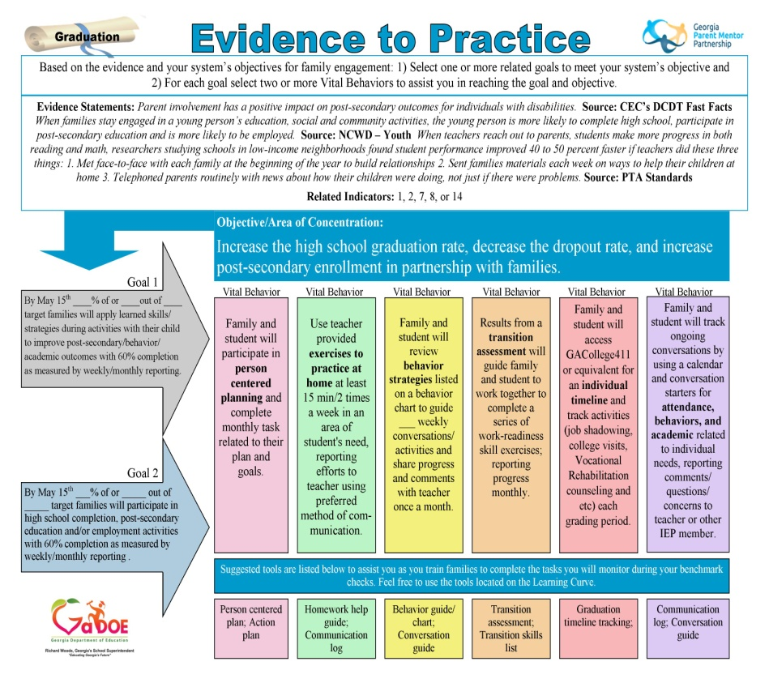
Collaboration and Tools
Parent Mentors have several opportunities to collaborate with one another during the school year. Parent Mentors are required to attend professional development opportunities once a quarter in their regions and once a year at the GaPMP Kickoff Conference in the fall. Other opportunities to collaborate together may include online learning opportunities, webinars, and/or other system or state related conferences you may attend as part of your local school system. Regional Reps and the Listserve are ongoing resources available to assist in your successful family engagement related work and reporting.
FY GaPMP Family Engagement Toolkit
1. Evidence to Practice Guides– Parent Mentors will use these guides to utilize family and community engagement research related to Parent Mentor initiatives. Data results will be demonstrated as Parent Mentor and their partners collaborate, using goals and vital behaviors to reach positive outcomes related to improving graduation rates.
2. Parent Survey– Data collection tool for end of the year evaluation of your target group. Will assist in validating the family engagement work during FY__.
3. Pre and Post and Year End Surveys– Data collection tool for target group, administered prior to targeted activities and at the end of year, to assist in identifying impact of family engagement work during FY__.
4. Data Reporting Tool– Shortened version of reporting form to record Parent Mentor related work.

Slide 27
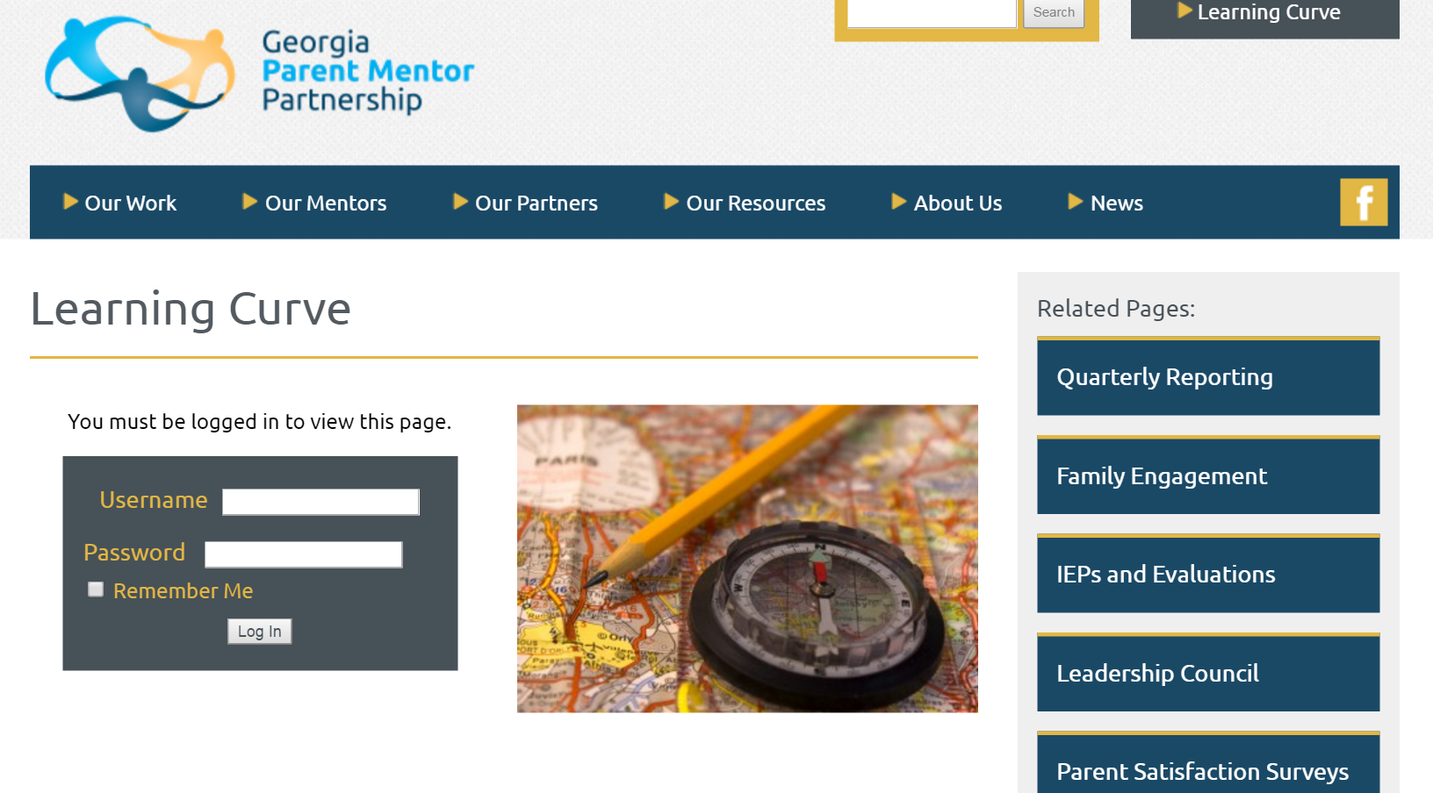
Online and Ongoing Support
Connect with seasoned mentors to help you.
Attend regional meetings and trainings for professional development and reporting support.
All tools mentors need for fulfilling their contract requirements can be found on the Learning Curve under the Quarterly Reporting tab.

Slide 28
Parent Concerns
General Hints
Listening and communication skills.
Collect all available background information
The student's file may be reviewed, with prior parent permission or as per
School District protocol, if you are working with the family/student. You do not have access to all IEPs, only those of students/families with whom you are directly working.
If required, with guidance from the Director or supervisor, you can act as a
liaison to assist in resolving the concern or dispute.
Ensure that the parent/guardian has a copy of the GaDOE Dispute Resolution Sheet. This can be found on the GaDOE website and in many counties is included in the Parent Welcome Packet when a child enters into the Program for Exceptional Children.
NOTE: Discuss these steps with your Director/supervisor before proceeding. There is specific updated information available on the DOE website, regarding dispute resolution. Please check this out. You can also direct the parent to information on the site.
Informal Resolution/Local
1.) Suggest that the parent talk with the child’s teacher(s). If necessary, request an IEP team meeting to discuss concerns. At the meeting focus on the issue at hand. Keep the discussion ALL about the student and his or her educational needs. Remember that everyone is on the same team, working to ensure an appropriate education for the student.
2.) If the concern is still unresolved, discuss it with lead special education teacher
3.) If the concern remains unresolved, discuss it with the principal
4.) If it is still unresolved, discuss the concern with the special education director or his/her designee.
5.) Finally, if the concern hasn’t been resolved yet, discuss it with the
superintendent.
Remember that professional protocols may exist in the district for making appointments ahead of time to see the teacher, lead teacher, principal, director, or superintendent. Find out what these are and be sure to keep your immediate supervisor informed at each step along the way, especially if contacting the principal or superintendent.

Slide 29
Parent Concerns
Formal Resolution/GaDOE
If the issues are still unresolved after every effort to correct the problem locally, parents may elect to use the formal IDEA dispute resolution options. It is always recommended
to first try to resolve the problem with the teacher, school or school district, so encourage parents to try to resolve the issues locally before turning to these formal
options.
The three formal dispute resolution options are:
•Filing a Formal Complaint
•Requesting Mediation
•Requesting a Due Process Hearing
The procedure to follow for each of these options can be found on the GaDOE website. Go to http://www.doe.k12.ga.us. Click on Home on the upper left > Curriculum and Assessment > Special Education Services and Supports. Scroll down to Dispute
Resolution and click on the desired option. The parent should follow the directions as indicated for the option they wish to pursue.
Be sure to notify your immediate supervisor and the special education director if a parent intends to file a complaint or request mediation or a due process hearing. It is important to follow up with the parent/district to check on the outcome. It may help to direct parents to agencies and proactive support groups and resources to support their
ongoing needs.
Don’t forget the parent-friendly explanation forms on major special education issues and regulations on the GaDOE website.

Slide 30
Participation & Leadership
Leadership Council
The Georgia Parent Mentor Partnership Leadership Council membership is made up of seasoned mentors who understand the mission and vision of the GaPMP and wish to help strengthen and improve this initiative.
Leadership Council
Executive Board
  • Chairperson – Amy McCollum, Oconee
  • Chairperson Elect – April Wooten, Jones
  • Vice Chairperson – Edith Abakare, Atlanta Public Schools
  • Recorder – Diane Johnson, Newton
  • Immediate Past Chair- Allison Stevenson, Fayette
Region Representatives
  • Northeast –Jodie Zeuke, Oglethorpe
  • Northwest - Rene Davis, Douglas
  • Metro – Ashley Gellis, Marietta City
  • Middle –Kathy Simmons, Dodge
  • Southeast - Lori Bonds, Emmanuel
  • Southwest - Shanitha Jones, Marion
Advisors
  Ann Cross, Gordon
  Charity Roberts, Coastal GLRS
  Loranda Holmes, Marion
Sunshine Fund
Parent mentors contribute annually to the Sunshine Fund, a project to help provide emergency funds for families of parent mentors who experience crisis or loss of a loved one. The Sunshine Fund also is used to support activities which strengthen the Partnership such as the annual Phil Pickens Award.
Cherokee County Parent Mentor JoEllen Hancock is the chair for the Sunshine Fund and has put together a little shopping opportunity for mentors to spread the word about the GaPMP and, add needed dollars to this endeavor.

Slide 31
Congratulations!
Notes and Questions

