Slide 1
Parent Satisfaction Surveys 2012-2013
Notes:
Mentors,
This is my parent survey presentation. Again, the idea of linking the parent survey questions to the PTA National Standards is April Lee's original idea that she sent to the list serve a year and a half or so ago. If you like the format of the presentation, please feel free to use it in your own districts. You can easily change the chart information to reflect data from your own system. Also, please remember that for the purposes of my presentation, the fact that percentages on the lowest ranked items of "Least Satisfaction" decreased from 2011 to 2012 is a positive.
Renee Davis
Parent Mentor
Douglas County Schools
770-651-2081
rhonda.r.davis@douglas.k12.ga.us

Slide 2
What is the Parent Satisfaction Survey?
Each year schools from our district are selected to participate in the survey.
The survey consists of 25 questions that examine schools’ efforts to partner with parents and 5 additional informational items.
It is completed by parents of children receiving special education services and is available in print form and online at the GaDOE website in English and Spanish.
Once all surveys have been returned, the responses are ranked by Strong Satisfaction and Least Satisfaction.
The results are reported as percentages in Return Rate and Parent Satisfaction and are included in each school district’s Annual Report Card for Special Education.
Survey schools this year are being determined.

Slide 3

2012 Was Our Best Year Yet
For Survey Returns!

Slide 4
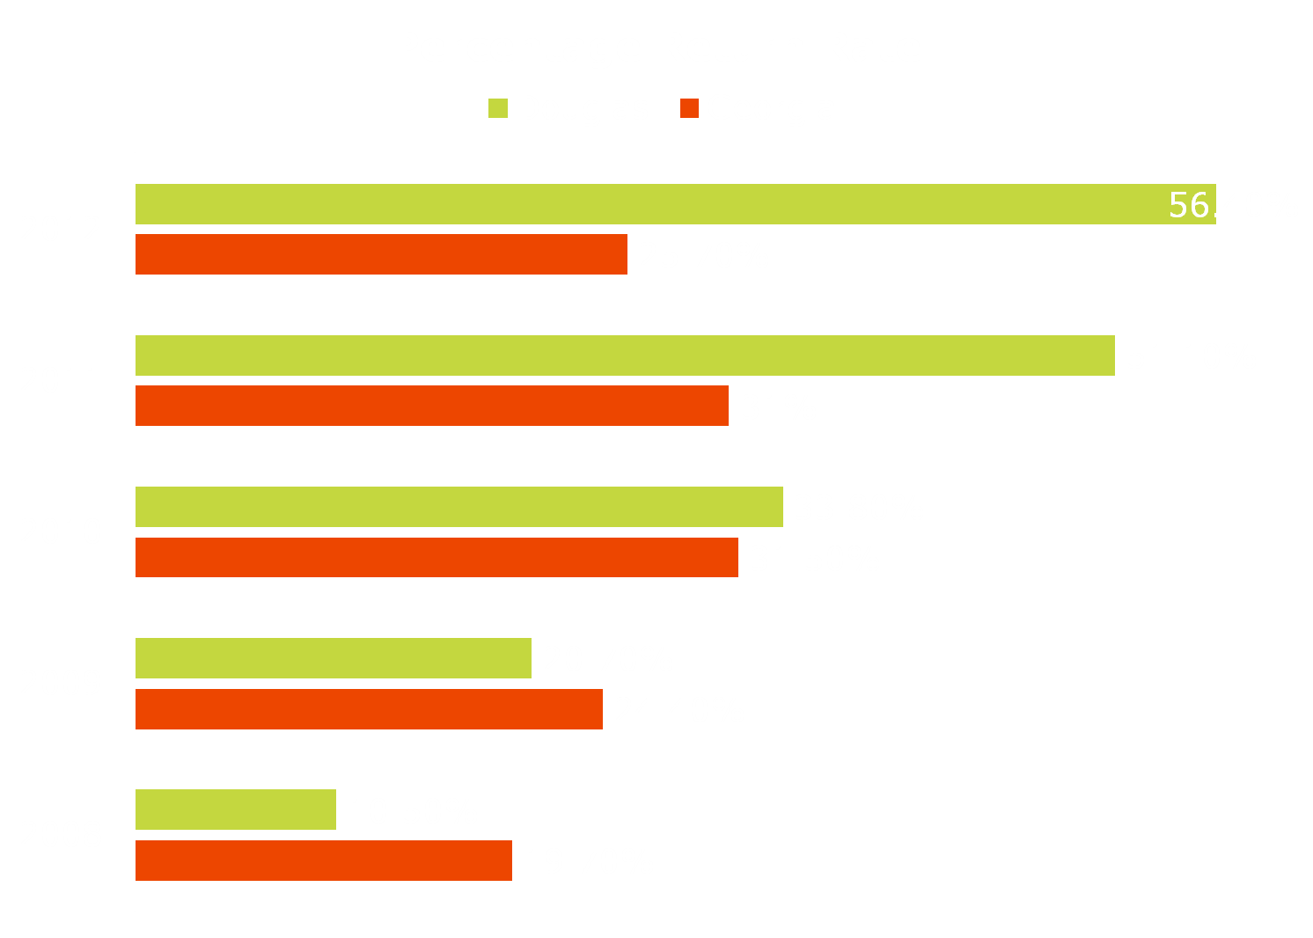

Slide 5


Slide 6

Linking National Standards to Parent Satisfaction Results
National Standards for Family School Partnerships
Survey Results
Ten lowest ranked items based on % of parents answering either Strongly Disagree or Very Strongly Disagree for a particular item.

Slide 7
Standard 1: Welcoming all families into the school community
Families are active participants in the life of the school, and feel welcomed, valued, and connected to each other, to school staff, and to what students are learning and doing in class.
Survey Question: I have been asked for my opinion about how well the special education services my child receives are meeting my child’s needs.
2011: 51%
2012: 45%

Slide 8
Standard 1: Welcoming all families into the school community
Families are active participants in the life of the school, and feel welcomed, valued, and connected to each other, to school staff, and to what students are learning and doing in class.
Survey Question: I was offered special assistance (such as child care) so that I could participate in the Individualized Educational Program (IEP) Meeting.
2011: 31%
2012: 27%

Slide 9
Standard 2: Communicating Effectively
Families and school staff engage in regular two-way, meaningful communication about student learning.
Survey Question: At the IEP meeting, we discussed how my child would participate in statewide assessments.
2011: 56%
2012: Not a Lowest Ranked Item

Slide 10
Standard 2: Communicating Effectively
Families and school staff engage in regular two-way, meaningful communication about student learning.
Survey Question: The school offers parents a variety of ways to communicate with teachers.
2011: Not a Lowest Ranked Item
2012: 50%

Slide 11
Standard 3: Supporting Student Success
Families and school staff continuously collaborate to support students’ learning and healthy development both at home and at school, and have regular opportunities to strengthen their knowledge and skills to do so effectively.
Survey Question: The school gives parents the help they may need to play an active role in their child’s education.
2011: 52%
2012: 48%

Slide 12
Standard 3: Supporting Student Success
Families and school staff continuously collaborate to support students’ learning and healthy development both at home and at school, and have regular opportunities to strengthen their knowledge and skills to do so effectively.
Survey Question: The school offers parents training about special education issues.
2011: 44%
2012: 31%

Slide 13
Standard 4: Speaking Up for Every Child
Families are empowered to be advocates for their own and other children, to ensure that students are treated fairly and have access to learning opportunities that will support their success.
Survey Question: Written justification was given for the extent that my child would not receive services in the regular education classroom.
2011: 48%
2012: 47%

Slide 14
Standard 4: Speaking Up for Every Child
Families are empowered to be advocates for their own and other children, to ensure that students are treated fairly and have access to learning opportunities that will support their success.
Survey Question: The school explains what options parents have if they disagree with a decision of the school.
2011: 46%
2012: 38%

Slide 15
Standard 5: Sharing Power
Families and school staff are equal partners in decisions that affect children and families and together inform, influence, and create policies, practices, and programs.
Survey Question: The school gives me choices with regard to services that address my child’s needs.
2011: 50%
2012: 47%

Slide 16
Standard 6: Collaborating with Community
Families and school staff collaborate with community members to connect students, families, and staff to expanded learning opportunities, community services, and civic participation.
Survey Question: The school provides information on agencies that can assist my child in the transition from school.
2011: 44%
2012: 30%

Slide 17
Standard 6: Collaborating with Community
Families and school staff collaborate with community members to connect students, families, and staff to expanded learning opportunities, community services, and civic participation.
Survey Question: I was given information about organizations that offer support for parents of students with disabilities.
2011: 36%
2012: 32%

Slide 18
Questions?
Parent Mentor website:
http://www.parentmentors.org/Surveys2011.php
Renee Davis, Parent Mentor
770-651-2081
rhonda.r.davis@douglas.k12.ga.us

