Slide 1
Online Learning Modules
10 Step Guide

Slide 2
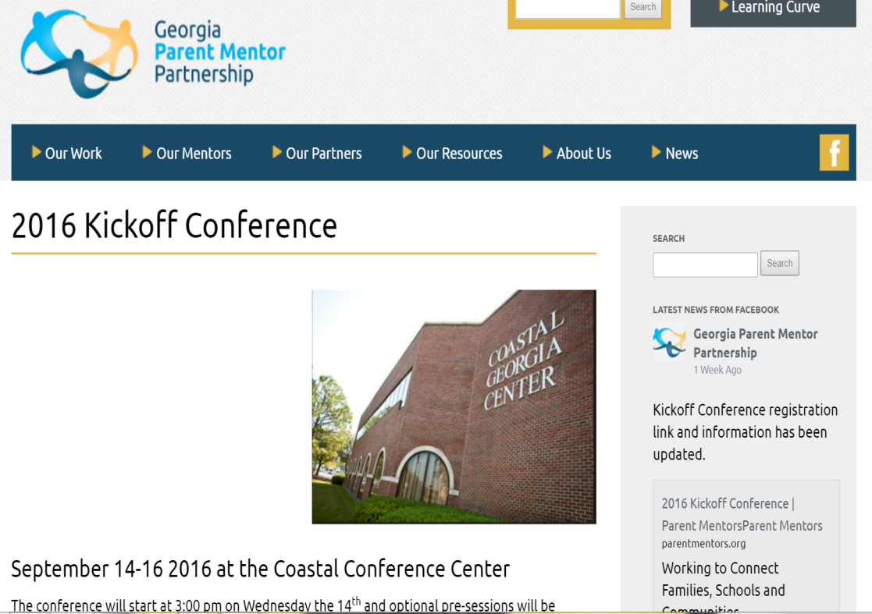
Step 1
Go to www.parentmentors.org
Click on the Learning Curve

Slide 3
Step 2
You will receive an email from WORDPRESS
Login with your user name and temporary password

Slide 4
Step 3
You now have created your user login and password.
You can click “remember me” however, it may just save user name not password… so save it somewhere else in case. You can save both in your browser, but it is not recommended when are using a public network
This user name and password will be used to track your progress on the learning modules.

Slide 5
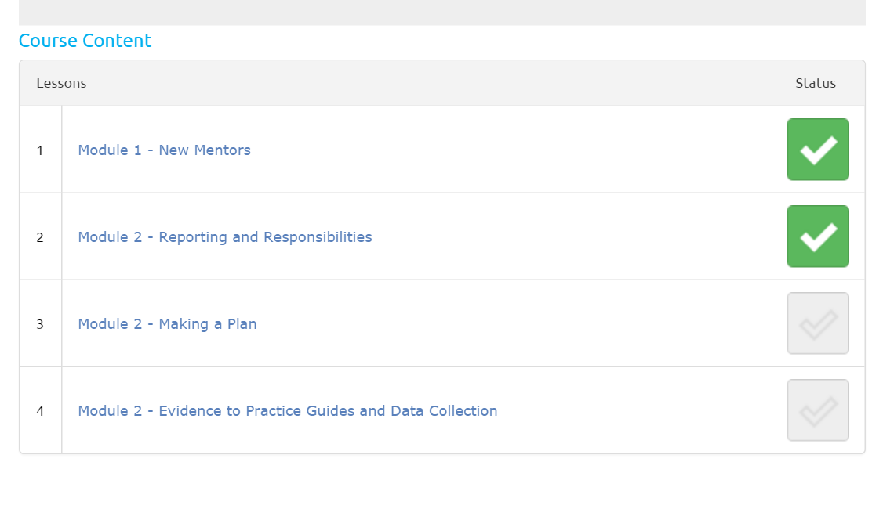
Step 4
Become familiar with the Learning Modules
As you complete modules you will see your progress

Slide 6
Step 5
Start Learning!
Course Description and Learning Targets

Slide 7
Step 6
Complete the module! Not all modules end in quizzes, but every time you complete a quiz you can earn a cerrtificate.

Slide 8
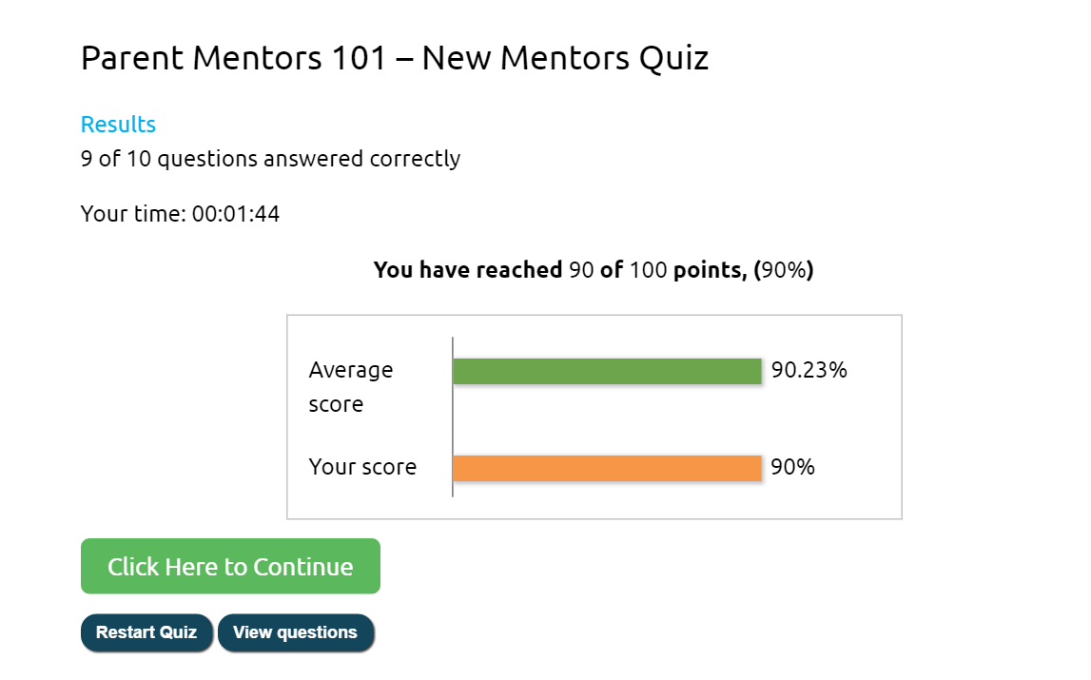
Step 7
A progress window will show up when you have completed your quiz

Slide 9
Step 8
Not all lessons have quizzes.
When you complete a lesson which has no quiz, click on the box that says Mark Complete and that lesson will show on your board making you one step closer to the badge for that learning module.
Click Next Lesson to move on to the next lesson.

Slide 10
Step 9
When you finish the lessons in a course, this window will pop up.

Slide 11
Step 10
Print your Certificate and celebrate your success!!!!

