Slide 1
From Learning to Earning
Georgia High School High Tech (HSHT) Program
Carmen Cates
Islands High School HSHT Program
Valita Nichols
Islands High School HSHT Students
D’Shawn Smith
Jazzmine Bell

Slide 2
GEORGIA HIGH SCHOOL HIGH TECH

Slide 3
High School High Tech is….
A comprehensive community-based program providing youth with disabilities a link to academic and career-development experiences that enable them to successfully meet the workforce demands of the 21st century.
Notes:
3

Slide 4
High School High Tech in Georgia
Transition Program
Partners
Georgia Committee on Employment of People with Disabilities, Inc.
Vocational Rehabilitation
Local school system
AMAC Accessibility Solutions and Research Center, Georgia Institute of Technology

Slide 5
Who is eligible?
Student in grades 8-12 (ages 14-22) and have a documented disability that’s physical, sensory, or learning related.
Georgia HSHT Target population: Jrs. & Srs. with a disability with average to above average IQ’s who are capable of going to post-secondary education and into the workforce.

Slide 6
Who is involved?
Voc Rehab
Families
Educators
Students
Advocacy
Groups
Colleges,
Universities, &
Technical Colleges
Employers:
Plant Hatch
Kubota
Viracon
CDC

Slide 7
Georgia’s HSHT program’s services are based on research that indicates the five categories for success
Summary of Five Guideposts for Success
School Preparation
Youth Development & Leadership
Career Preparation & Work Based Learning Experiences
Connecting Activities
Family Involvement
Pre-ETS (Pre – Employment Transition Services)
Counseling on Post Secondary Programs
Job Exploration
Work Based Learning Experiences
Workplace Readiness Training to Develop Social Skills and IL Skills
Instruction to Build Self Advocacy Skills

Slide 8
Focus of HSHT Program
Reducing the dropout rate of students with disabilities
Teaching students how to advocate for themselves, and gain a high degree of self – reliance
Career exploration and opportunity awareness
Facilitate a successful transition to post-secondary education and into the workforce
Development of a high level of self-discipline and leadership

Slide 9
Georgia High School High Tech Partnerships
86 school systems
146 High Schools
Provided almost 14, 000 activities throughout the state of Georgia
53% of the students we serve are students with a learning disability
Translation of statistics

Slide 10
Assistive Technology
According to the National Longitudinal Transition Study (NLTS2) - 2012:
Comparing postsecondary outcomes of students with disabilities who reported receiving assistive technology (AT) in high school to those who reported not receiving AT (study included 305,000+ students).
99.8% of the students who received AT graduated while only 79.6% of those who did not receive AT graduated
“For people without disabilities, technology makes things easier. For people with disabilities, technology makes things possible.” -ibm training manual 1991
Notes:
10

Slide 11
Two Statewide Initiatives
1. Resources to Assist with Transition Activities
such as
Industry and Post-Secondary Site Visits
for Career and Educational Exploration
2. Computer Project
HSHT Seniors
Awards presentations and ceremonies varied from site to site—luncheons including peers, press releases, class activities, awards included teachers, parents, site coordinator.
Must be on VR caseload, participating in HSHT activities, and complete an application.

Slide 12
High School High Tech Computer Project
THE HIGH SCHOOL HIGH TECH COMPUTER COMPETITION IS NOT THE FOCUS OF THE PROGRAM BUT IT GENERATES A LOT OF INTEREST FOR STUDENTS TO PARTICIPATE IN THE PROGRAM

Slide 13
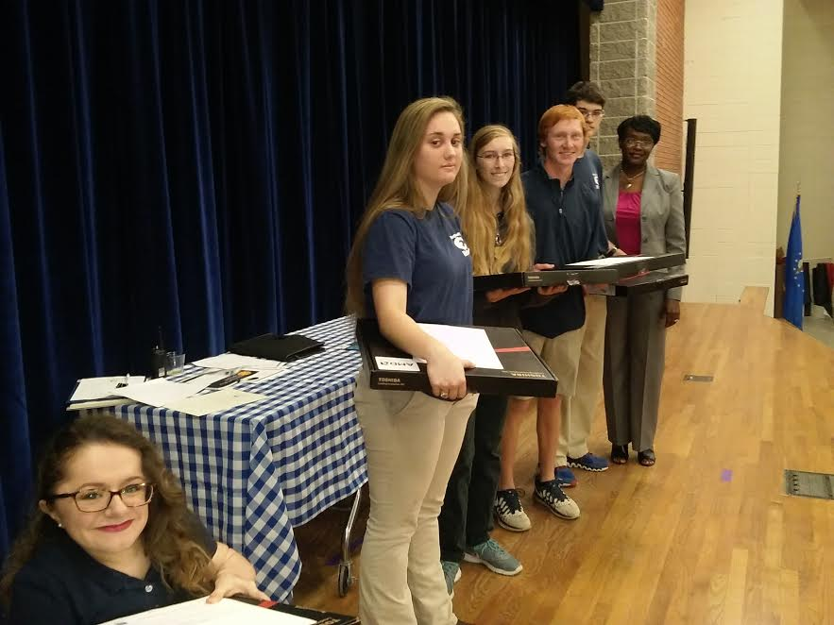
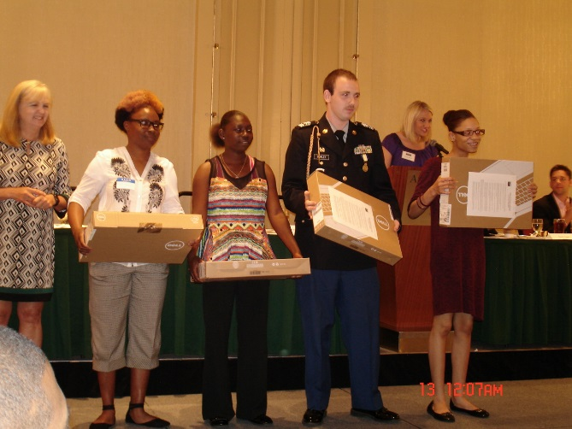
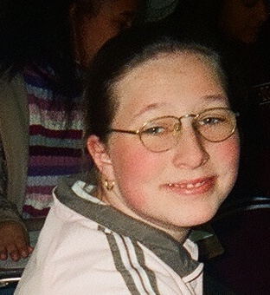
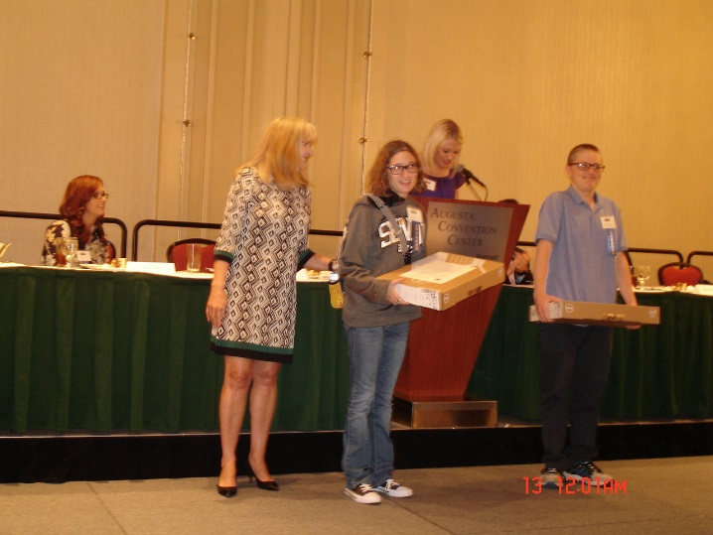
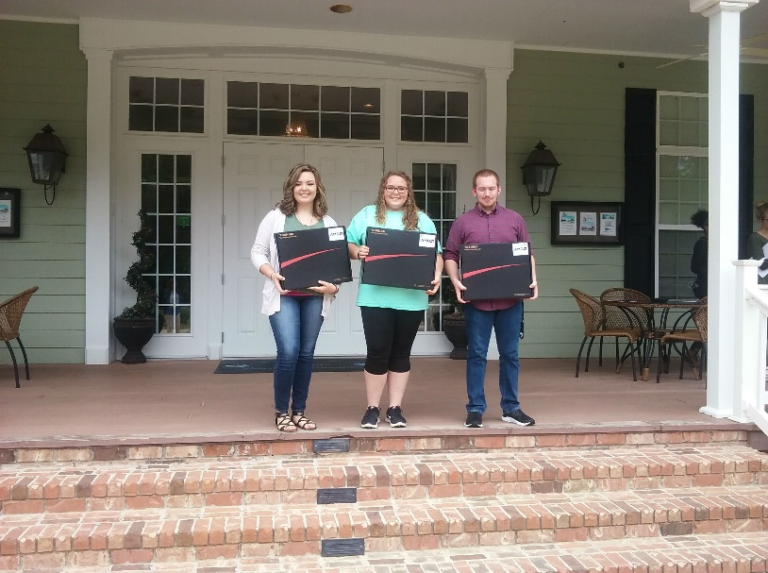
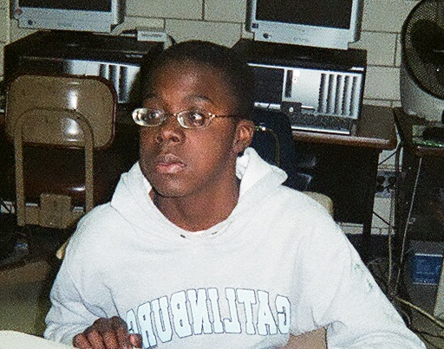
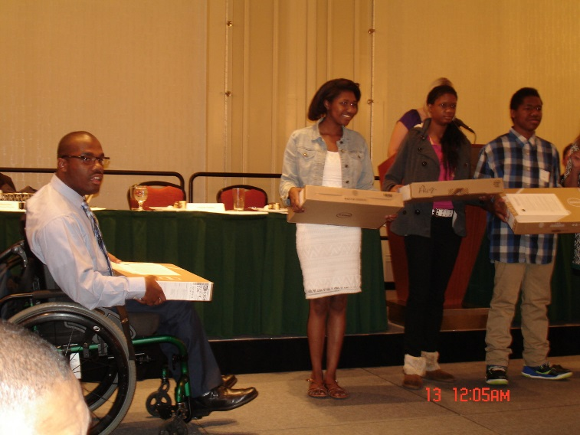
Over 650 laptops have been awarded to rising HSHT juniors and seniors
Georgia HSHT Computers Committee

Slide 14
How Can Parent Mentors can support HSHT in their Districts?
MESSAGE THE PURPOSE OF HSHT TO YOUR DISTRICT
HOST SCHOOL MEETINGS WITH HSHT / TEACHERS, PARENTS & STUDENTS
ASSIST WITH:
Applications for HSHT/GVRA
Funds Request Form & Write up of HSHT Activities
Ideas for Lunch & Learn, trips to industry sites in the community

Slide 15
Parent Mentors & HSHT
EVIDENCE TO PRACTICE
Target families of HSHT students
Post-secondary
Graduation
ASPIRE
SUPPORTS SSIP & GSCI
Family and Community Engagement

Slide 16
Islands High School HSHT Program
STARTED DURING THE 2018-19 SCHOOL YEAR
WHILE NOT AN EVIDENCE-BASED INTERVENTION, SSIP STUDENTS WERE TARGETED AS PARTICIPANTS
Reducing drop-outs
Self-Advocacy
High school graduation and
Successful transition to post secondary life
SUPPORTED THE DISTRICT’S ASPIRE INITIATIVES

Slide 17
Islands High School HSHT Program
Campus Visit to Georgia Southern Unversity in Statesboro Georgia

Slide 18
Importance of Self-Advocacy
Learning about the role of the Student Disability Center on college campuses

Slide 19
Thanks for the pizza & soda HSHT!
Lunch and Learn Activities give students an opportunity to talk about what they learned and observed on industry tours in the community

Slide 20
Hat’s Off to Student Success!
Events like Hat’s Off to Student Success not only give our community the ear of the State Special Education Director, Dr. Zelphine Smith-Dixon but also give our students opportunity to share what they have learned about self-advocacy.

Slide 21
Text from Karleigh, 1st year college student
Just got this text from Karleigh. She spoke at Hats off to Student Success last year.
“ Hi! It’s Karleigh Buchan from last year! I just wanted to let you know college starts Monday. I have made appointments with ALL my professors to give them my accommodation letters. I also have a meeting with UGA transfer specialist in a few minutes. I just want to thank you again for everything and all of the confidence and knowledge you and my IEP team placed in me. I know that I am more than capable of doing anything I want to. Every time I go to a meeting I remember that. And I am going to make you guys proud!”

Slide 22
GA Ports Authority
HSHT students learn about all kinds of high tech jobs in their community.

Slide 23
HSHT students presenting the benefits of the HSHT Program to district leadership.
Sharing the opportunity that HSHT has provided to Islands High School to our Board of Education Leadership.
For the 2018-19 school year, Savannah Chatham County Public Schools will offer HSHT to all eligible juniors & seniors with IEPs or 504 plans district wide!

Slide 24
Post Secondary Data
Six of the seven 2018 seniors are actively engaged in post secondary activities.
Three are employed full time
Three are attending school full time
One senior chose to return to school through IDEA.

Slide 25
Thanks to our HSHT staff and students for presenting to the GA PMP.
More great opportunities for HSHT students in Savannah Chatham County Public Schools during the 2018-19 School Year!

Slide 26
Questions
Georgia High School High Tech Program
http://www.gacomm-hsht.org/
Face Book: HSHT Works@HSHT.Works

